Slide 1
Go MAD!
Go
MAD!
What does MAD mean?

Slide 2


Go MAD!
MAD is an acronym for…

Slide 3
Go MAD!
Go MAD and…
Make
A
Difference

Slide 4

Why should you make a difference?
Go MAD!

Slide 5
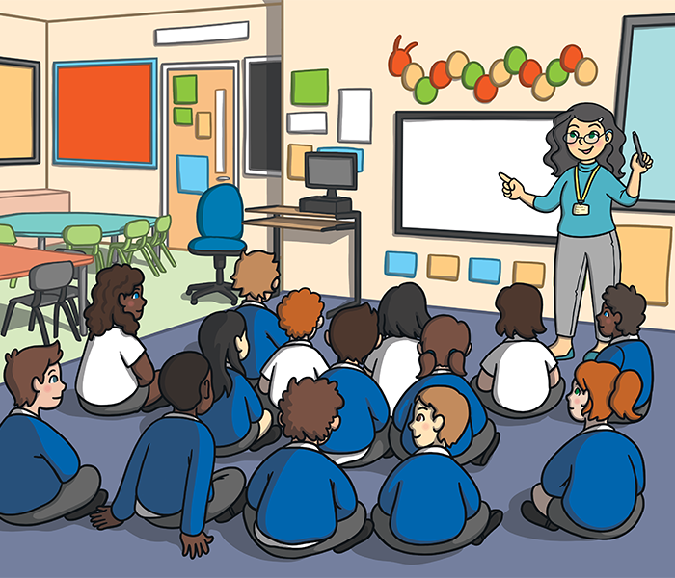

How can we make a difference at school?
Go MAD!

Slide 6
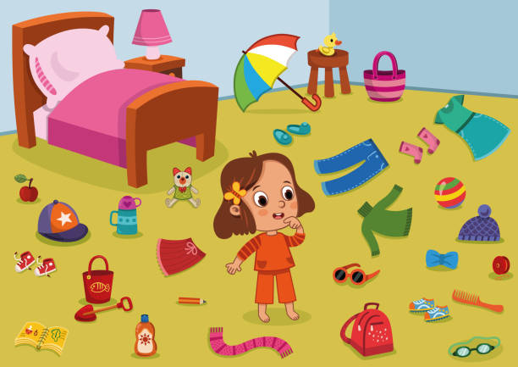

Go MAD!
How can we make a difference at home?

Slide 7
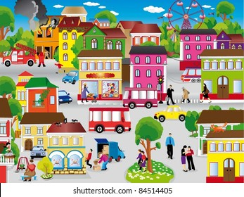

Go MAD!
How can we make a difference in the local community?

Slide 8


Go MAD!
How can we make a difference in the wider world?

Slide 9

Go MAD!
Is it easier to make a difference by yourself?

Slide 10

Go MAD!

Slide 11
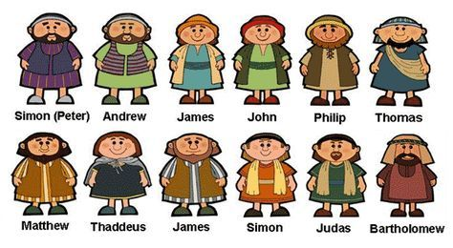
Go MAD!

