Slide 1
Welcome

Slide 2
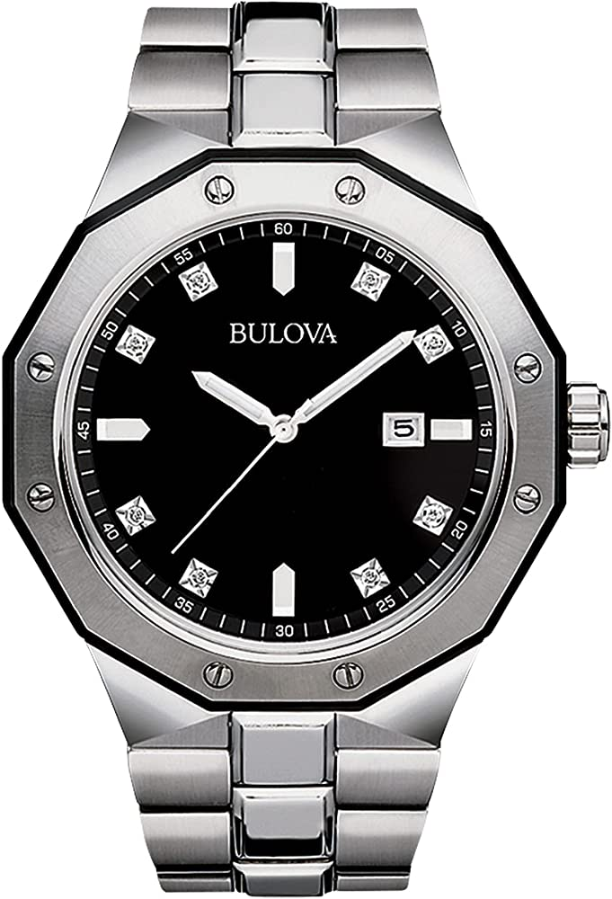

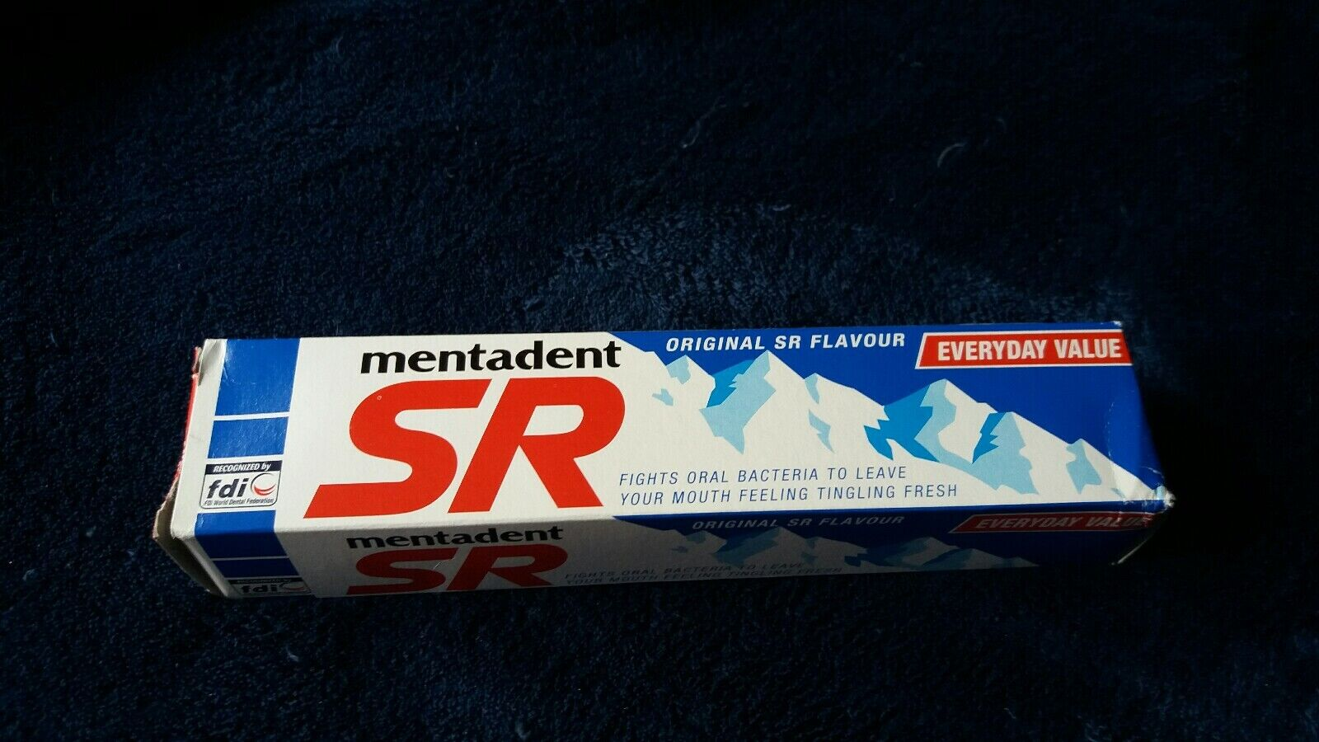

Slide 3
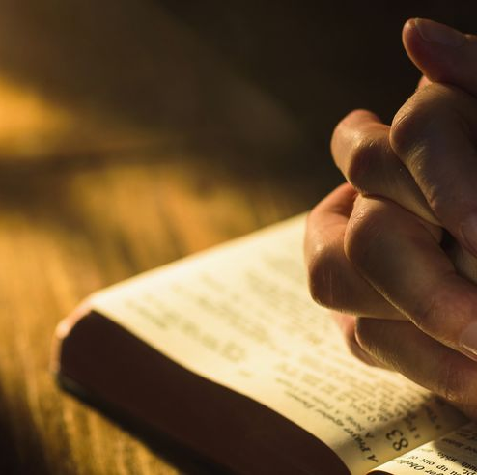
Philippians 4:8:
‘Finally, brothers and sisters, whatever is true, whatever is noble, whatever is right, whatever is pure, whatever is lovely, whatever is admirable--if anything is excellent or praiseworthy--think about such things.’

Slide 4
Hebrews 12:12
‘Let us keep our eyes fixed on Jesus.’

