Slide 1
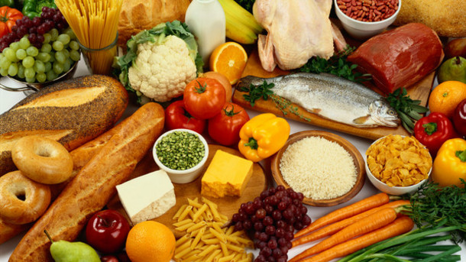


Slide 2
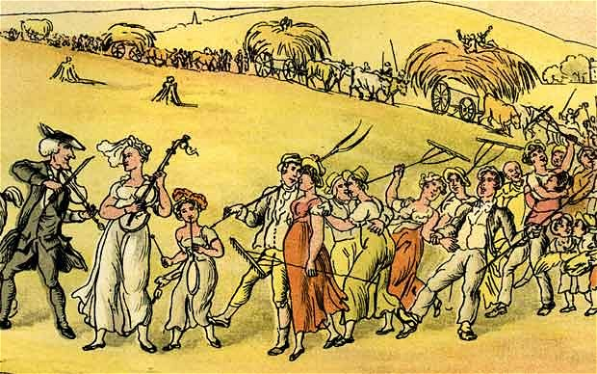
Bringing in the Harvest, around 1820).

Slide 3
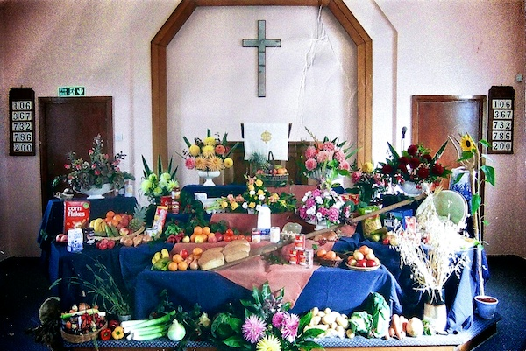

Slide 4
"When you reap the harvest of your land, do not reap to the very edges of your field or gather the gleanings of your harvest."
(Leviticus 23:22)

Slide 5
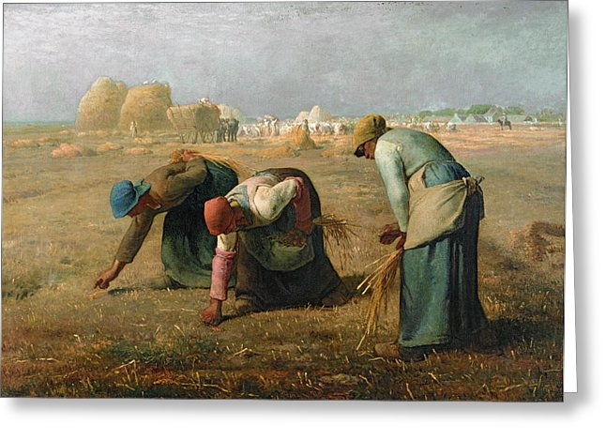
The Gleaners by Jean-François Millet (1857).

Slide 6

“The true measure of any society can be found in how it treats its most vulnerable members”.
Mahatma Gandhi

Slide 7


