Slide 1

Welcome

Slide 2
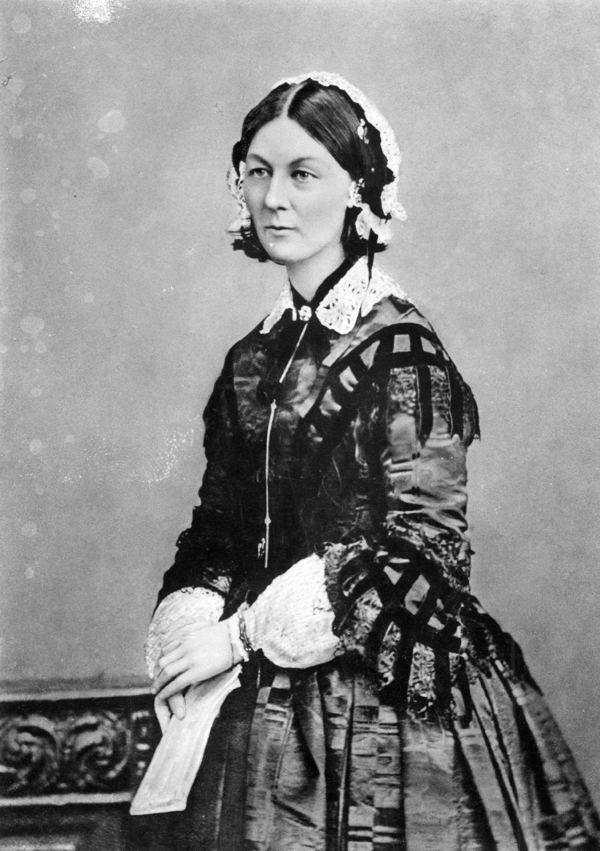
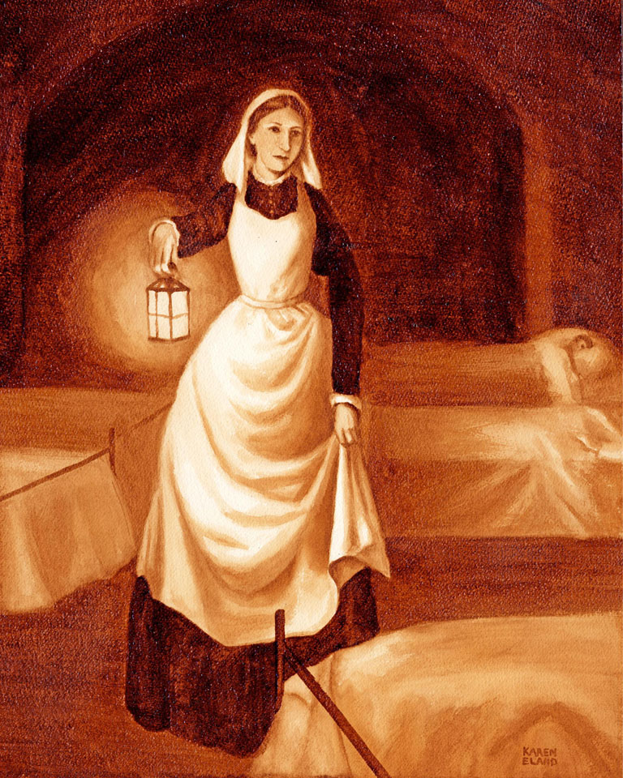
Florence Nightingale (1820-1910)
“The Lady with the Lamp”

Slide 3


Slide 4


Slide 5
Care
Nurses demonstrate that they care for their patients. They want to help their patients’ health and wellbeing.

Slide 6
Compassion
Nurses show kindness, empathy, respect and dignity for their patients. They conduct their duties with a compassion for the people in their care.

Slide 7
Courage
Nurses have the courage that enables them to do the right thing for the people they care for. That might mean speaking up when they have concerns.

Slide 8
Communication
Nurses communicate clearly. That includes active listening to patients, as well as giving clear information about their care.

Slide 9
Commitment
Nurses are committed to improving techniques and ways of working to ensure the best outcomes for patients. They strive to be the best nurse they can be.

Slide 10
Competence
Nurses undertake continual training to ensure they have the necessary ability, knowledge and skills to perform their role safely and effectively.

Slide 11


