Slide 1

Walk to School Week

Slide 2


Slide 3
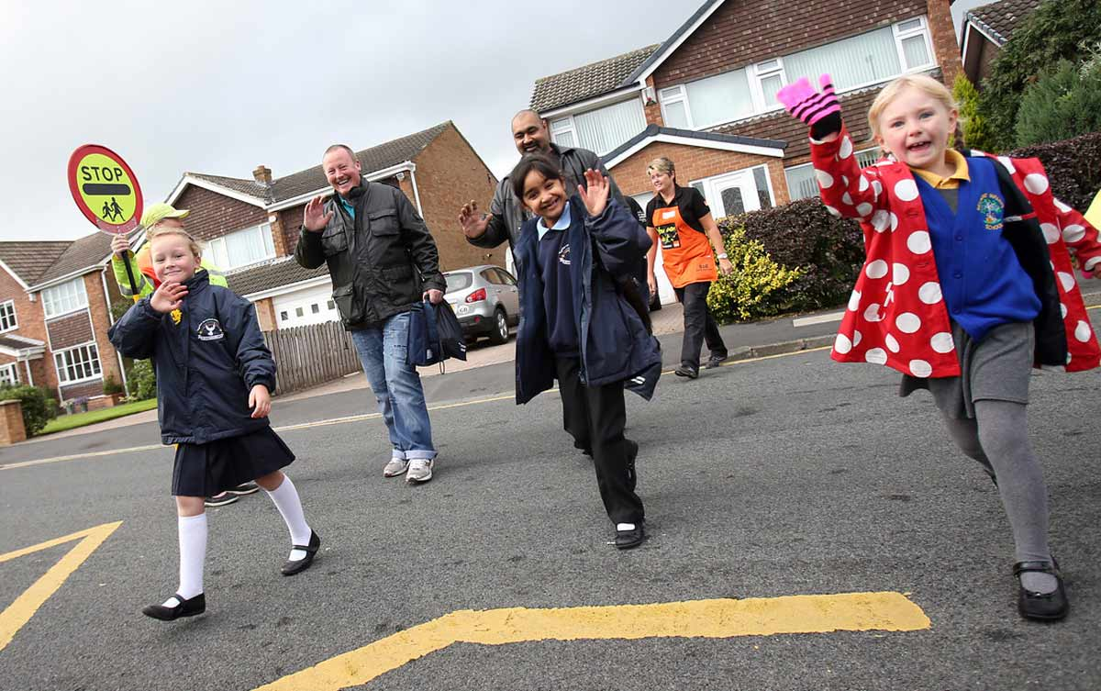

Slide 4
