Slide 1
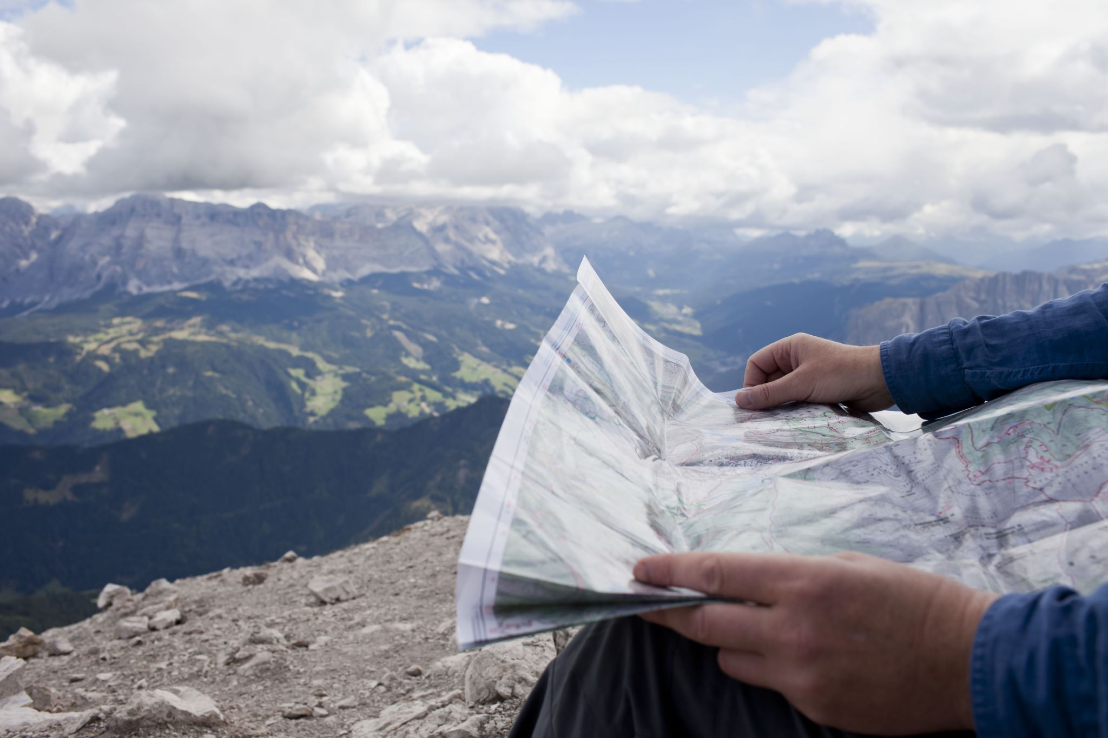
Welcome

Slide 2
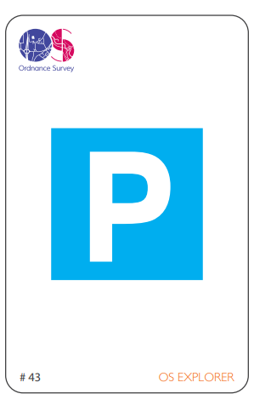

Slide 3
Parking

Slide 4
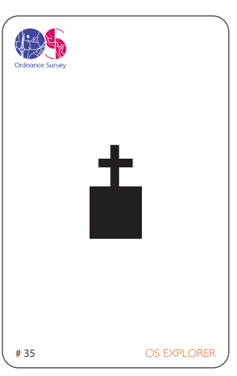

Slide 5
Place of worship with a tower

Slide 6
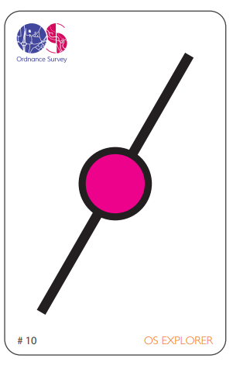

Slide 7
Railway station

Slide 8
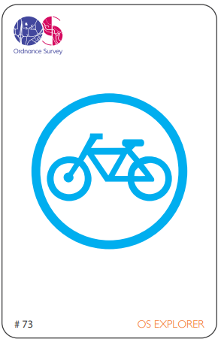

Slide 9
Bike hire

Slide 10
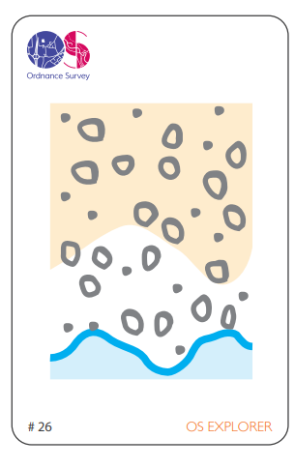

Slide 11
Shingle

Slide 12
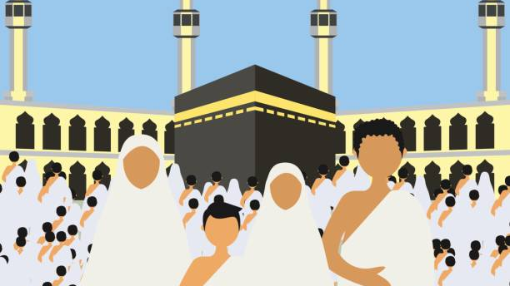

Slide 13
