Slide 1

What should we get angry about?

Slide 2

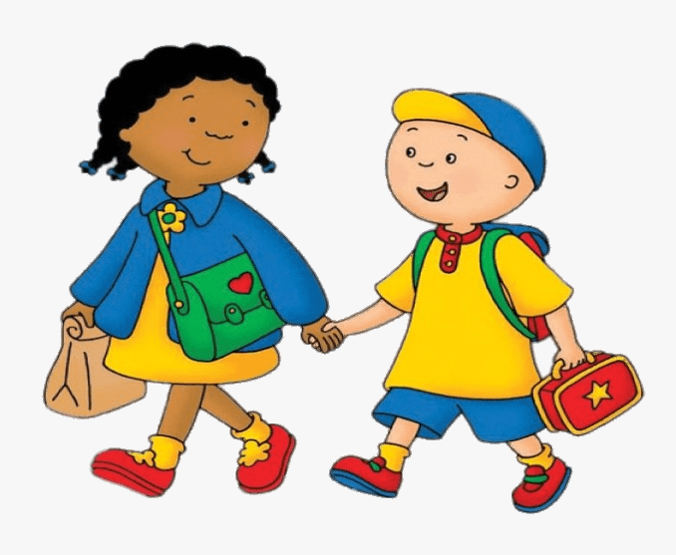
A long walk to
school
A short walk to
school
Or

Slide 3


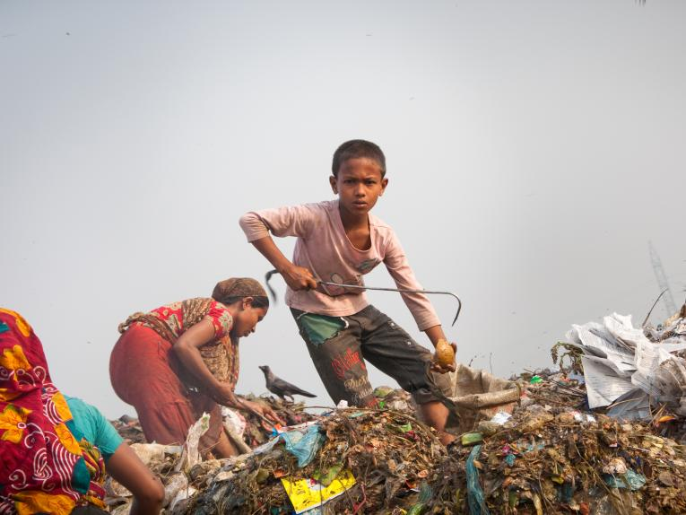
Learning your least
favourite subject
Not being allowed to go to school
Or

Slide 4
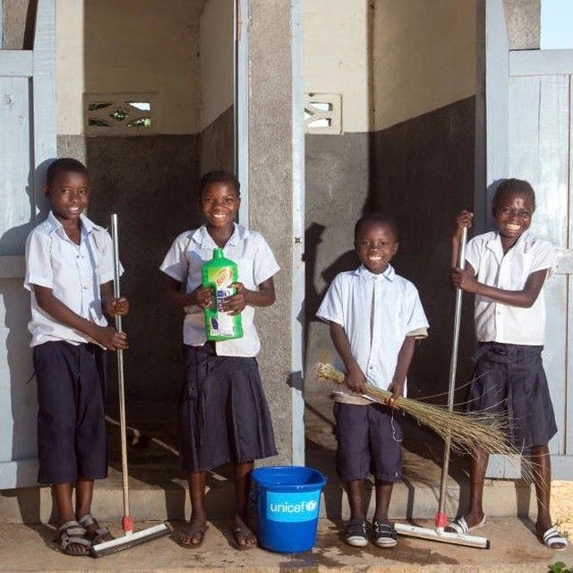
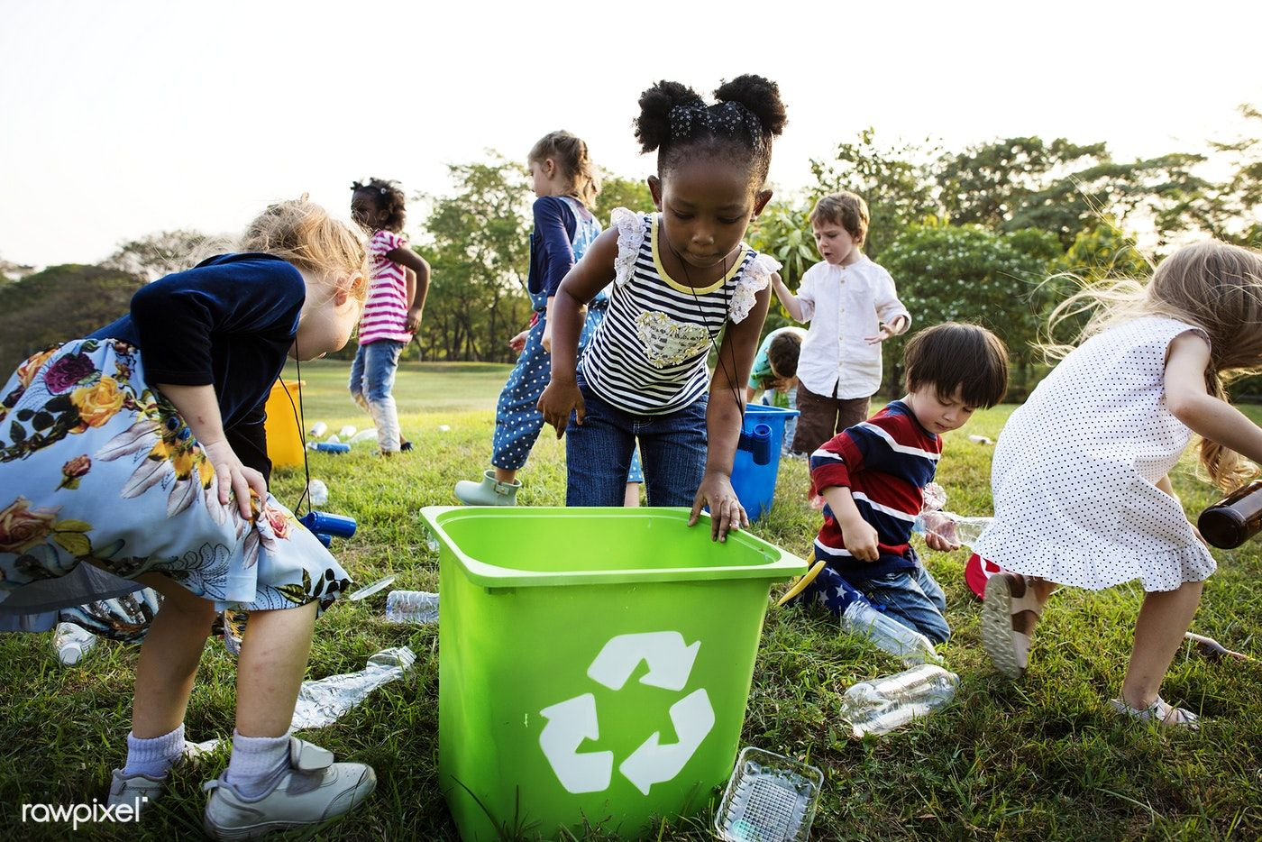
Cleaning your school
Or
Picking up litter

Slide 5
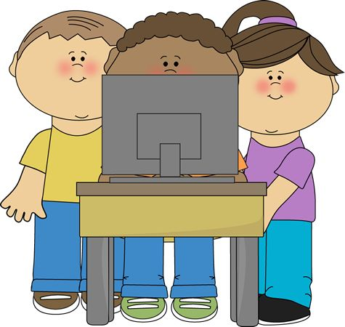
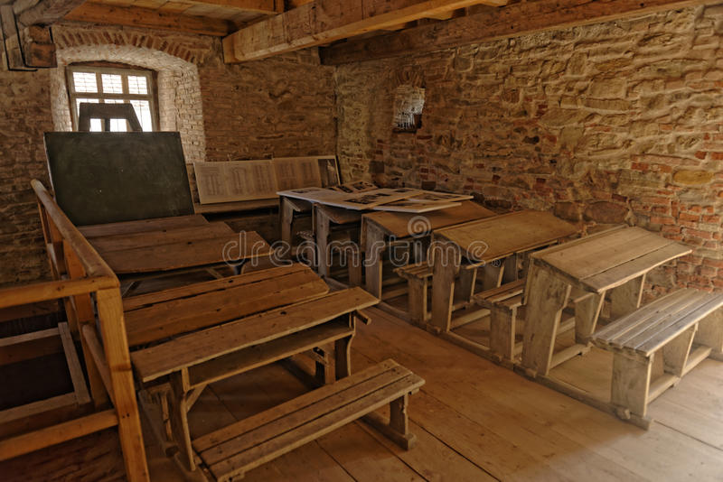
Not having enough
laptops in the classroom
Not having any tablets or other tech in the classroom
Or

Slide 6

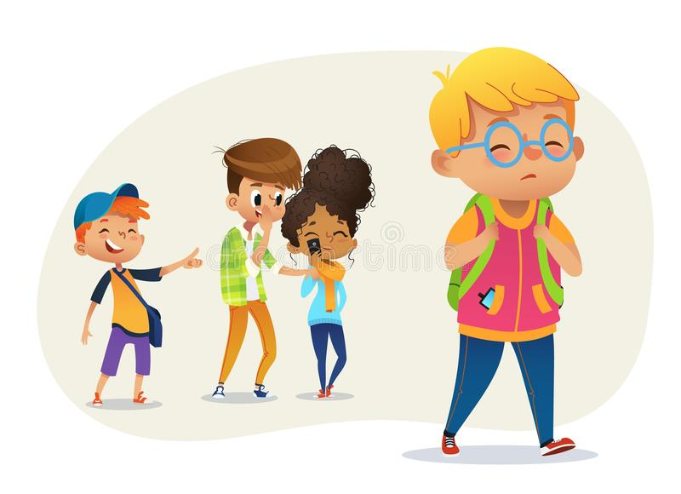
Sharing our friends
Or
Somebody being bullied

Slide 7
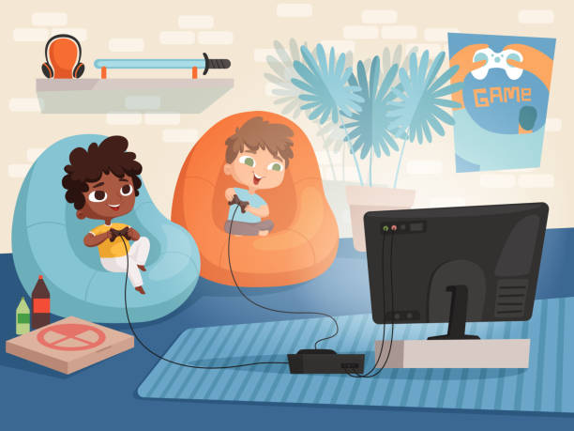
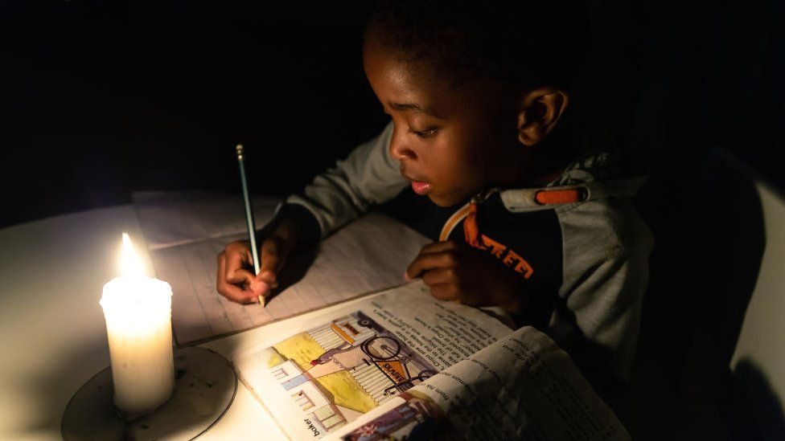
Falling out with friends
when playing online
Having to do homework
by candlelight
Or

