Slide 1
‘The generous will themselves be blessed.’
(Proverbs 22.9)

Slide 2
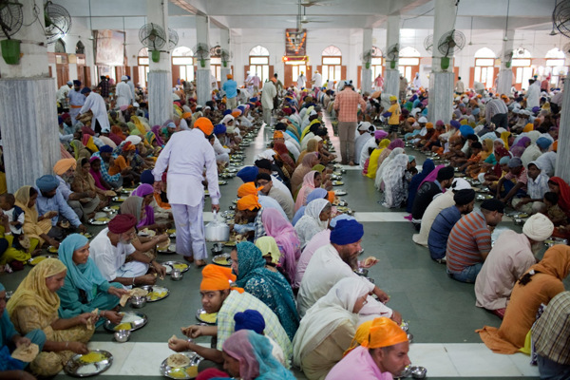
Langar meal: a free meal served in a Sikh gurdwara to all visitors, without distinction of faith, religion or background.

Slide 3
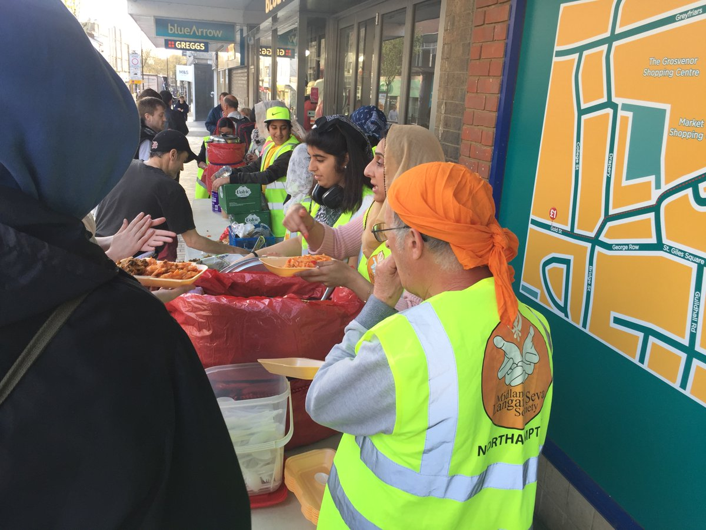

Slide 4
‘It is in giving
that we receive.’
(St Francis)

Slide 5
‘You give but little when you give of your possessions. It is when you give of yourself that you truly give.’
(Kahlil Gibran)

