Slide 1
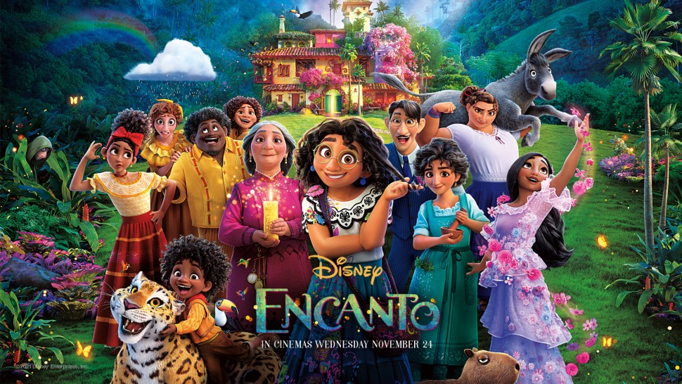
The Importance of Forgiveness

Slide 2
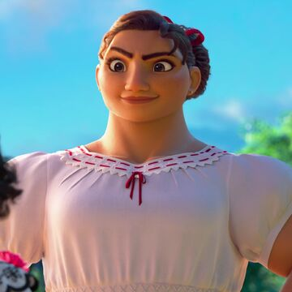
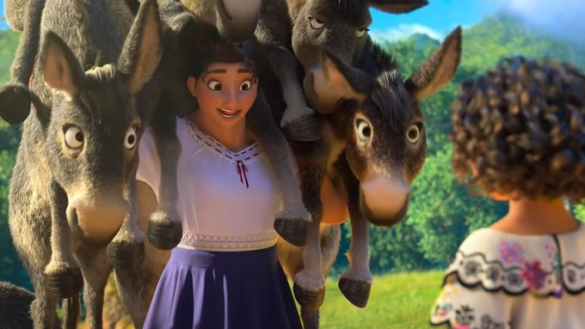
Luisa’s magical gift is . . .
Strength

Slide 3
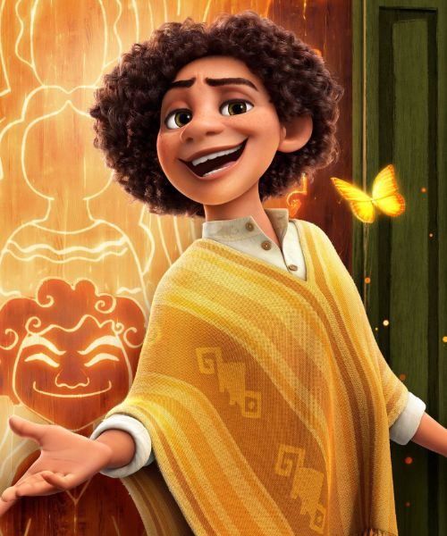
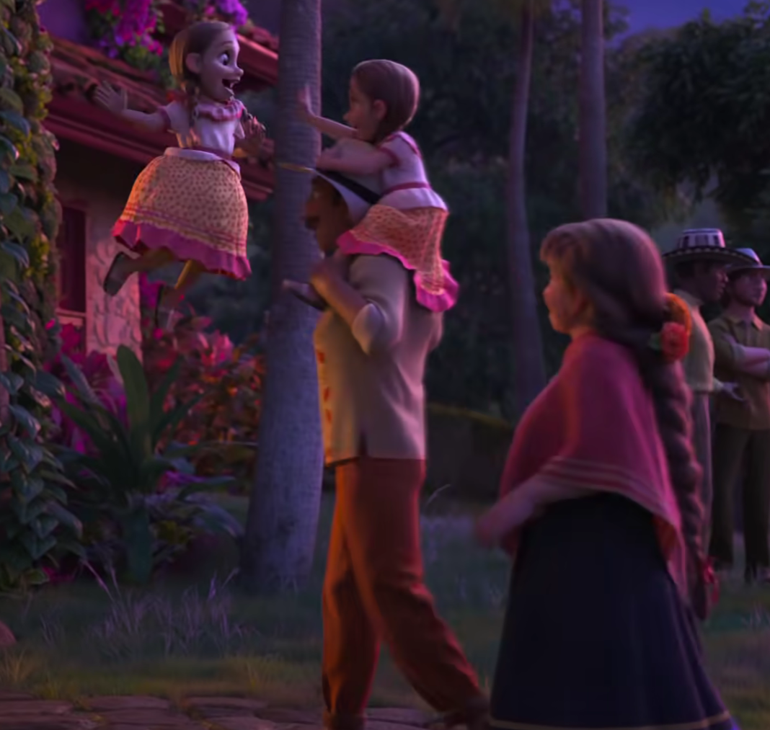
Camilo’s magical gift is . . .
Changing appearance

Slide 4
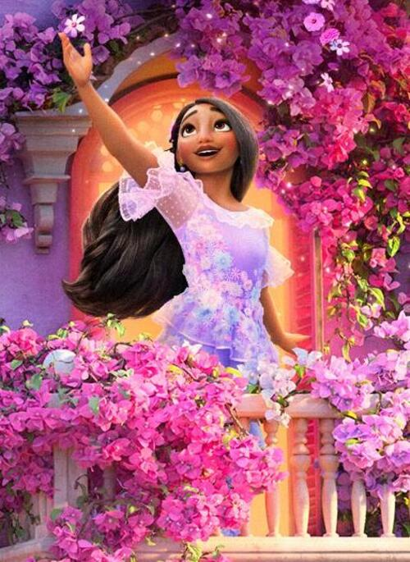
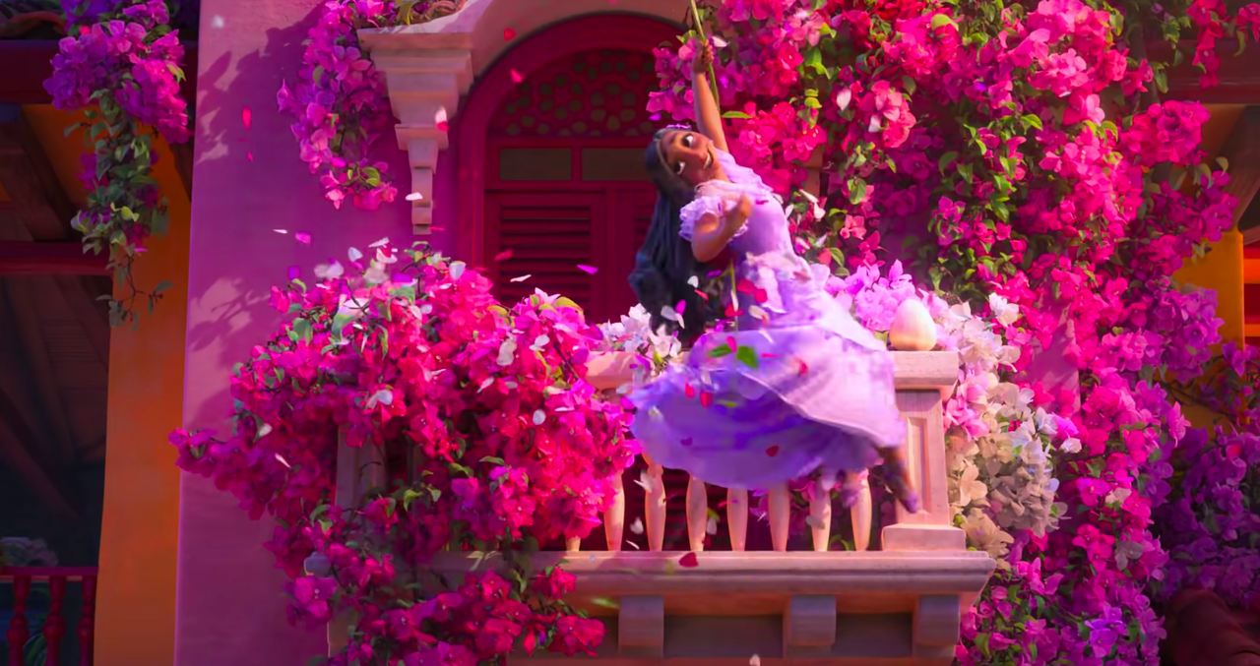
Isabela’s magical gift is . . .
Making flowers grow from nothing

Slide 5
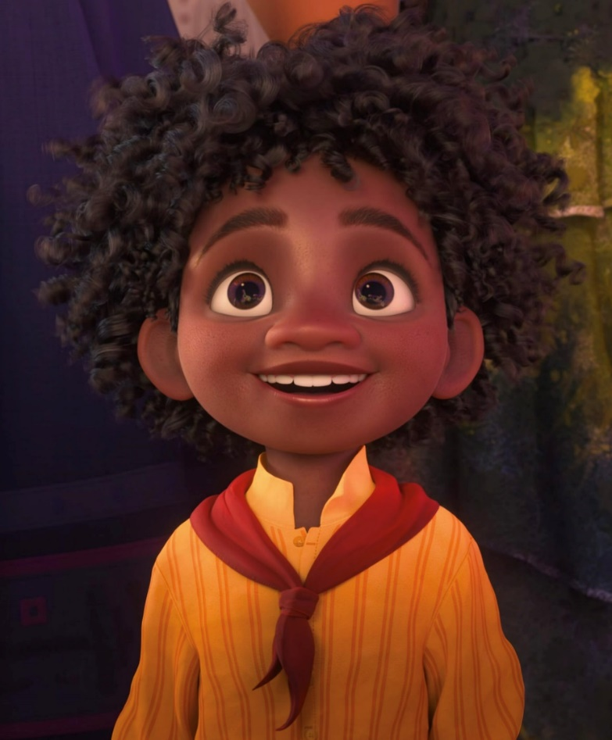
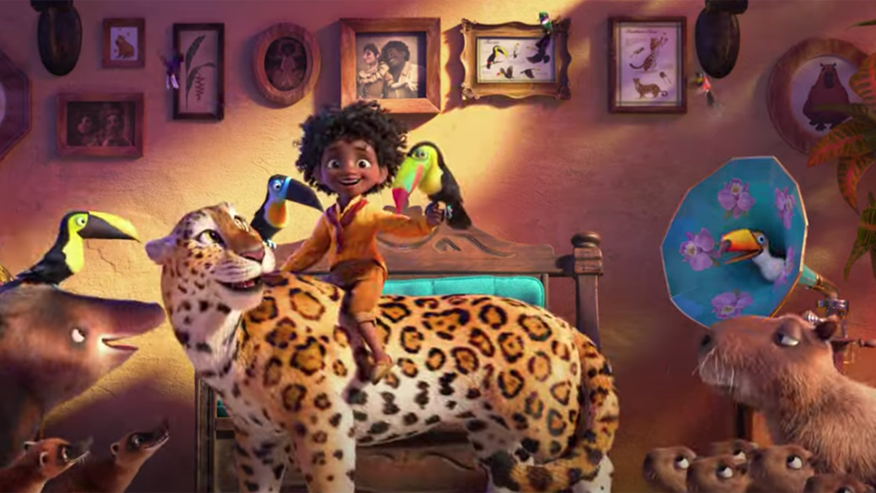
Antonio’s magical gift is . . .
Talking to the animals

Slide 6
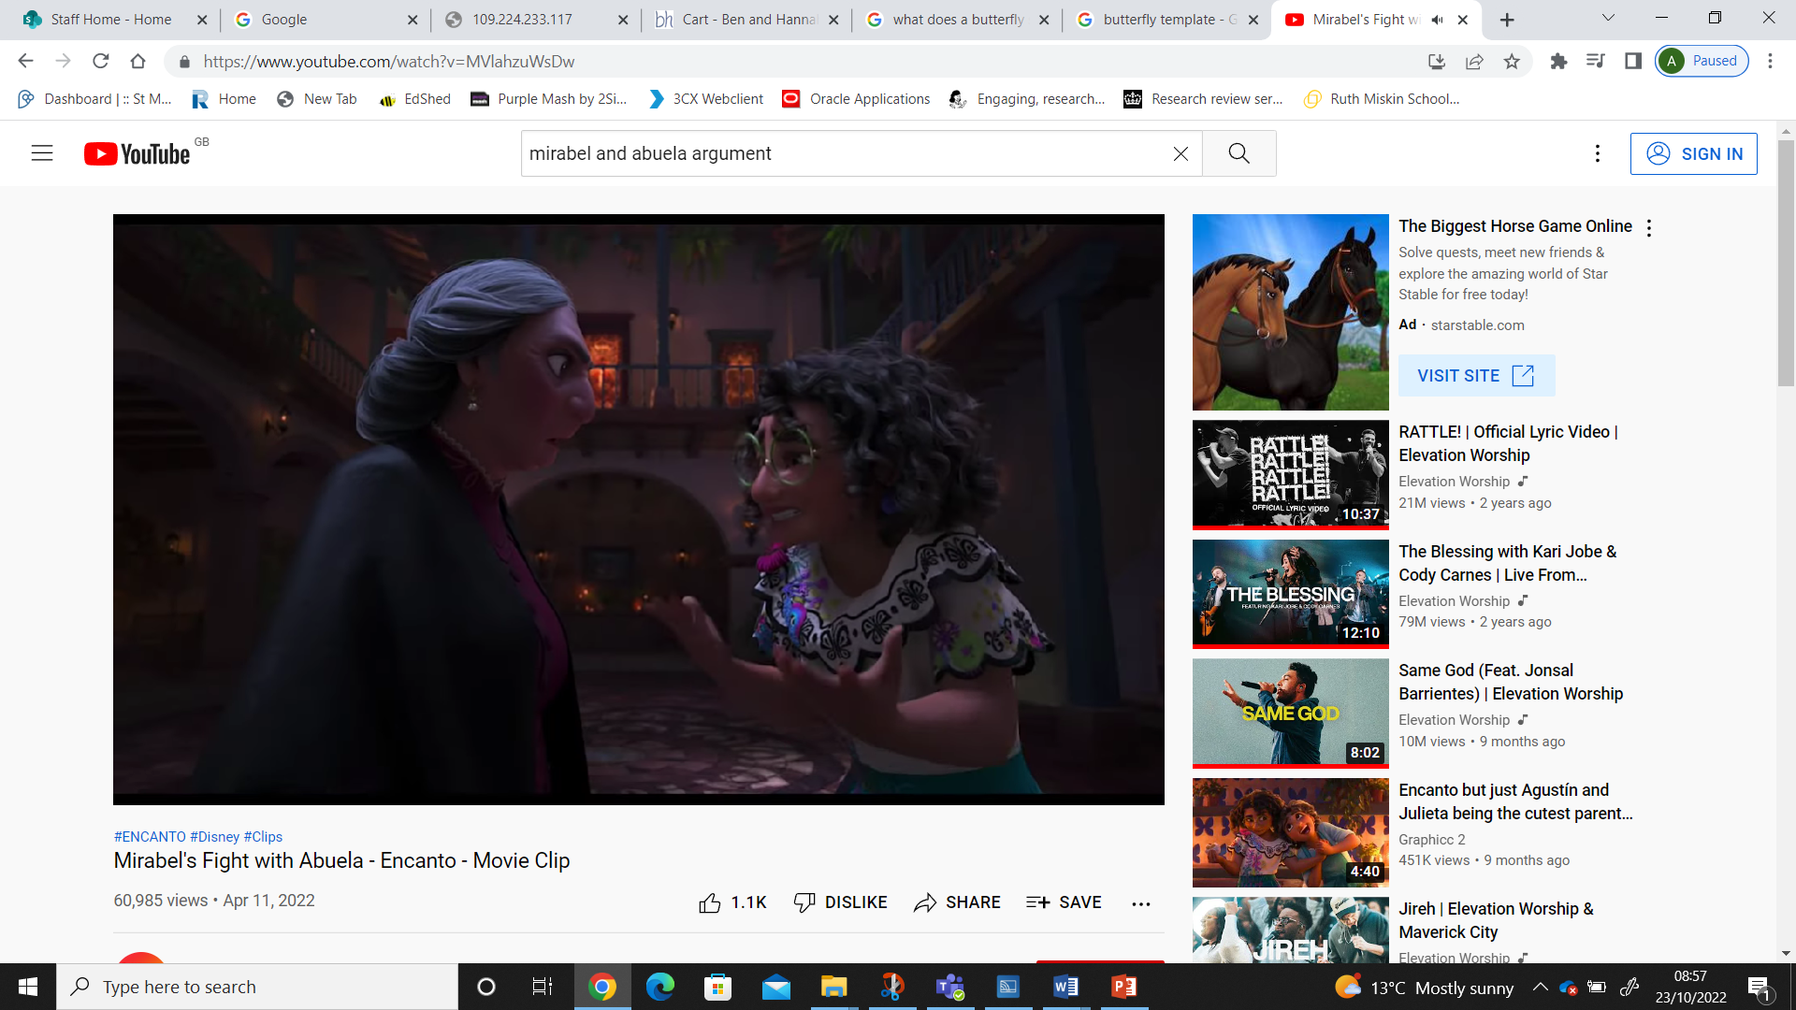
But Mirabel has no gift.
How does she get on with Abuela?

Slide 7
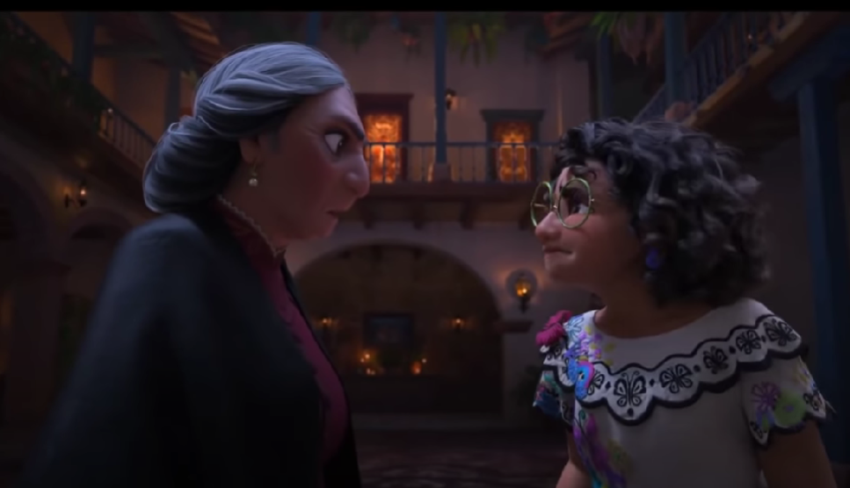
After their argument,
what should they both do?

Slide 8
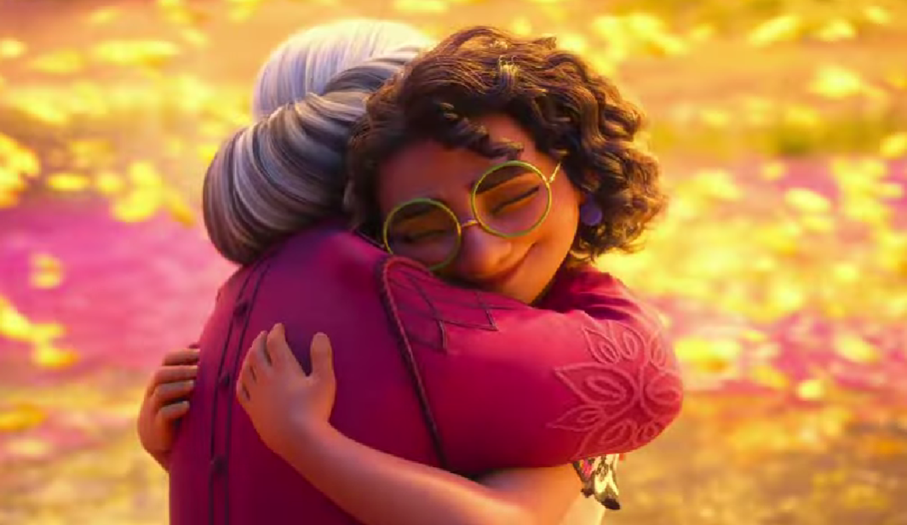
Listen to one another, say sorry,
forgive and move forward

Slide 9
