Slide 1
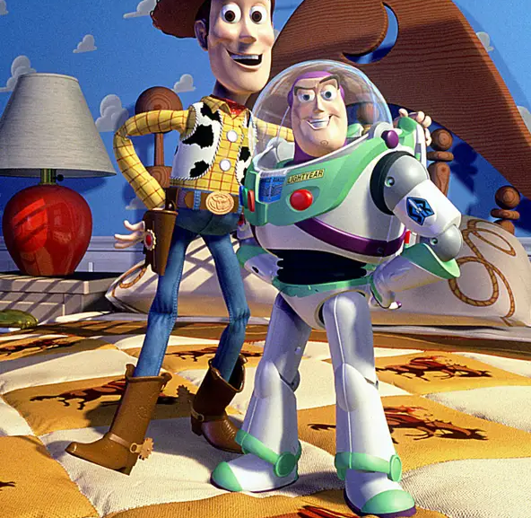
Welcome

Slide 2
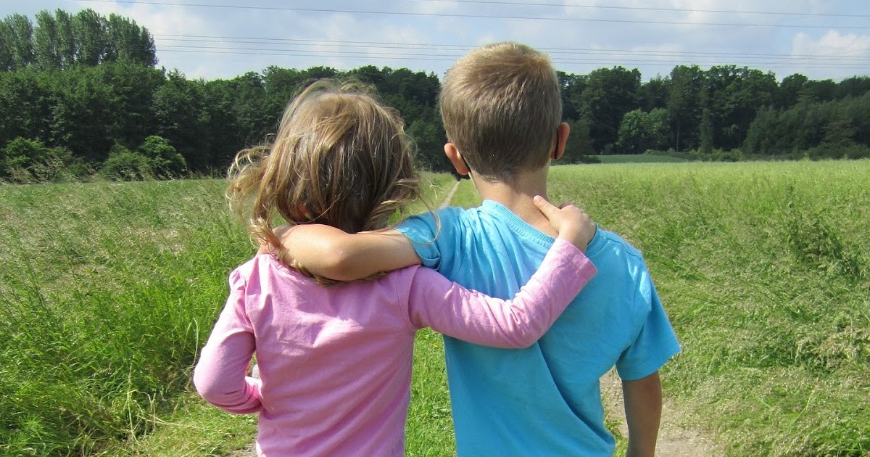
Patient
Generous
Forgiving
Thoughtful
Upbeat
Loyal
Warm
Compassionate
Encouraging
This Photo by Unknown Author is licensed under CC BY-SA-NC

Slide 3

Love is . . .
Friendship is . . .

