Slide 1
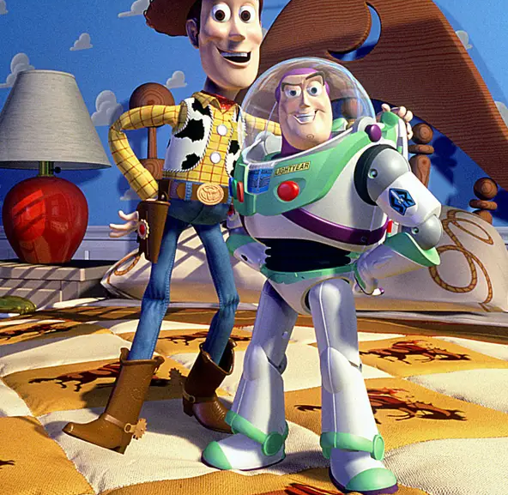
Welcome

Slide 2
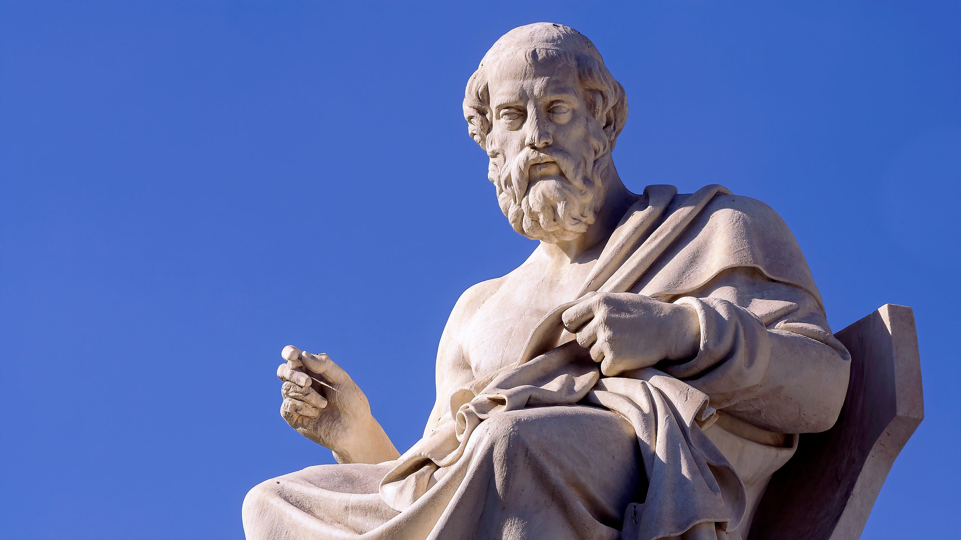
Plato, c. 428 to 348 BC

Slide 3
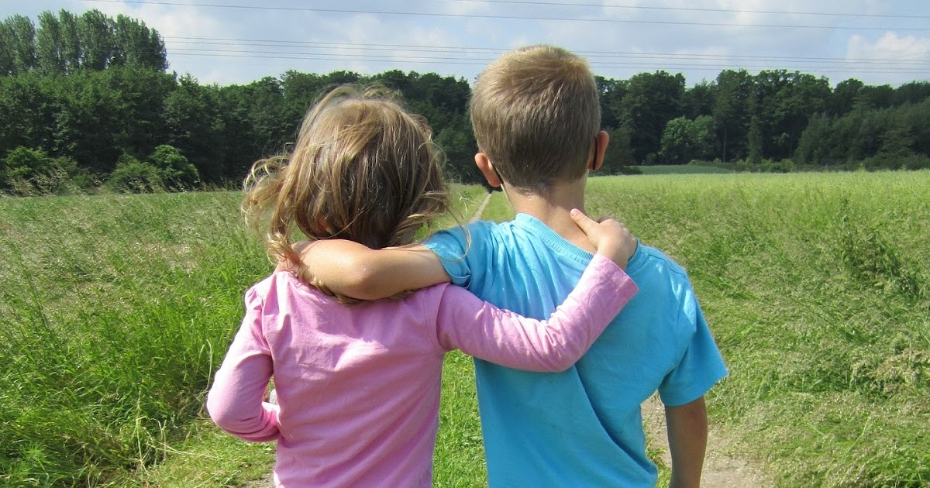
Patient
Generous
Forgiving
Thoughtful
Upbeat
Loyal
Warm
Compassionate
Encouraging

Slide 4

Love is . . .
Friendship is . . .

