Slide 1
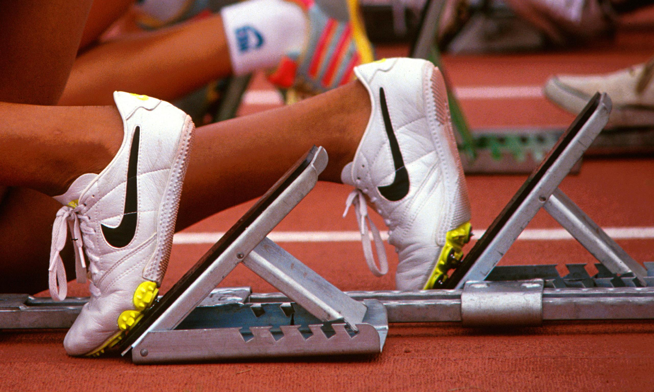
...running a race

Slide 2
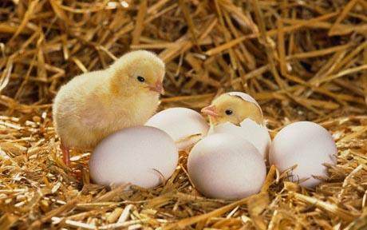
...chicks hatching from an egg

Slide 3
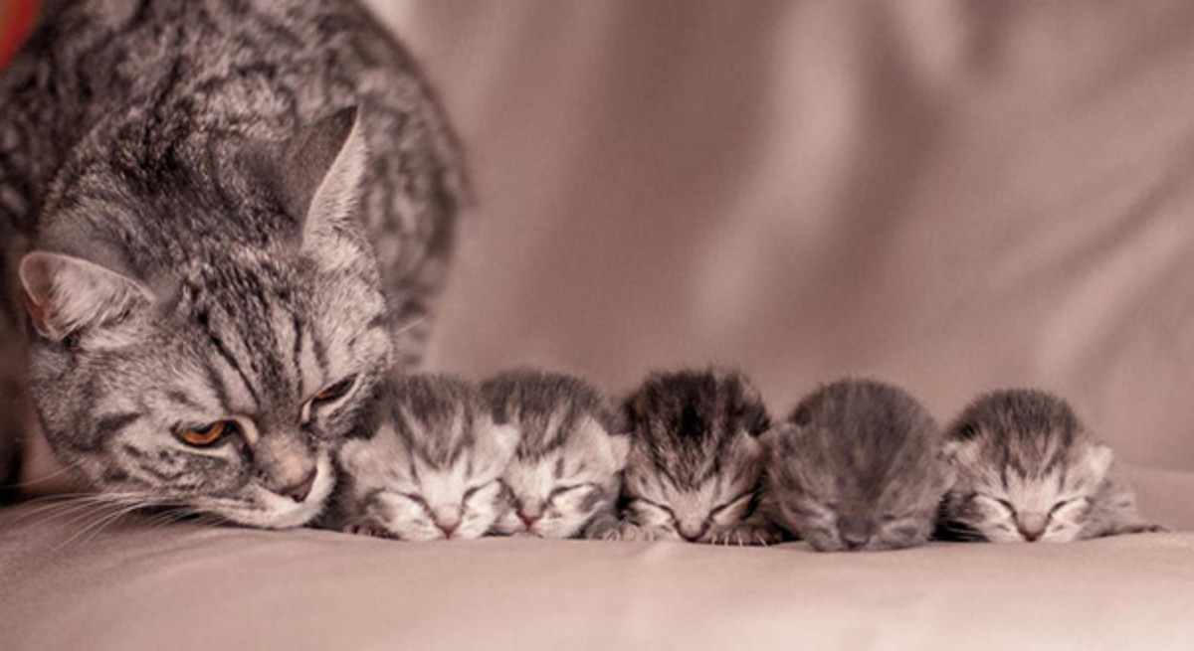
...new born kittens

Slide 4
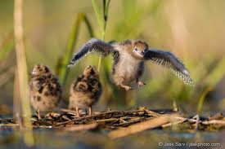
...learning to fly

Slide 5
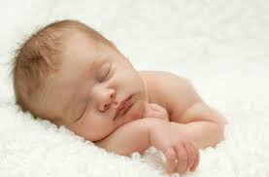
...new born baby

Slide 6
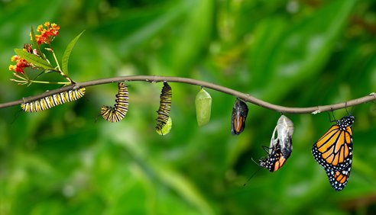
...caterpillar to butterfly

Slide 7

...Happy New Year

Slide 8
What is the connection?

