Slide 1
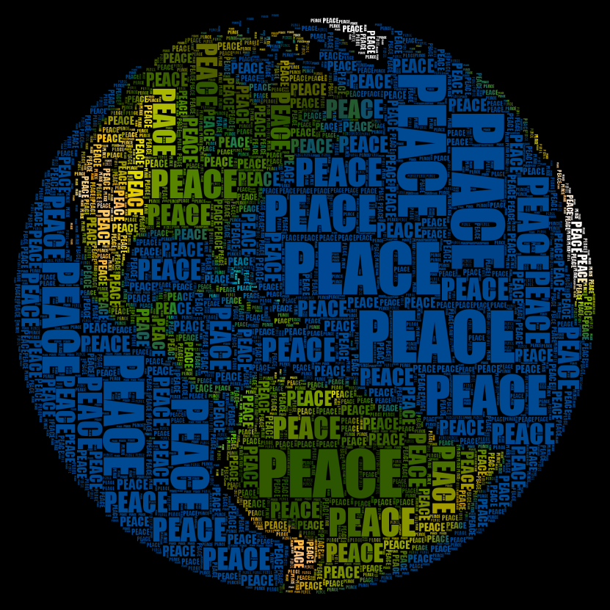
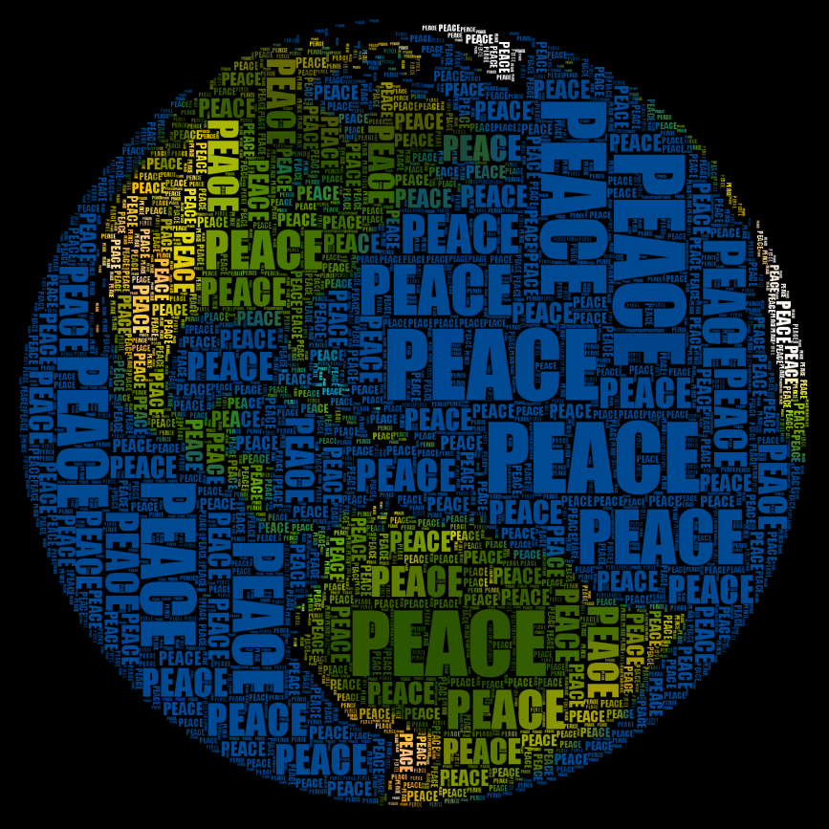
The Choice
of Peace

Slide 2
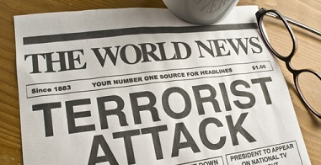

Slide 3
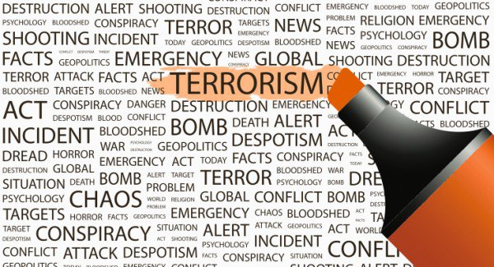

Slide 4
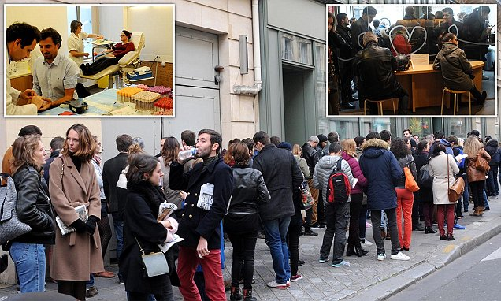

Slide 5


Slide 6
Some messages from world leaders
Canada: Prime Minister Justin Trudeau tweeted, ‘Canadians are shocked by the news of the horrific attack in Manchester tonight. Please keep the victims and their families in your thoughts.’
Australia: Prime Minister Malcolm Turnbull tweeted, ‘Our heartfelt sympathy and resolute solidarity is with the people of the United Kingdom.’
France: President Emmanuel Macron tweeted, ‘We come together in the fight against terrorism.’
Germany: Chancellor Angela Merkel expressed her ‘sorrow and horror’.
China: President Xi Jinping sent a telegram to the Queen, saying, ‘The Chinese people and British people are standing side by side firmly during this difficult time.’

Slide 7
