Slide 1
Welcome!

Slide 2


Slide 3
Consideration
‘To think about something or someone before deciding on, or taking, a course of action.’

Slide 4
How we can show consideration
Being helpful
Being kind and sympathetic
Being caring
Being thoughtful
Being trustworthy
Being polite
Being appreciative

Slide 5
Being helpful
Tidy away items that you have used so that someone else doesn’t have to clear them up
Don’t drop litter or anything else. It isn’t good for the environment, and it could hurt our wildlife
Do chores for parents or carers, such as laying the table for dinner or drying the plates
Don’t quarrel with siblings or friends and cause them to be upset

Slide 6
Sympathetic
‘To be understanding towards someone and comfort them.’
When we do this, we show compassion

Slide 7
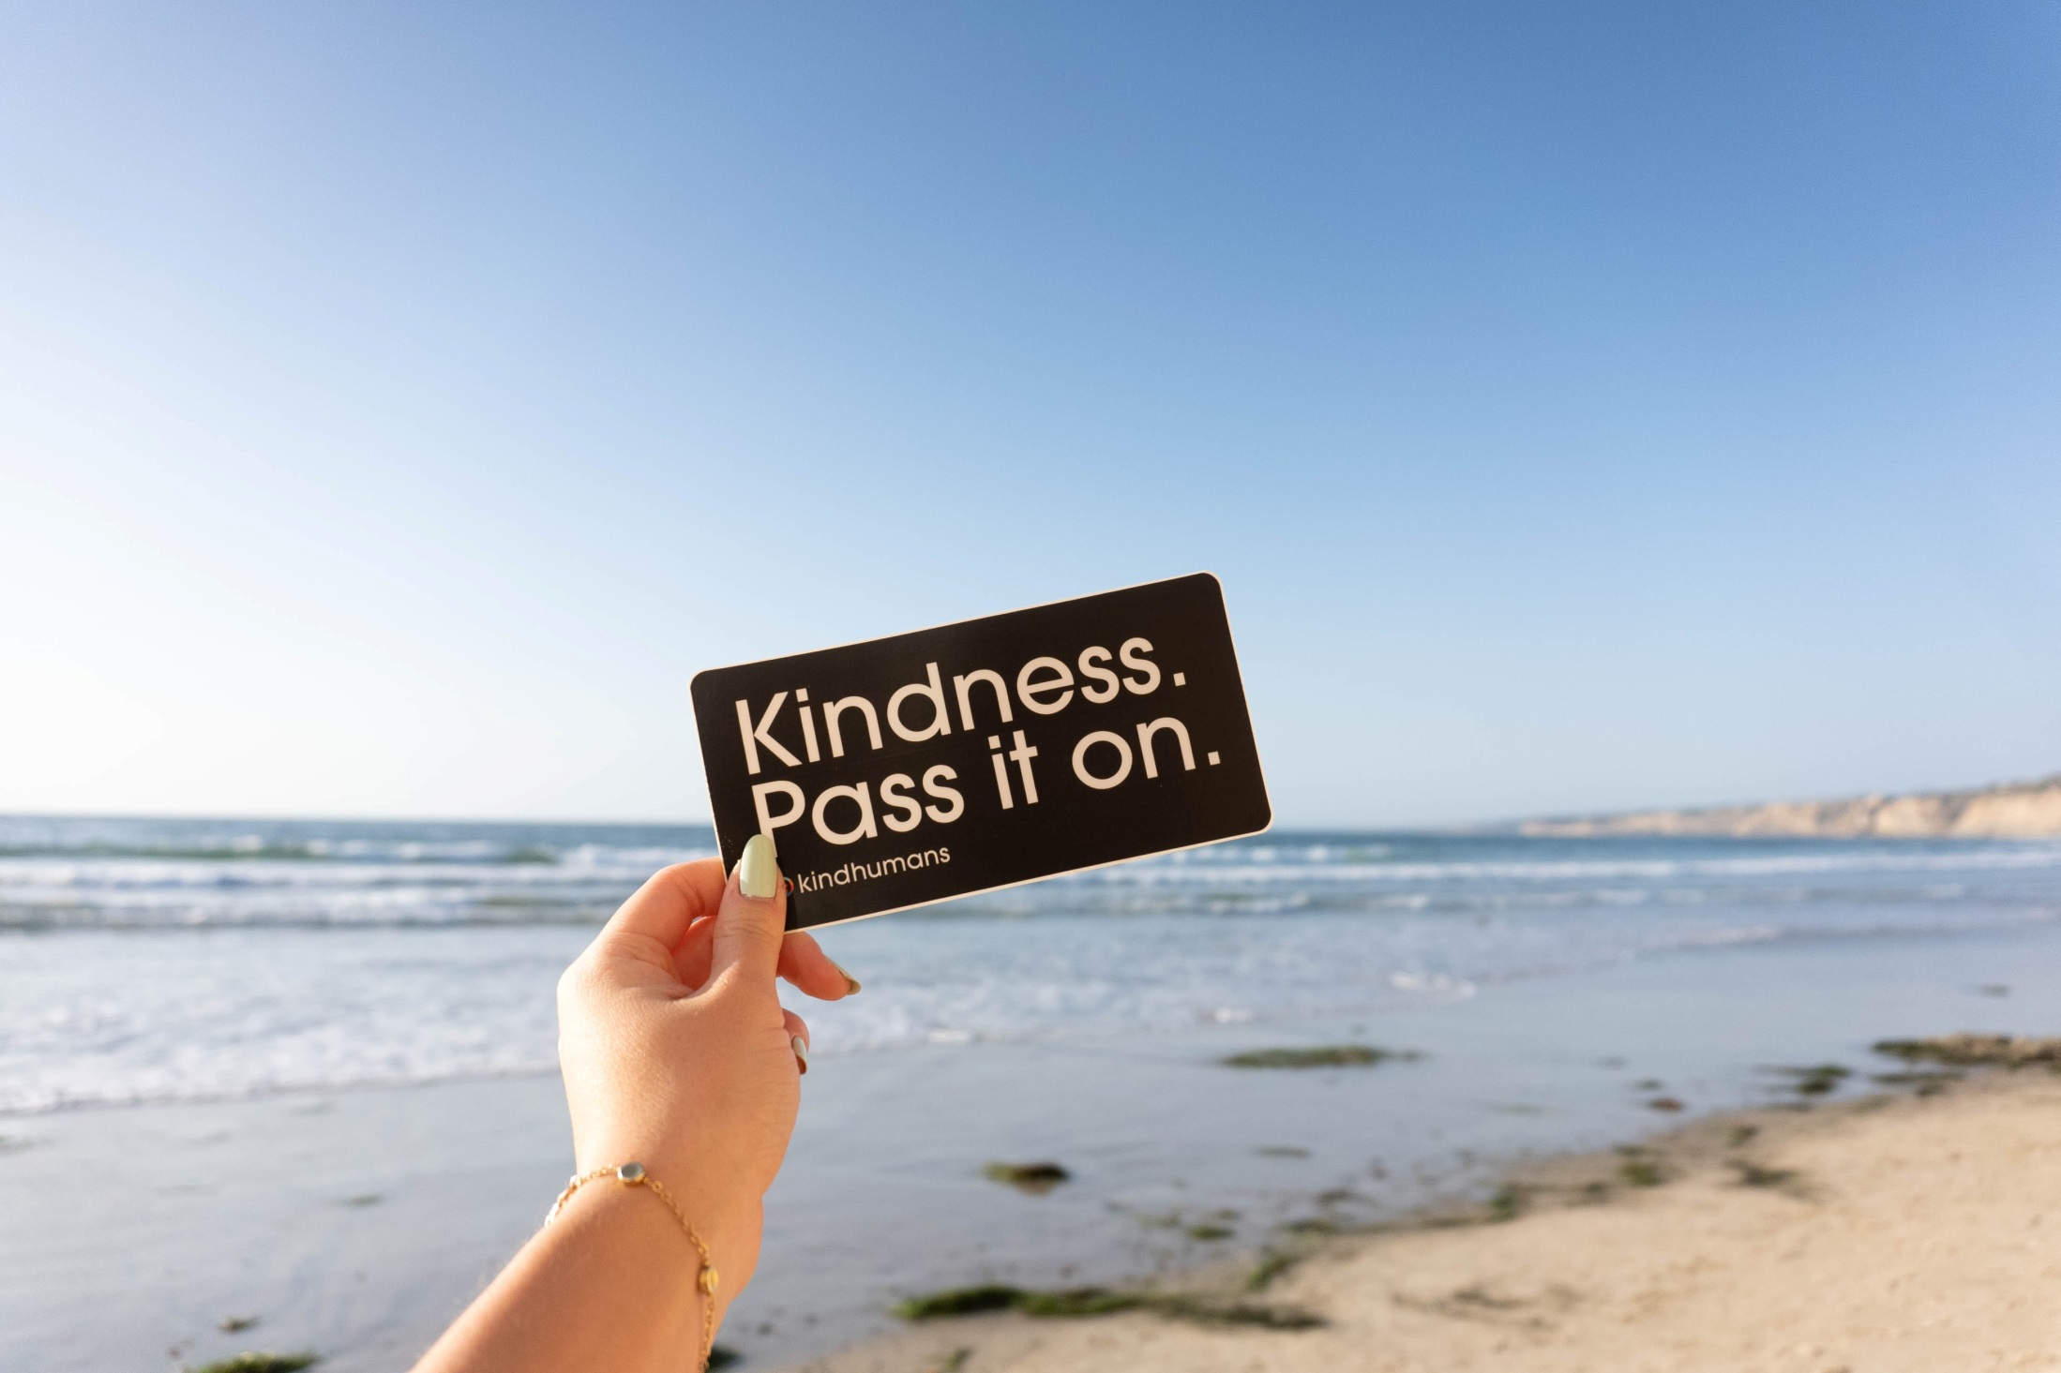

Slide 8
Being kind and sympathetic
Be careful with the words that you use when speaking to others
Listen to others and pay attention to what they are saying
Understand that we are all different and deal with challenges differently
Be constructive about giving feedback. Look for the good as well as areas that need improvement. Everyone has strengths and weaknesses
Don’t join in when others are making fun of someone or gossiping. It isn’t big to make someone else look small
Show compassion when someone makes a mistake
Forgive when someone makes a mistake
Be kind and cheer someone up when they are feeling down or unwell

Slide 9
Being caring
Make everyone feel welcome. You could do this when you play games during break or when someone new joins your school
Share by allowing everyone to have a turn at a game or by making sure that treats are divided up fairly
Give time to someone else. You could do this by playing with a younger sibling and helping at home, or by volunteering, such as helping at a school event
Put others first. If you want to watch a film, and a friend wants to watch a different one, maybe you could let them choose
Smile and say hello to your neighbours, or people you know on the street
If someone is upset about something, such as losing a pet, let them know that you are there for them

Slide 10
Being thoughtful
When you travel by public transport and it’s crowded, you could offer someone your seat
Don’t put your feet on a seat so that it makes it dirty for the next person to sit on
When things don’t go your way, try not to show your annoyance or disappointment to someone else when it isn’t their fault
It’s always nice to give a gift, but you can make it extra-special by thinking about what that person would really like – and it doesn’t have to be expensive
Think about how someone else is feeling
If your friend enjoys acting and is performing in a play, you could support them by going to watch
Put yourself in someone else’s shoes by thinking about how something might make that person feel

Slide 11
Being trustworthy
If you find something that doesn’t belong to you, hand it to someone who may be able to find the owner
Think before you speak about others: would you like it if someone gave away your secret?
Give credit to others when they deserve it. If someone has put work into something, it’s only fair to recognize them for the part that they played
Be honest and don’t tell fibs, like blaming someone else when it was you who made the mistake
If your parents ask you to come home by a certain time, do what they ask. That way, they will know that they can rely on you, and it won’t cause them worry

Slide 12
Being polite
Use good manners to everyone regardless of how you feel or whether that person is displaying good manners to you. Even if you don’t agree with someone or what they’ve done, shouting or saying mean things will not improve the situation
Good manners means speaking to people respectfully, like using words such as please and thank you. Show the same respect to everyone
Don’t talk in class when you shouldn’t. Being disruptive can disturb others
Wait your turn in the queue, such as in the canteen or at the bus stop
Apologize if you make a mistake, have a bad day or are rude

Slide 13
Being appreciative
Thank people for the things that they do for you
Show respect and appreciation to people who are different from you
Understand that everyone has different challenges in their lives to overcome
Encourage people when you can see that they are trying to do certain things better
Encourage people when they have a disappointment, such as if they get a lower score than they’d hoped for in a test
Congratulate someone when they do well at something that they have worked for
Recognize people’s good qualities

