Slide 1

All About You!
What makes you you?

Slide 2
All About You!
What makes you you?
Personality
Behaviour
Emotions
Clothes
Clubs and
activities
Belongings – toys and games
School
Family
Friends
Pets

Slide 3
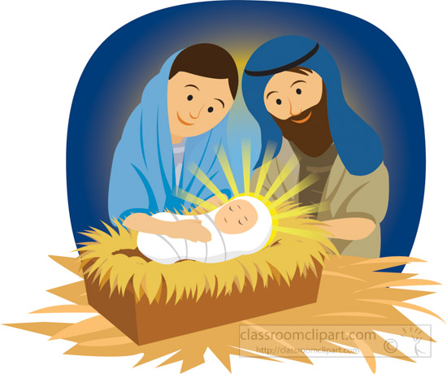
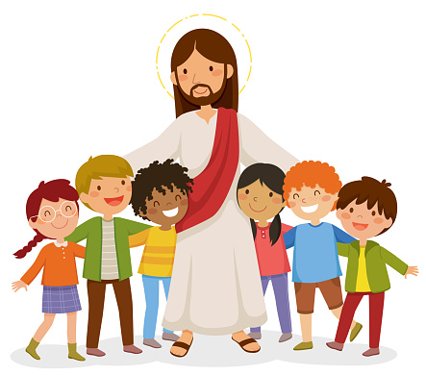
All About You!
What made Jesus Jesus?

Slide 4
All About You!
What made Jesus Jesus?
His learning – school and the Bible
Personality
Behaviour
Emotions
Mary and Joseph
Father in Heaven – God
Unusual presents
His job – carpenter
Extended family
Friends

Slide 5

All About You!
What made Jesus Jesus?

Slide 6
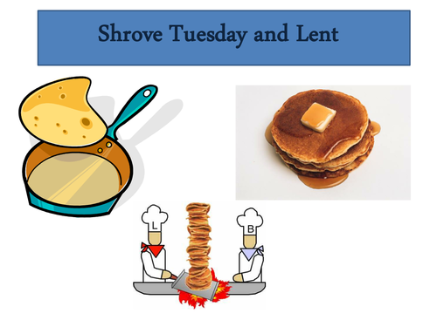

All About You!
What made Jesus Jesus?

Slide 7
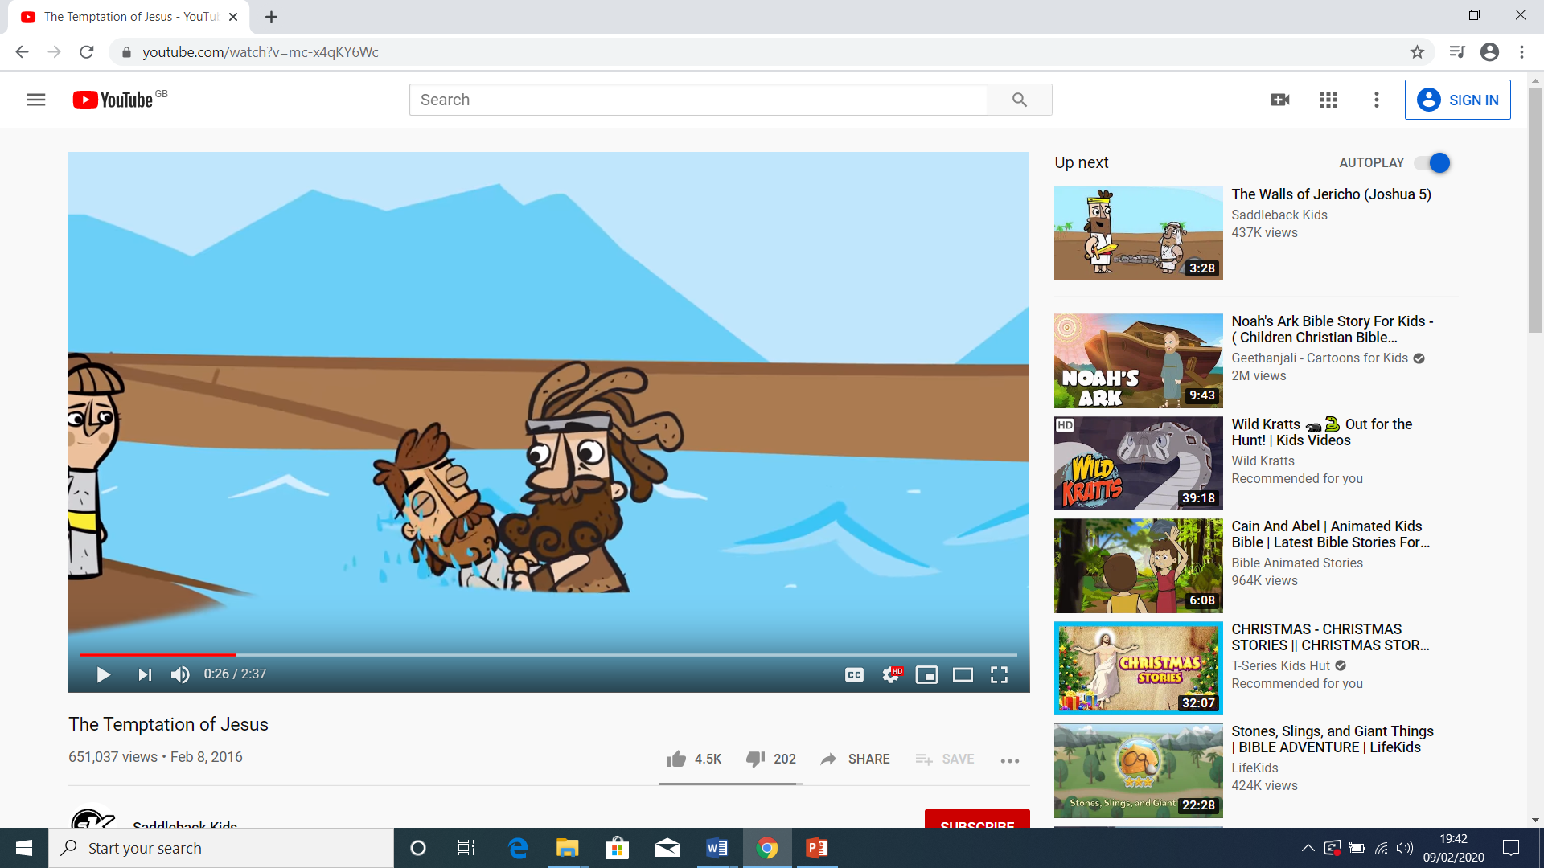
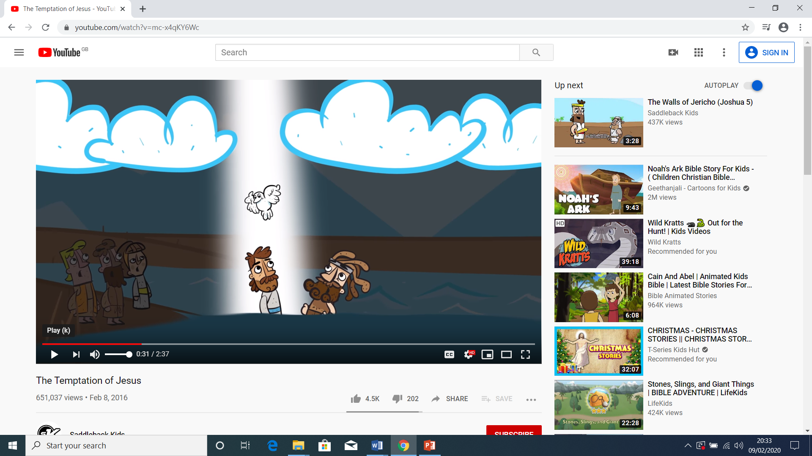
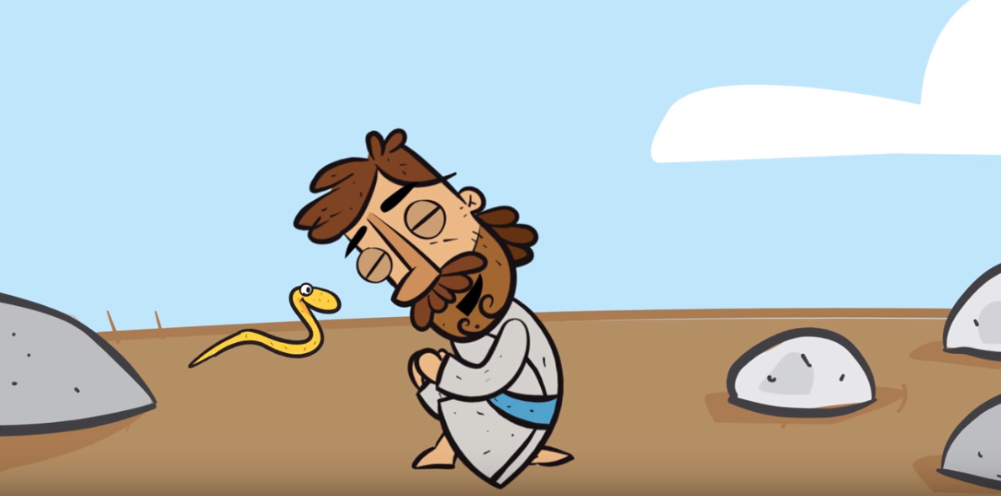
Jesus’ baptism
All About You!
40 days in the desert – but why?

Slide 8
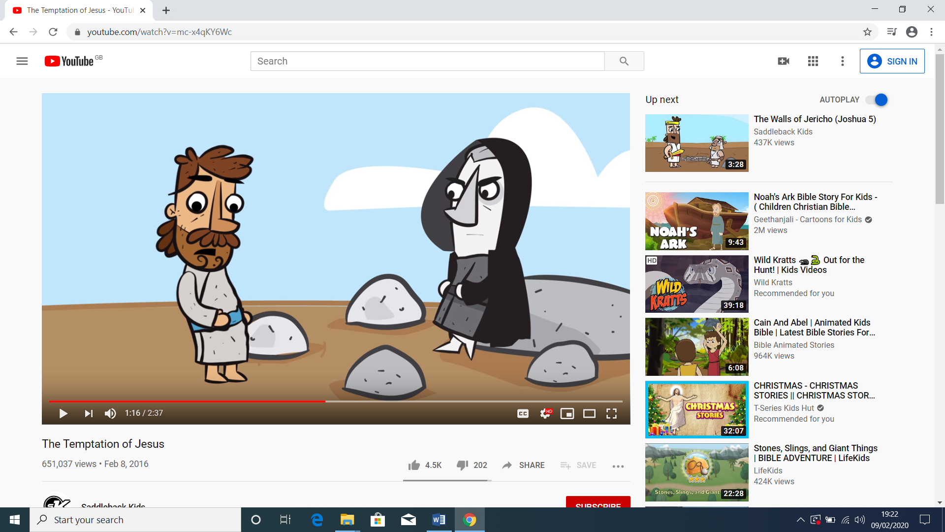
All About You!
First temptation: to turn stones into bread
First temptation: what Jesus needed

Slide 9
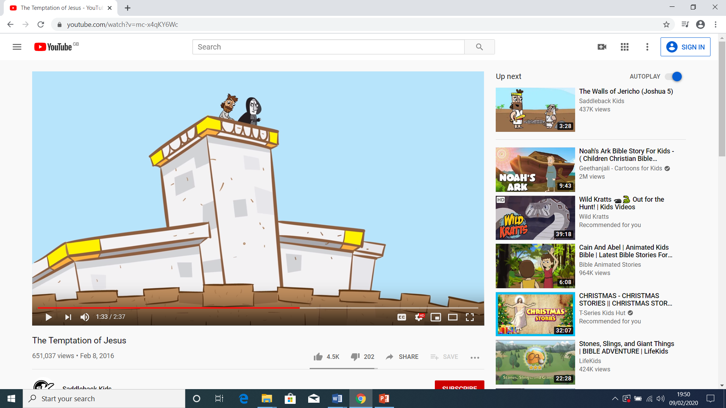
All About You!
Second temptation: to test God
Second temptation: who Jesus trusted

Slide 10
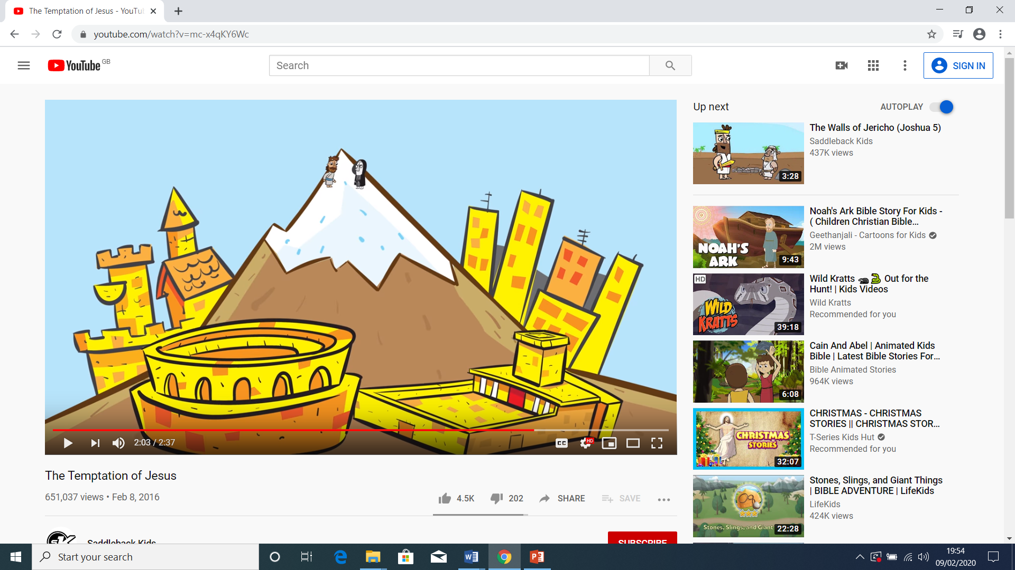
All About You!
Third temptation: God’s way or the devil’s way
Third temptation: the right way or the wrong way

Slide 11
All About You!
How is Jesus’ time in the desert connected to you?

Slide 12

All About You!

