Slide 1

Welcome

Slide 2

Welcome

Slide 3
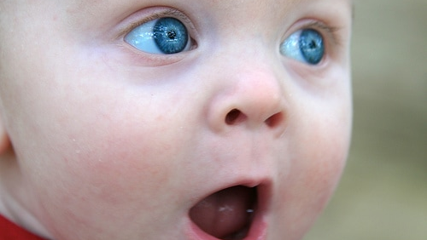

Slide 4
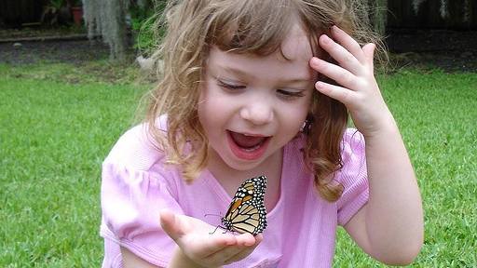

Slide 5


Slide 6
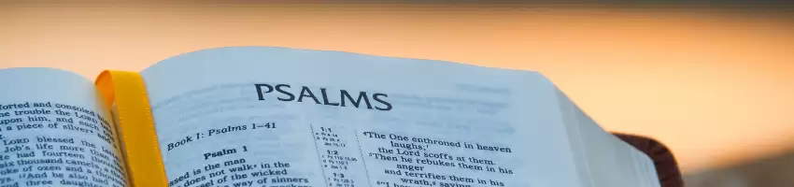
O Lord, our Lord, your majestic name fills the earth! Your glory is higher than the heavens . . .
When I look at the night sky and see the work of your fingers – the moon and the stars you set in place –
what are mere mortals that you should think about them?
Psalm 8.1 and 8.3–4
Welcome

Slide 7
You made all the delicate, inner parts of my body and knit me together in my mother’s womb.
Thank you for making me so wonderfully complex! Your workmanship is marvellous – how well I know it.
Psalm 139.13-14
Welcome

