Slide 1
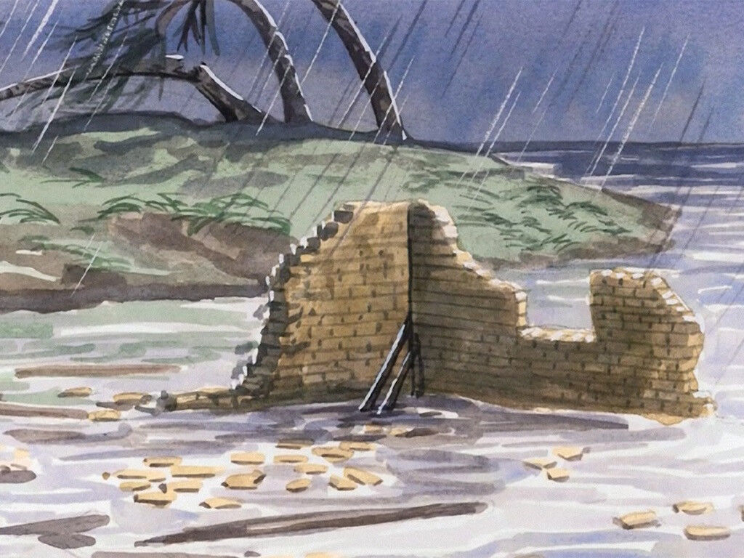

Slide 2
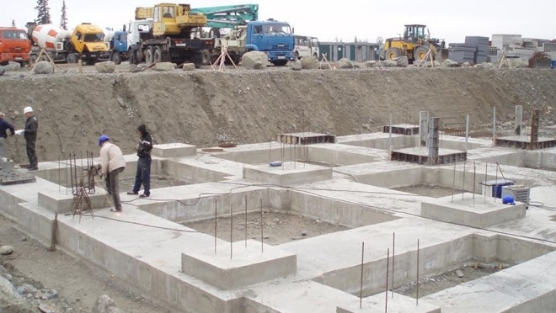

Slide 3
One house with foundations dug squarely
And one house built all willy-nilly.
When the storms came along,
The first house stood strong,
But the second collapsed like a jelly!
(Lucy Moore, The Gospels Unplugged, BRF, 2008)

