Slide 1




Slide 2
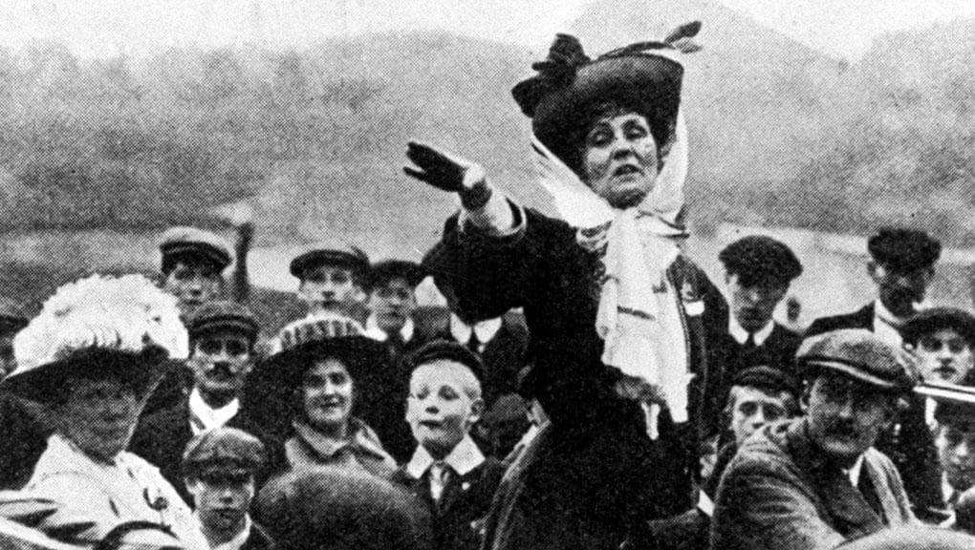

Slide 3
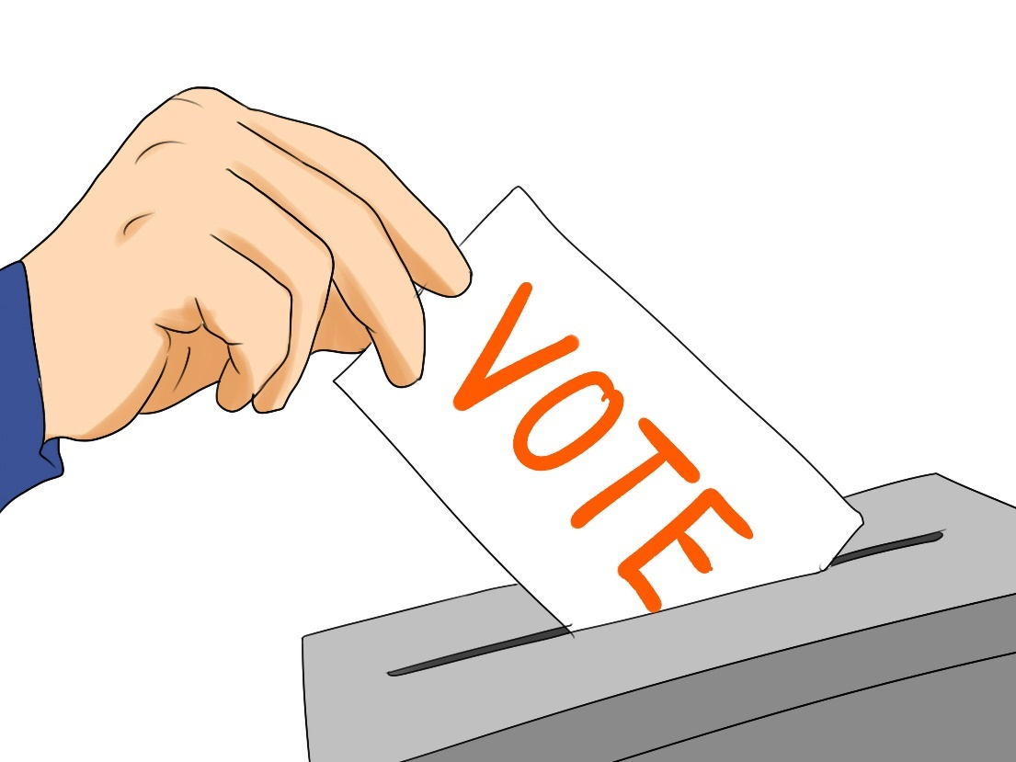
Democracy means ‘rule by the people’
Democracy means being allowed to have a say in how the country is run through the process of voting

Slide 4
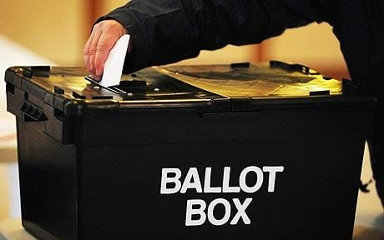
Adults have the right to vote in the UK
People campaigned and work hard for people to have this right to vote
The UK is a democratic country where a person’s right to vote is important
Voting matters!

