Slide 1
Welcome . . .

Slide 2

Hibernation resembles deep sleep
In hibernation, the body temperature is lowered, and breathing and heart rates slow down

Slide 3
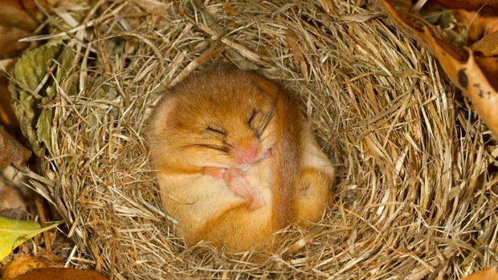

Slide 4
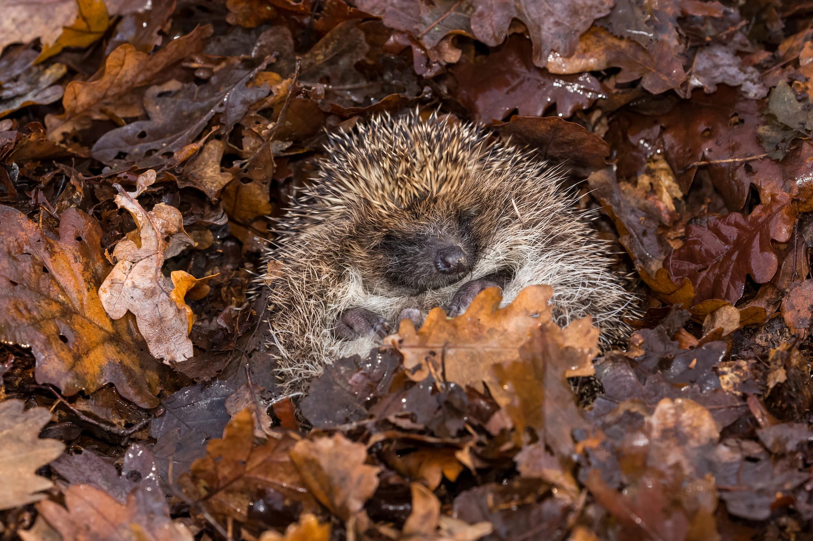

Slide 5
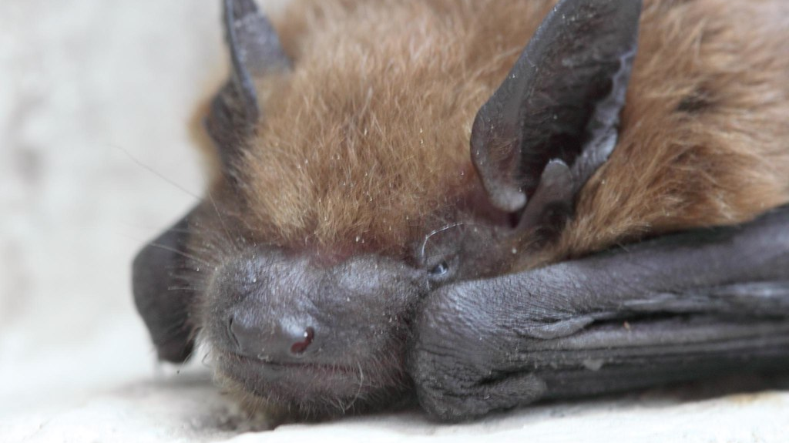

Slide 6


