Slide 1


Slide 2
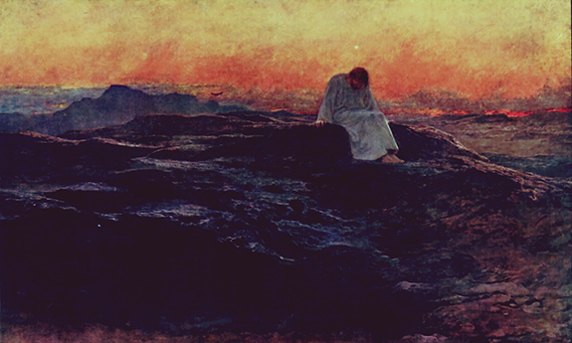

Slide 3
Pause for thought
In your daily routine, when do you have space to stop and be still and quiet?
What is it that you need to stop doing to find opportunities for quiet stillness and peace?
Can you think of a particular location that would be a helpful ‘quiet place’ for you?
In the lead-up to Christmas, can you find time for reflection?

Slide 4


