Slide 1
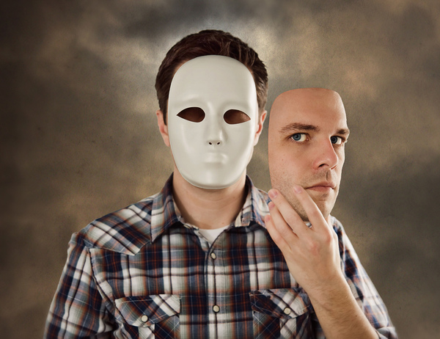
Who am I?

Slide 2
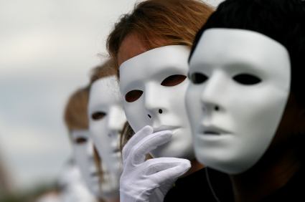
1. What does it mean to ‘wear a mask’?
2. Why might people wear a mask?

Slide 3
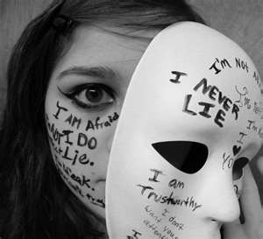
1. What does it mean to “wear a mask”?
We say that someone is ‘wearing a mask’ if they are hiding how they really feel or who they really are. They are pretending to be someone other than their true, authentic self).

Slide 4
2. Why might people wear a mask?
To fit in.
Other people’s expectations of them.
To avoid getting bullied.
To hide fear or feelings of being not good enough (low self-esteem).
As a wall to stop them getting hurt again.
Habit.
Not sure of who we really are (our authentic self).

Slide 5
How can we be more ourselves?
Removing the Masks
The first step to removing a mask is to be aware of it.
To be aware of our masks we need to have the time and space to reflect on who we really are.
How can I become more aware of the ‘real me’?

