Slide 1
Welcome

Slide 2
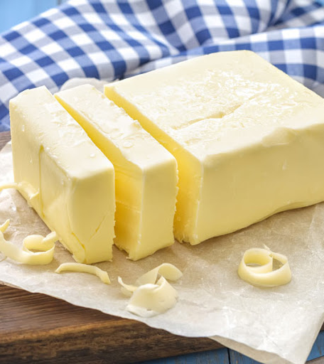
Betty Botter bought a bit of butter.
The butter Betty Botter bought was a bit bitter
And made her batter bitter.
But a bit of better butter makes better batter.
So, Betty Botter bought a bit of better butter,
Making Betty Botter’s bitter batter better.

Slide 3
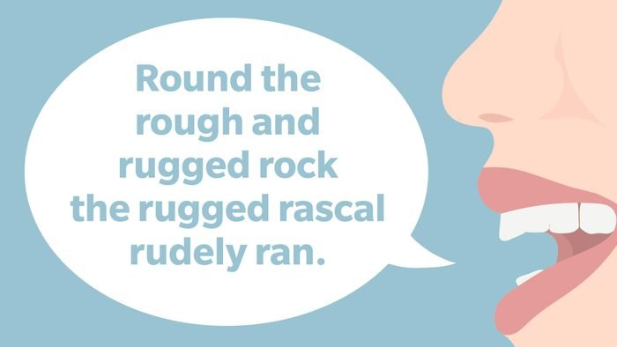

Slide 4
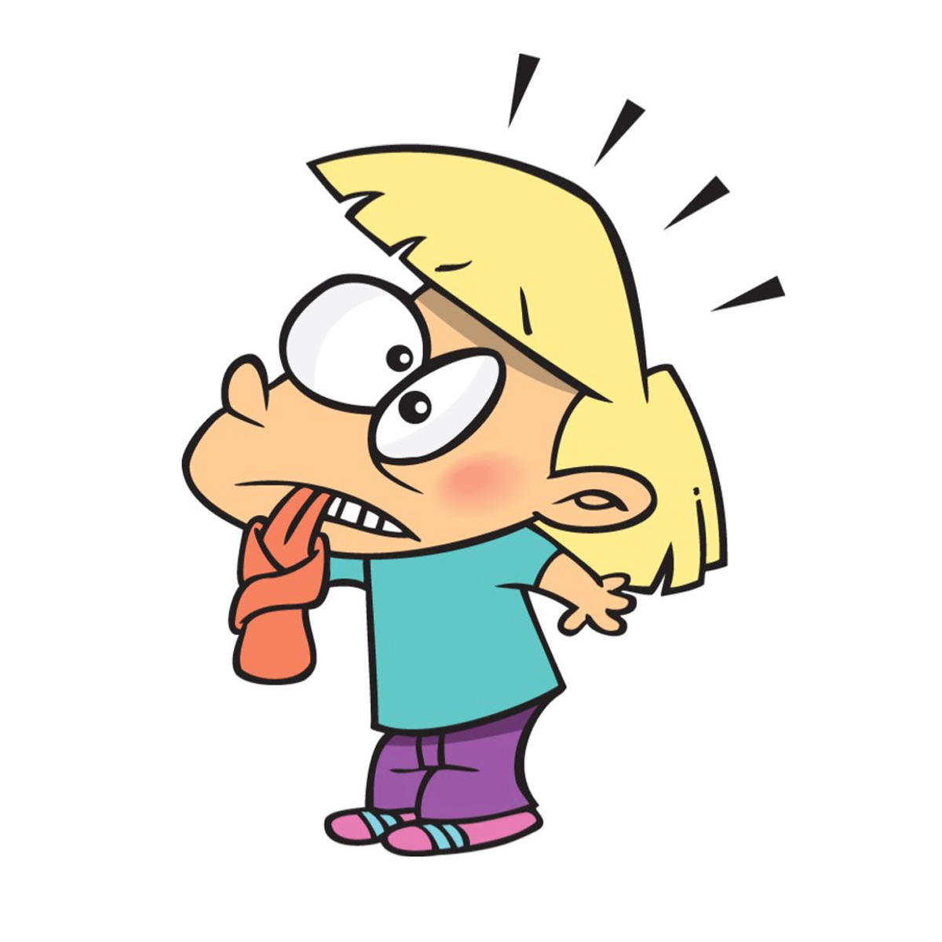
Sinful Caesar
Sipped his snifter,
Seized his knees
And sneezed.

Slide 5
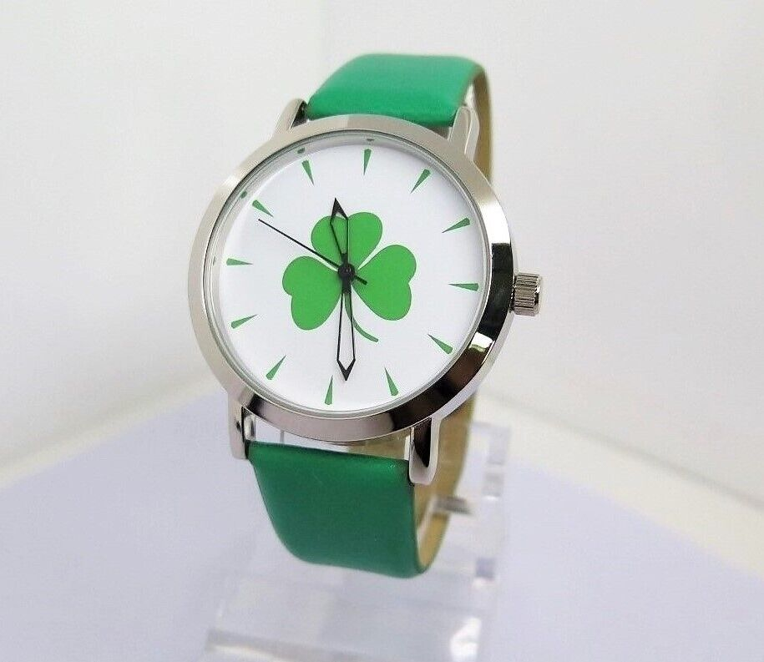
What’s this?
An Irish wristwatch

Slide 6

  ‘A cheerful heart is good medicine, but a crushed spirit dries up the bones.’
  Proverbs 17.22
  ‘Our mouths were filled with laughter, our tongues with songs of joy . . . the Lord has done great things for us, and we are filled with joy.’
  Psalm 126.2–3

