Slide 1
Welcome

Slide 2


Slide 3
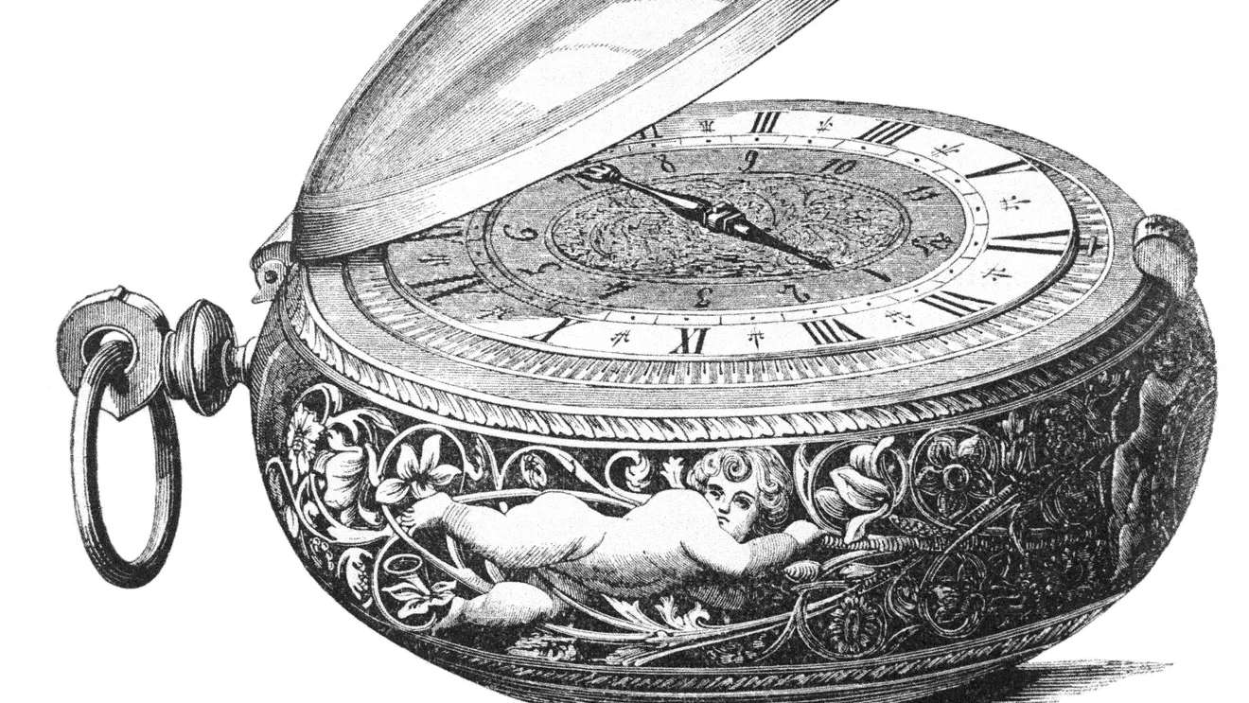

Slide 4
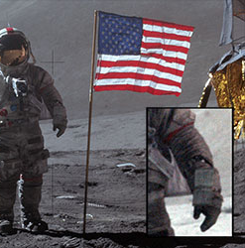


Slide 5

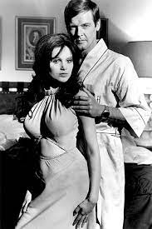

Slide 6


Slide 7
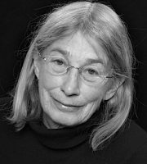
Doesn’t everything die at last, and too soon?
Tell me, what is it you plan to do
With your one wild and precious life?
From ‘The summer day’ by Mary Oliver

Slide 8
There is a time for everything,
and a season for every activity under heaven:
a time to be born and a time to die,
a time to plant and a time to uproot,
a time to kill and a time to heal,
a time to tear down and a time to build,
a time to weep and a time to laugh,
a time to mourn and a time to dance,
a time to scatter stones and a time to gather them,
a time to embrace and a time to refrain,
a time to search and a time to give up,
a time to keep and a time to throw away,
a time to tear and a time to mend,
a time to be silent and a time to speak,
a time to love and a time to hate,
a time for war and a time for peace.
Ecclesiastes 3.1–8

