Slide 1
The Queen died peacefully at Balmoral this afternoon.
Thursday 8 September 2022
Thursday, 8 September 2022

Slide 2
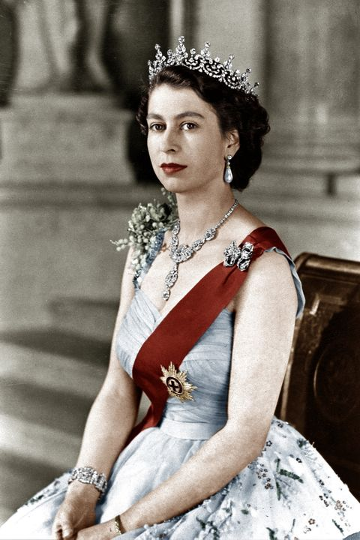
‘I declare before you all that my whole life whether it be long or short shall be devoted to your service.’

Slide 3
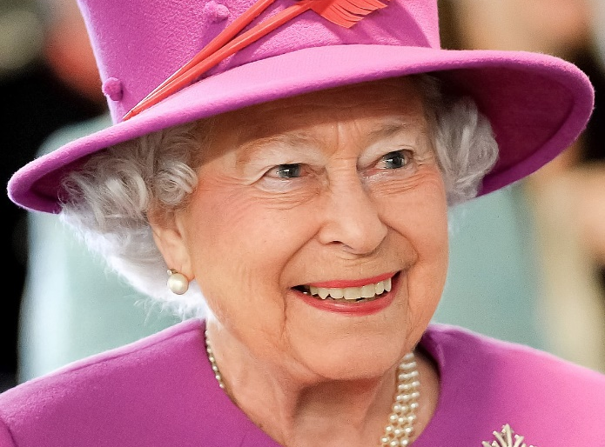

Slide 4
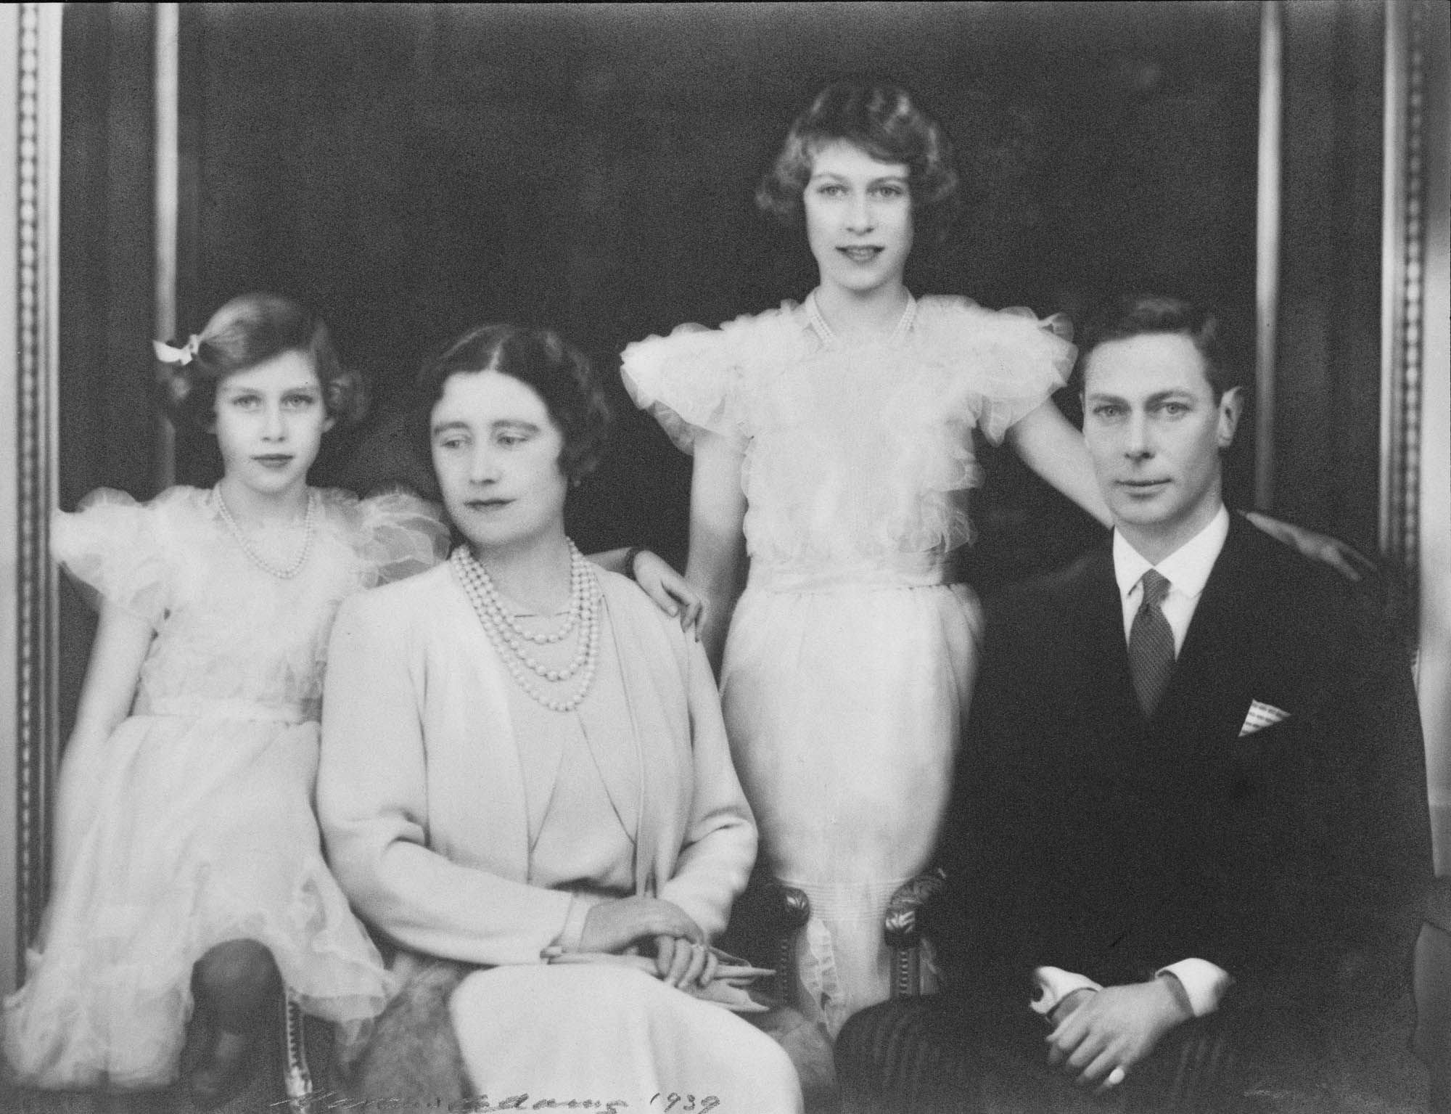

Slide 5
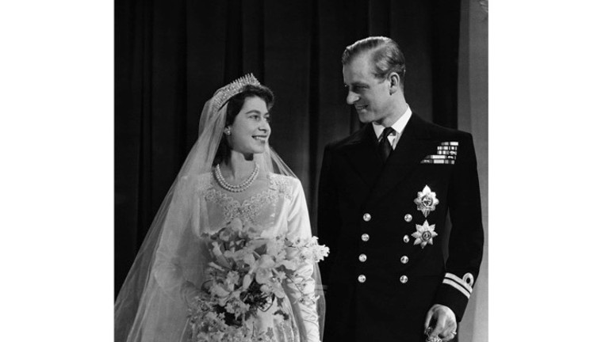

Slide 6
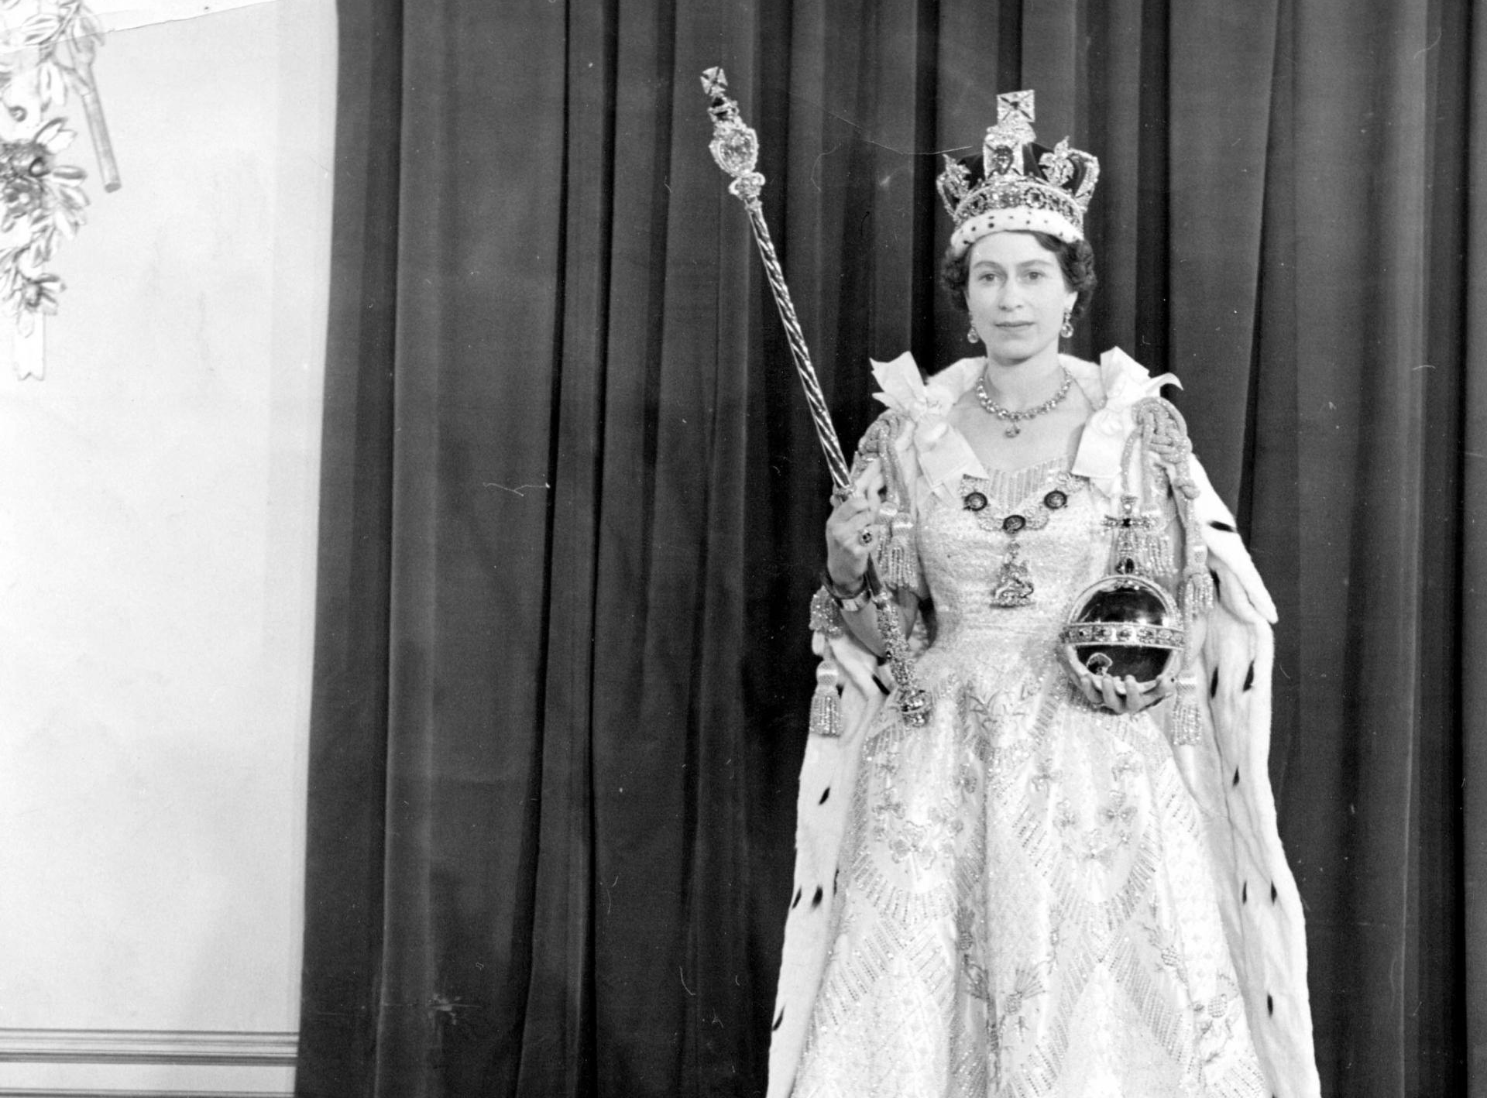

Slide 7
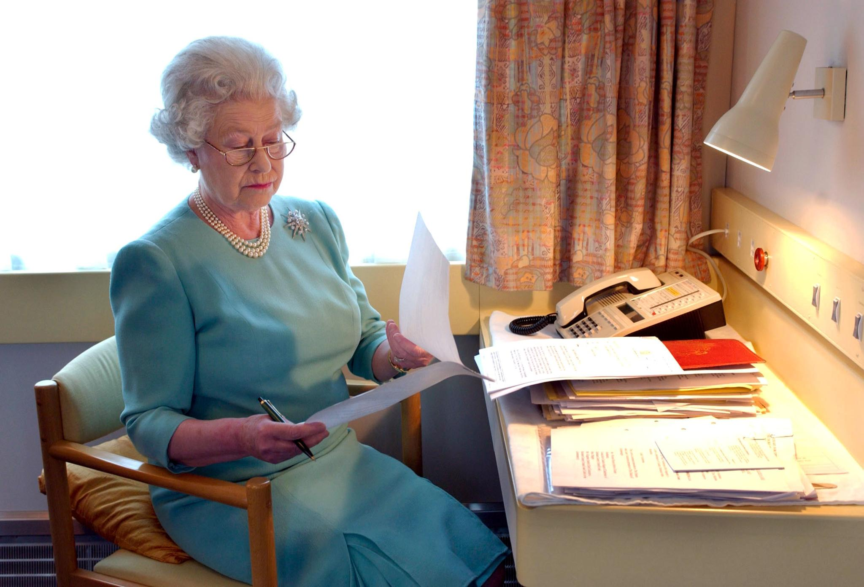

Slide 8
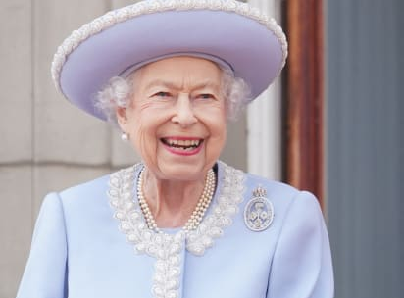

Slide 9
