Slide 1

Welcome

Slide 2

😊

Slide 3
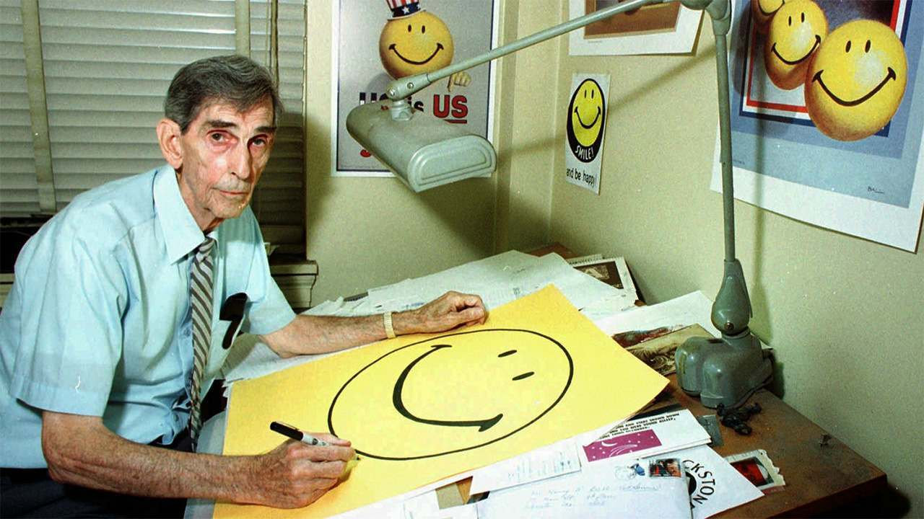

Slide 4


Slide 5

‘A cheerful look brings joy to the heart.’
(Proverbs 15.30)

