Slide 1
‘If there was only one fruit in the world, I would want it to be a . . . because . . .’

Slide 2
‘If there was only one vegetable in the world, I would want it to be a . . . because . . .’

Slide 3
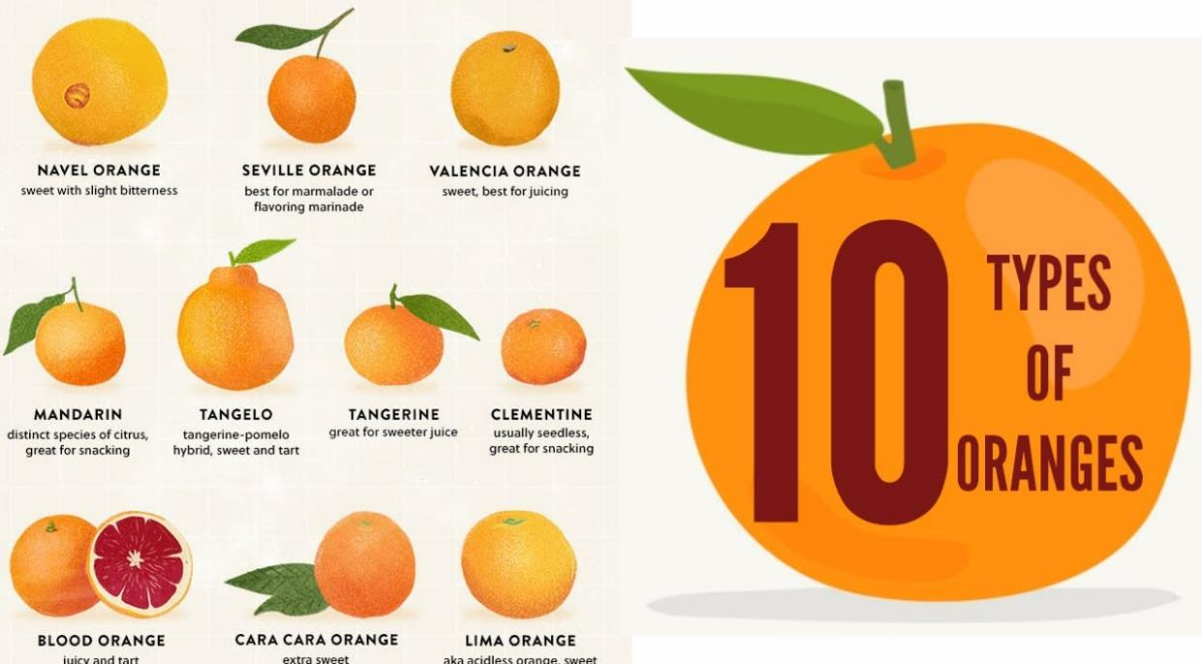

Slide 4
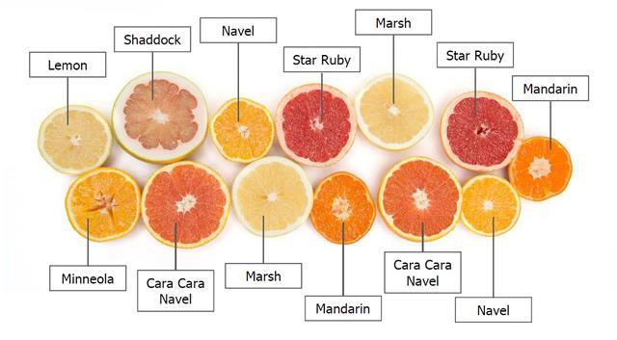

Slide 5
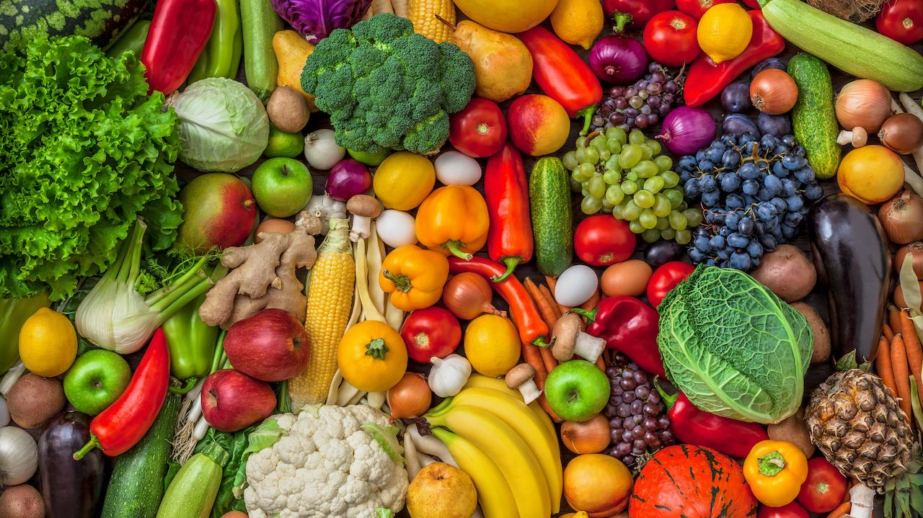

Slide 6
Song
Grapes and apples and kiwi and dates,
Oranges, bananas and plums.
Thank you for this harvest, for this harvest,
For juicy fruits, every one.
Potatoes, carrots and onions and peas,
Cauliflower, broccoli, beans.
Thank you for this harvest, for this harvest,
For vegetables, every one.
Oats and barley and rice and wheat,
Sorghum and millet and rye.
Thank you for this harvest, for this harvest,
For cereals, every one.

