Slide 1

Welcome

Slide 2


Slide 3
Contentment is a state of being at ease in both body and mind

Slide 4
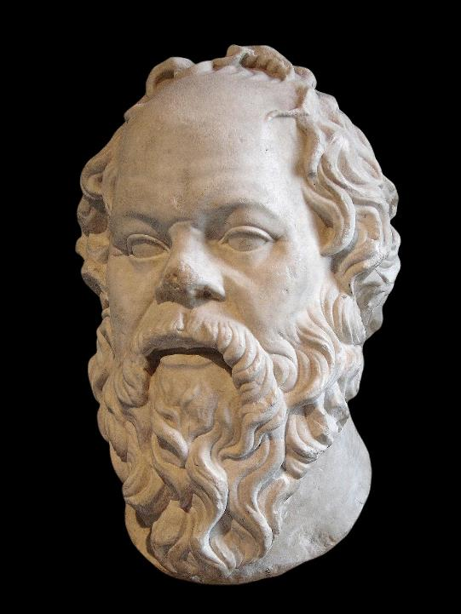
‘He who is not contented with what he has, would not be contented with what he would like to have.’
Socrates

Slide 5
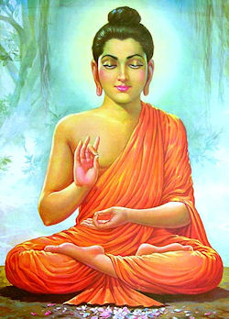
‘Health is the most precious gain and contentment, the greatest wealth.’
Siddhartha Gautama, the Buddha
‘Health is the most precious gain and contentment, the greatest wealth.’ ‘Health is the most precious gain and contentment, the greatest wealth.’
Siddhartha Gautama, the Buddha.
Siddhartha Gautama, the Buddha.

Slide 6
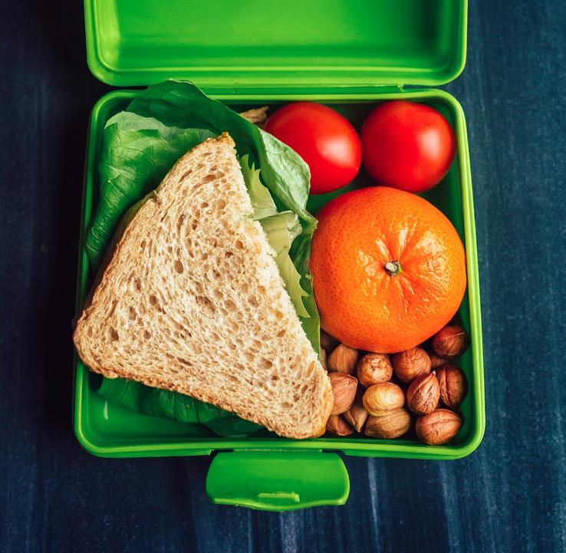
‘If we have food and clothing, with these we will be content.’
1 Timothy 6.8

