Slide 1

You Can Do Anything!

Slide 2
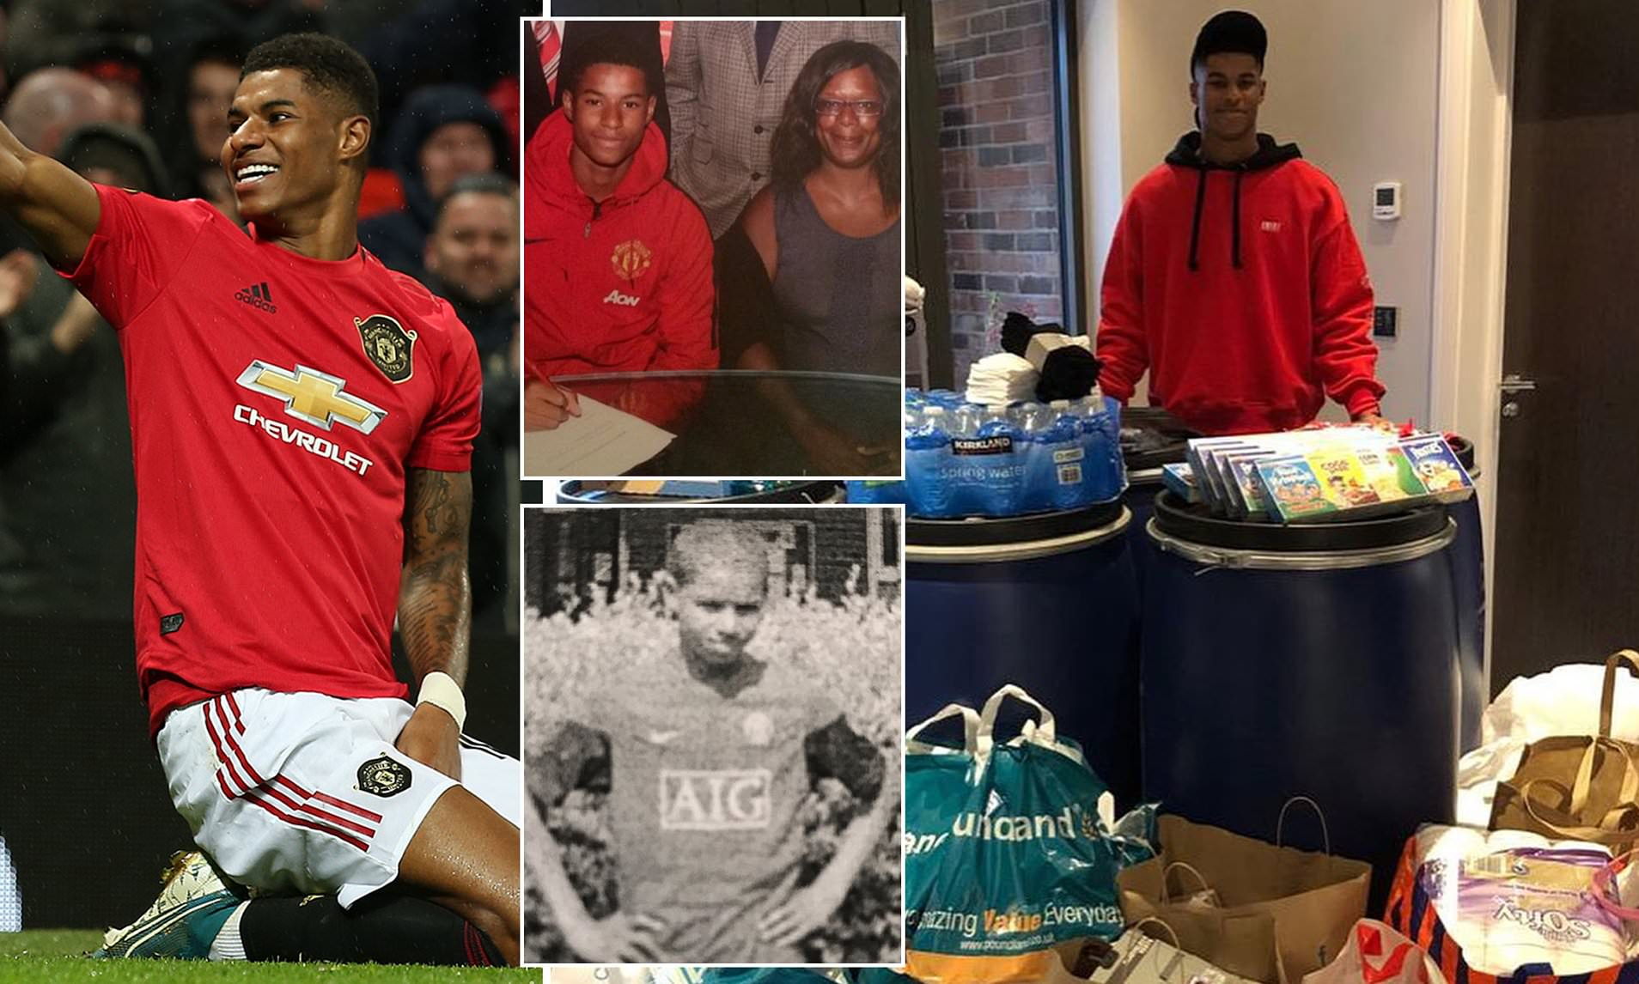
You can be . . .
a footballer
Marcus Rashford MBE

Slide 3

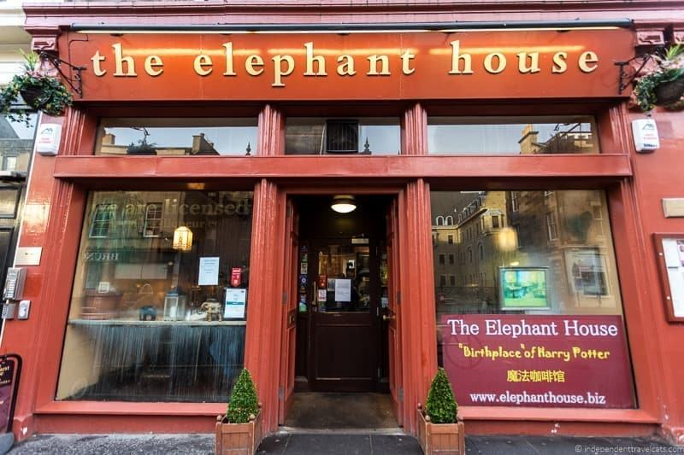
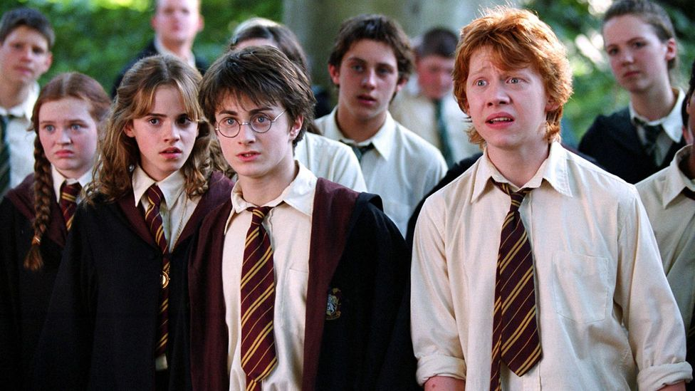
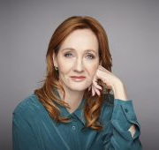
You can be . . .
an author
J.K. Rowling OBE

Slide 4
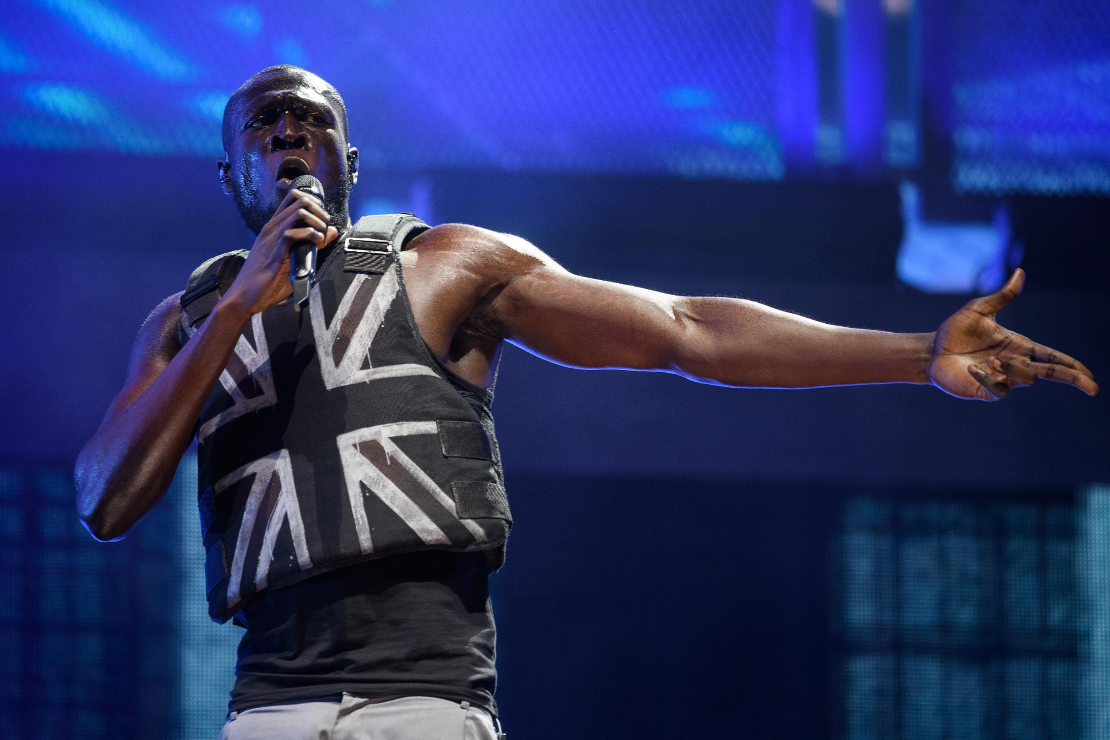
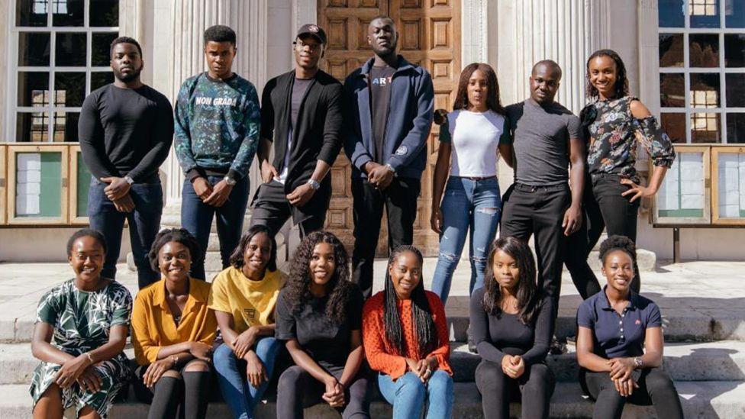
You can be . . .
a singer
Stormzy

Slide 5
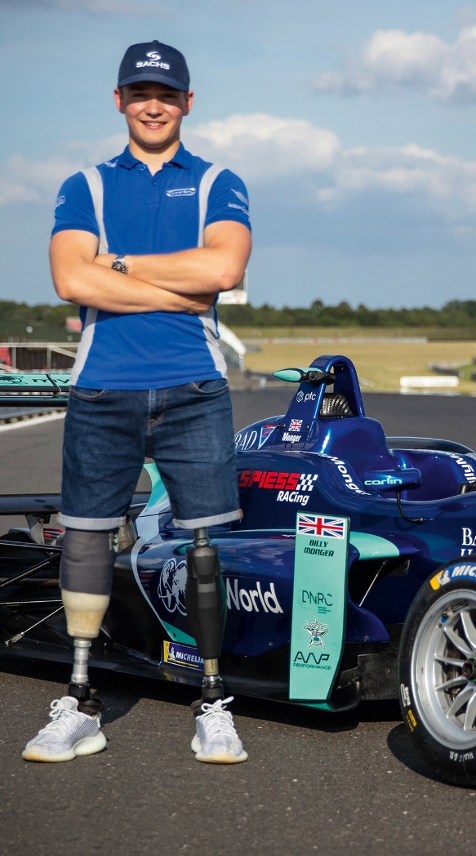
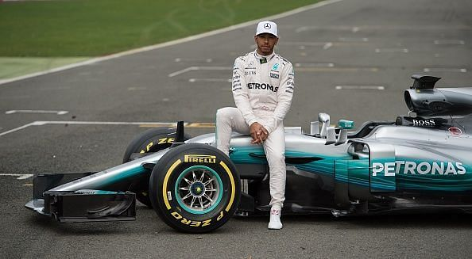
You can be . . .
a racing car driver
Sir Lewis Hamilton MBE
Billy Monger

Slide 6
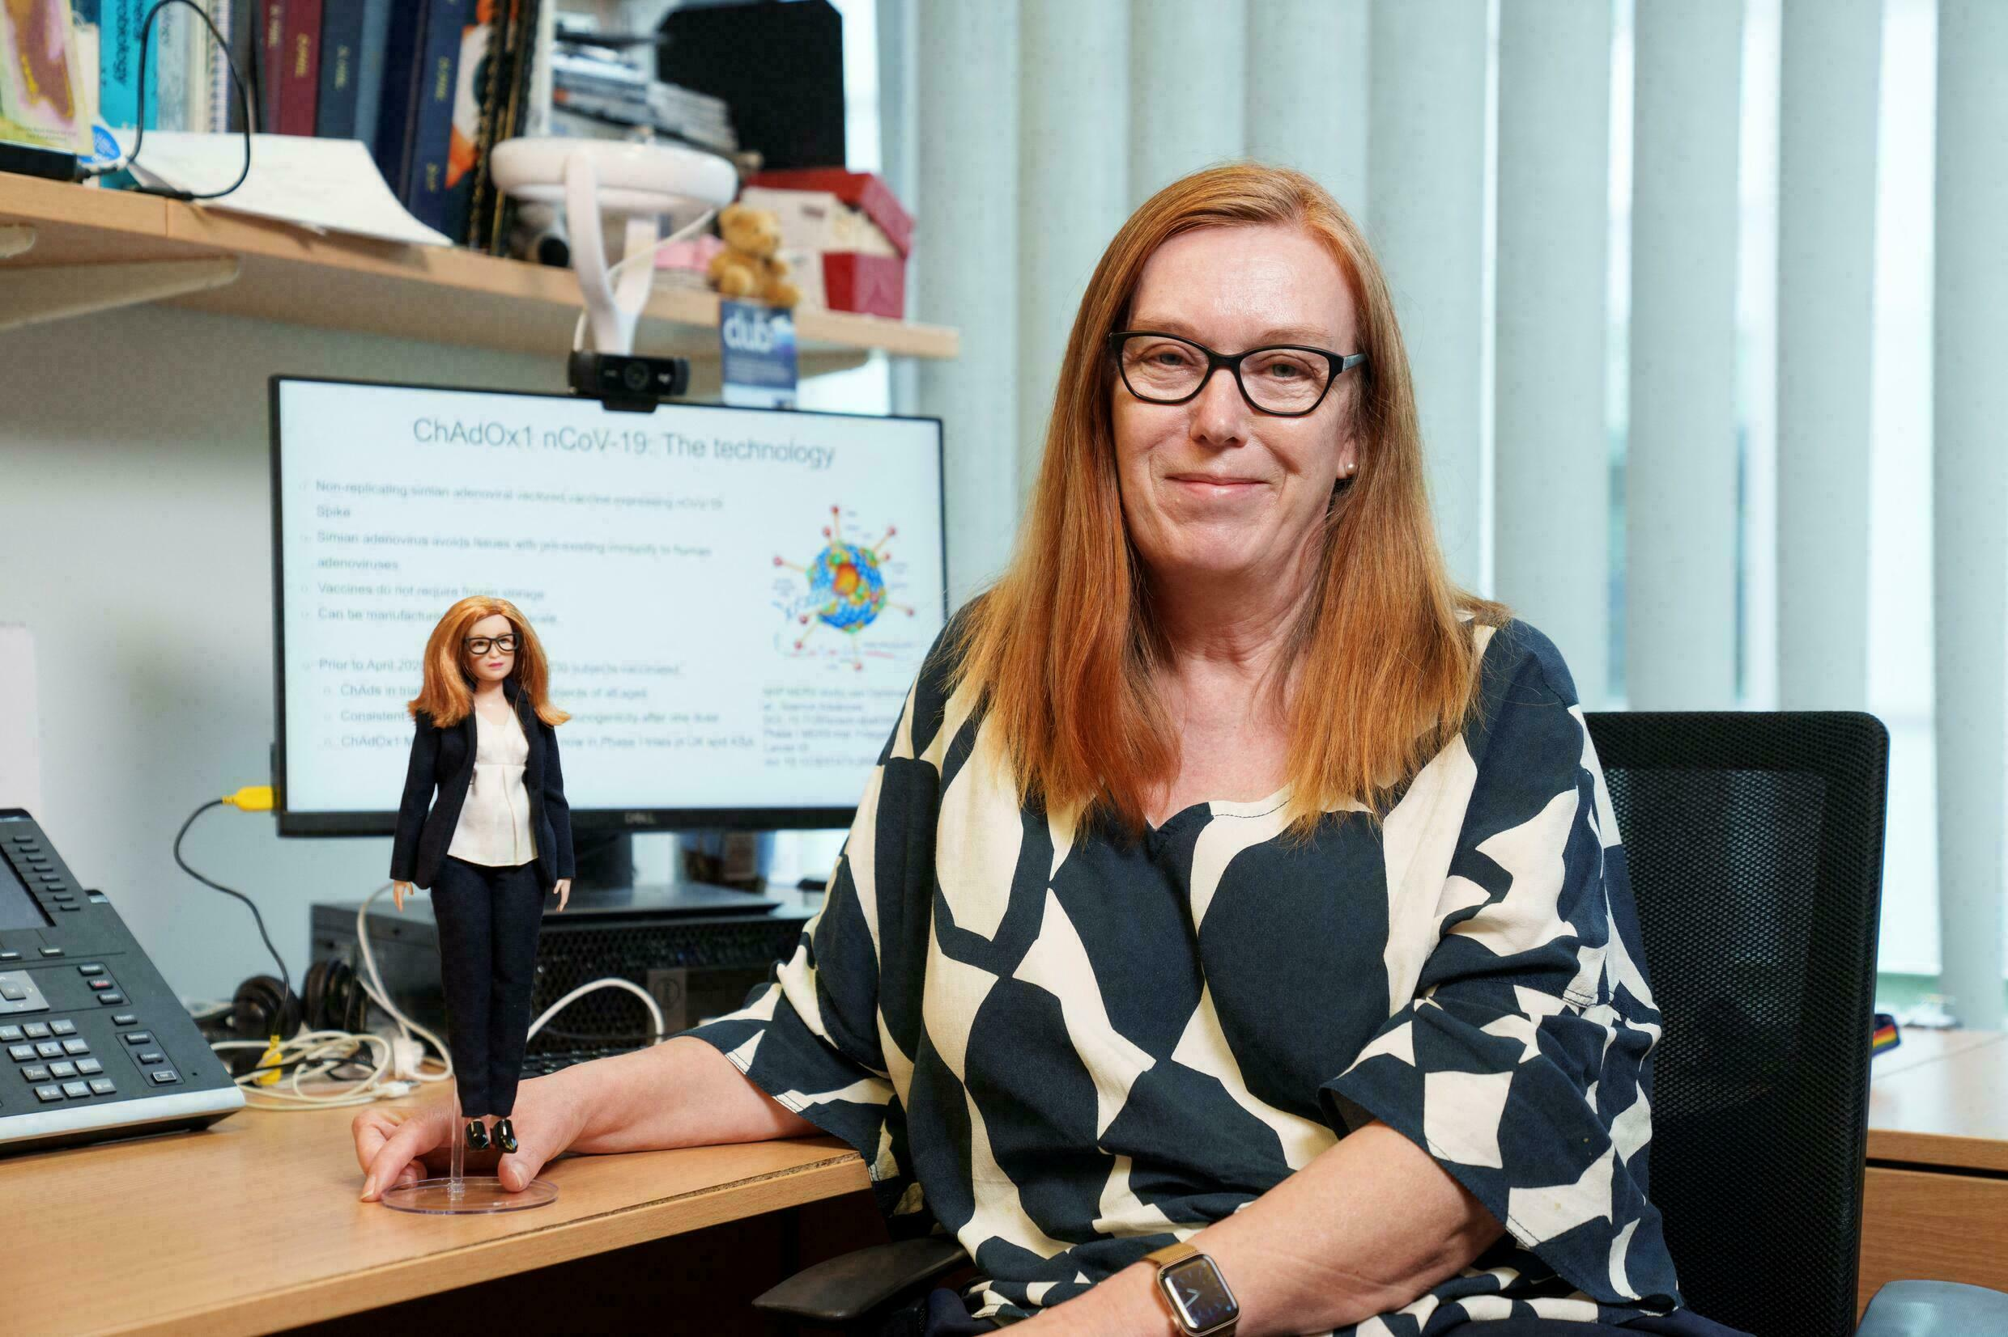
You can be . . .
a scientist
Dame Sarah Gilbert

Slide 7
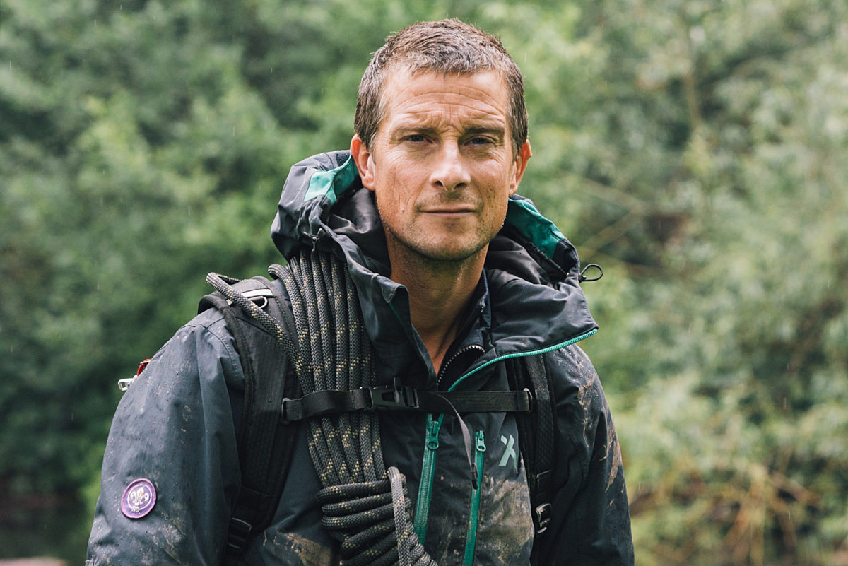
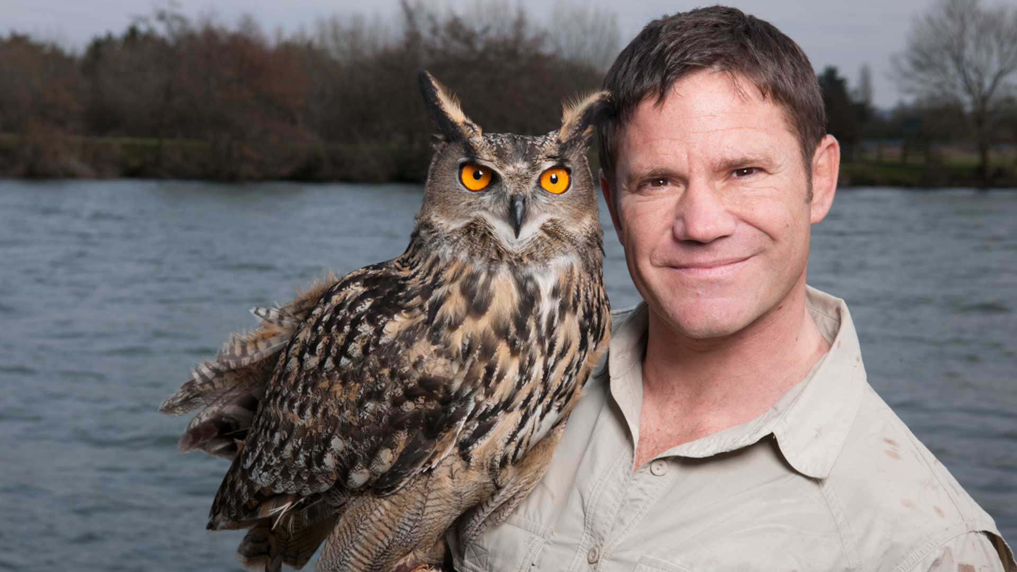
You can be . . .
an adventurer
Bear Grylls OBE
Steve Backshall MBE

Slide 8
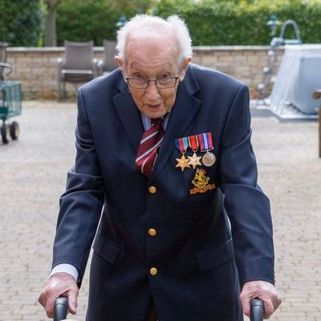
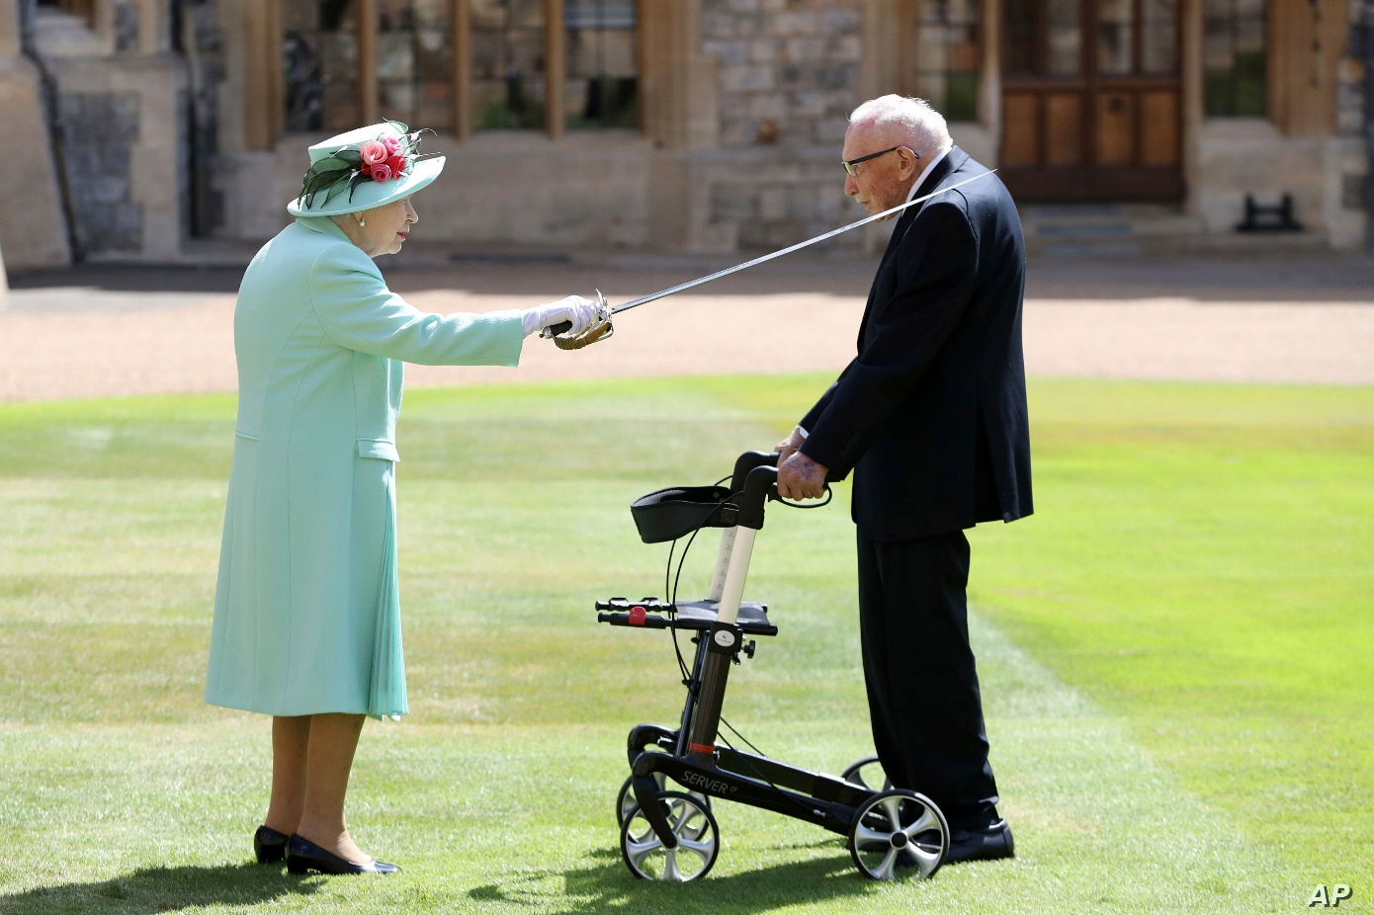
You can be . . .
a fundraiser
Captain Sir Tom Moore

Slide 9
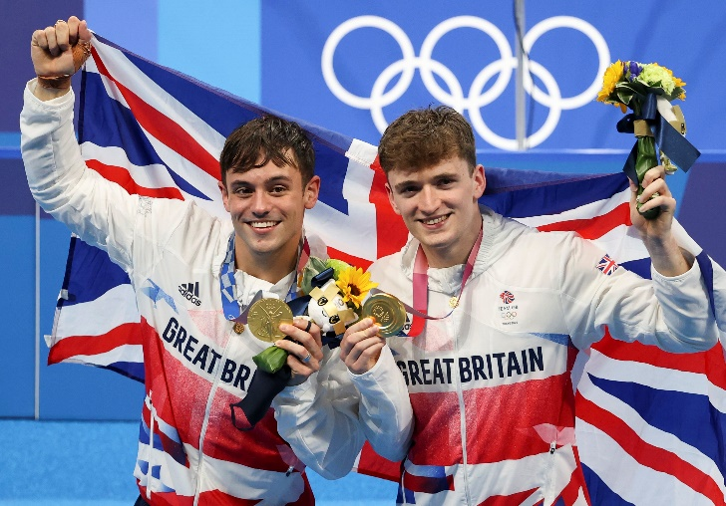
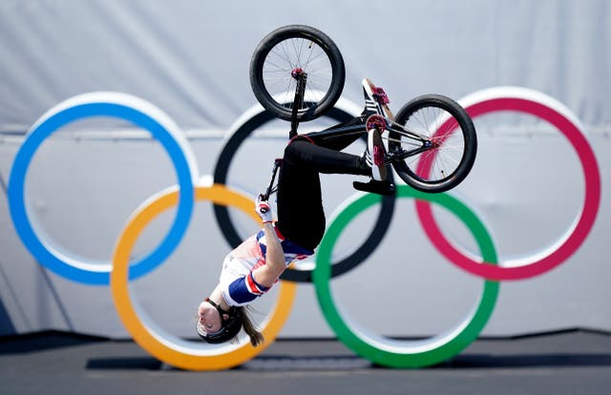
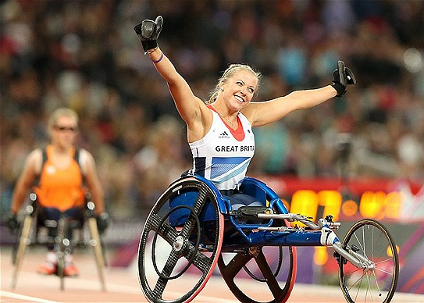
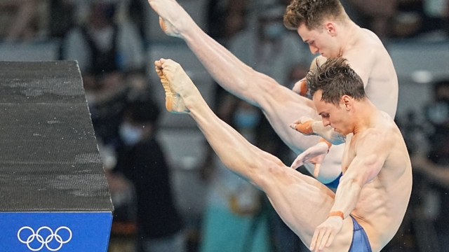
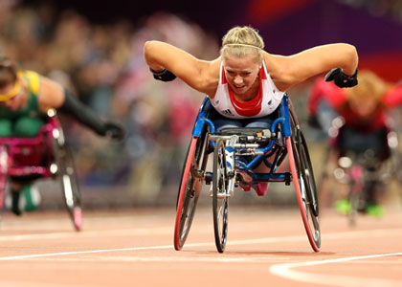
You can be . . .
an athlete
Hannah Cockroft OBE
Tom Daley OBE

Slide 10

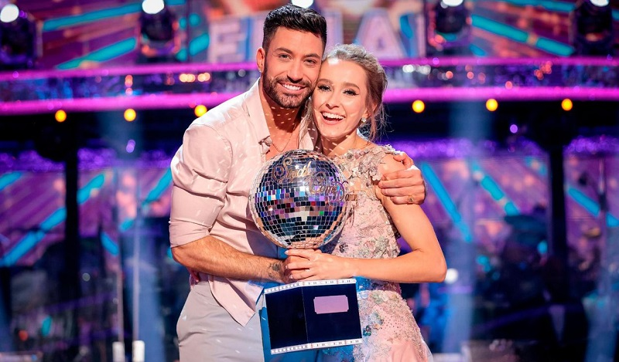
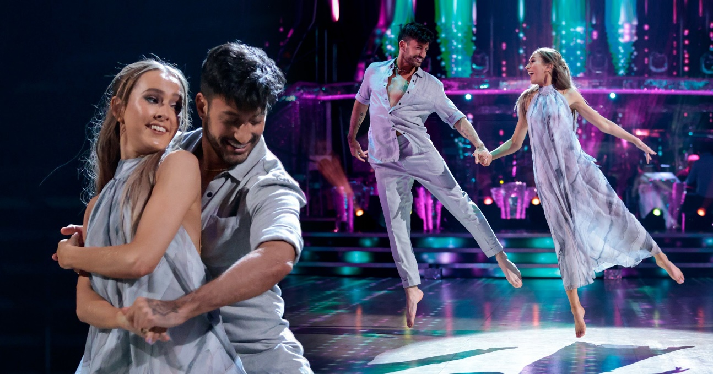
You can be . . .
an actor or
a dancer
Rose Ayling-Ellis

Slide 11
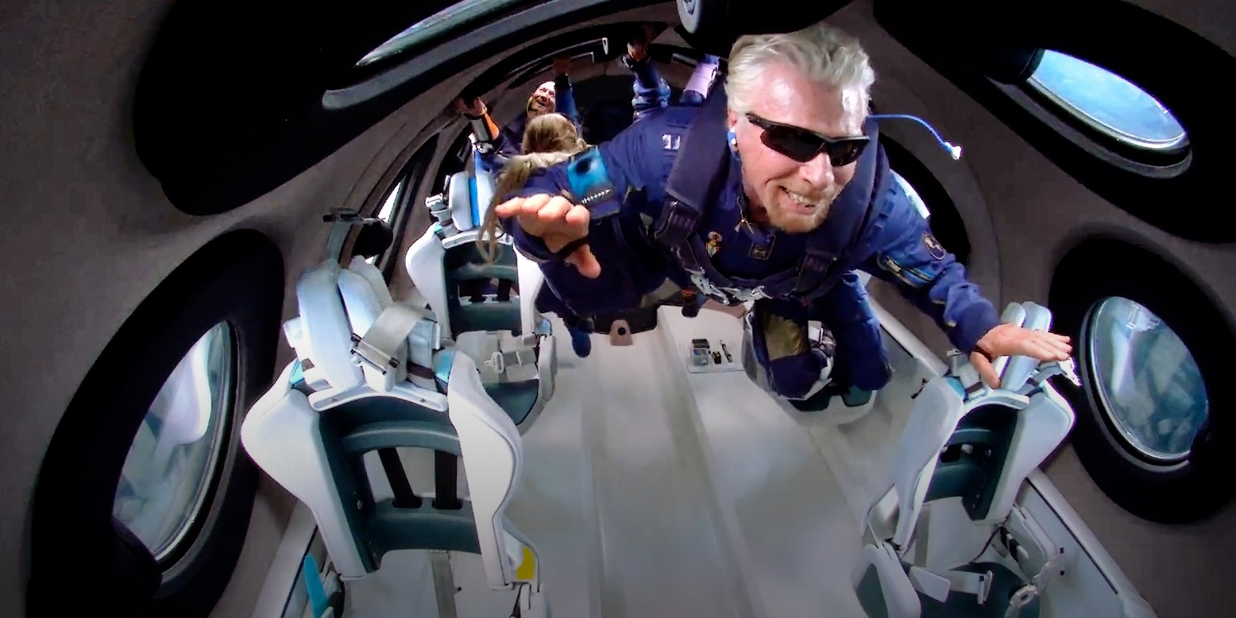
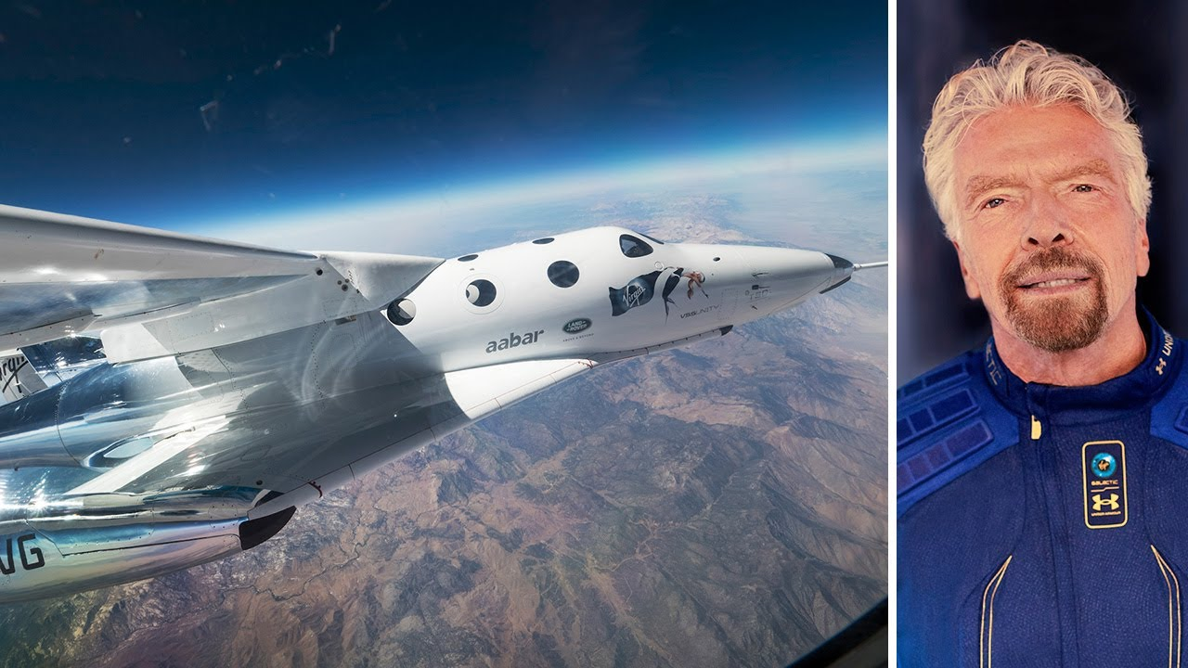
You can . . .
go into space
Sir Richard Branson

Slide 12
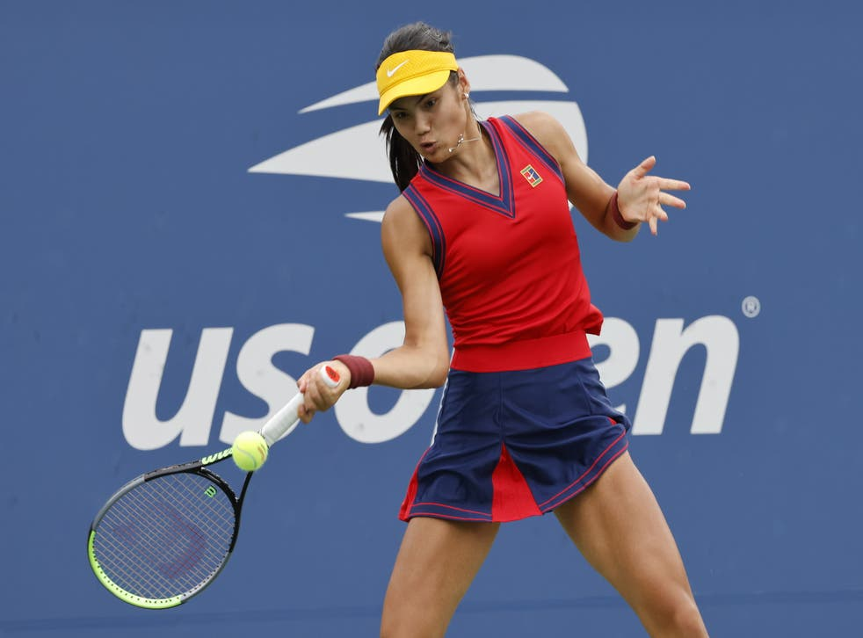
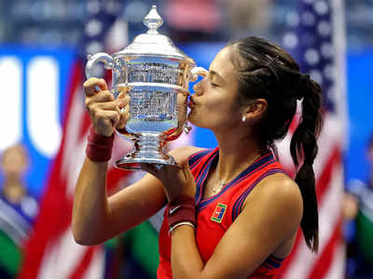
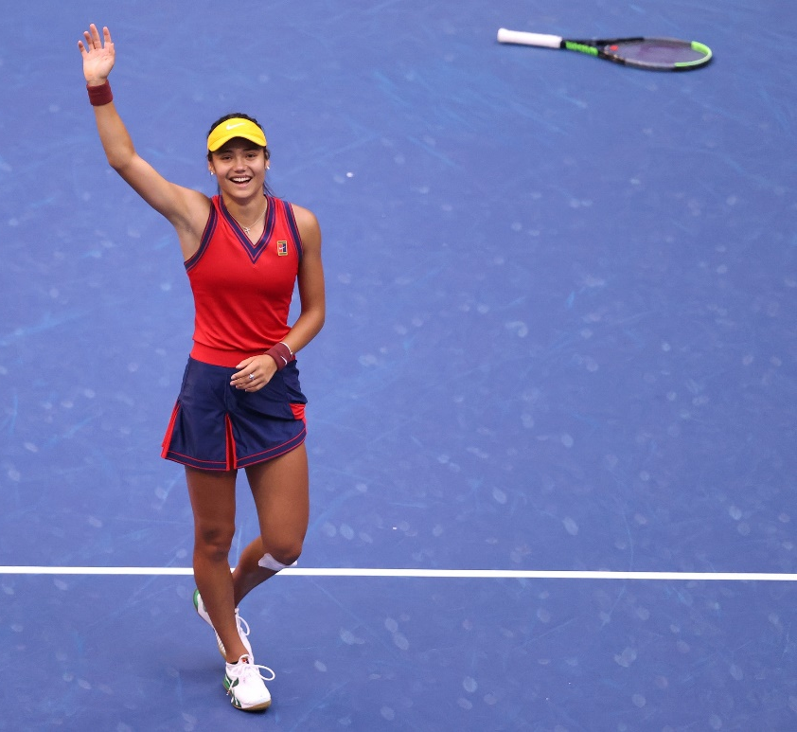
You can be . . .
a tennis champion
Emma Raducanu MBE

Slide 13

What do you think you need to achieve your ambitions?

Slide 14


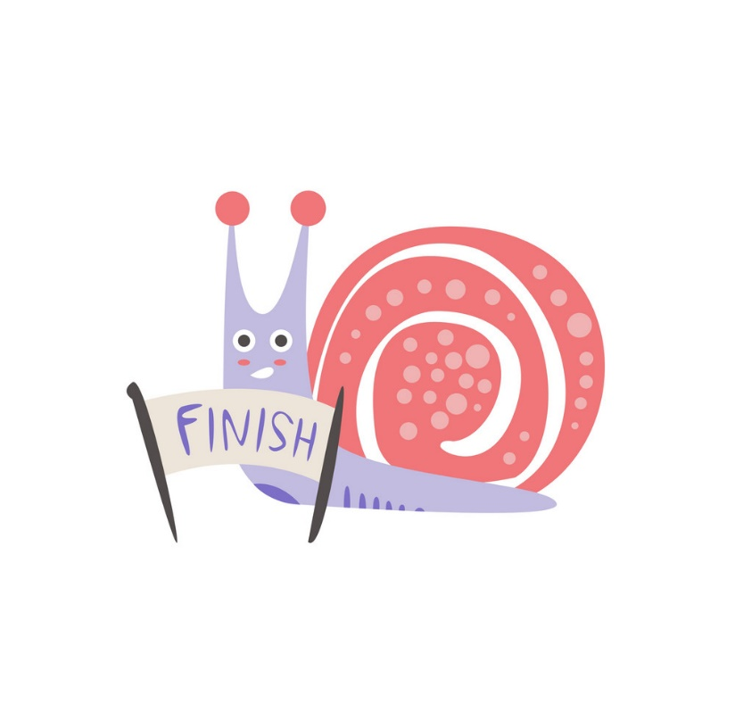
Determination to . . .

