Slide 1
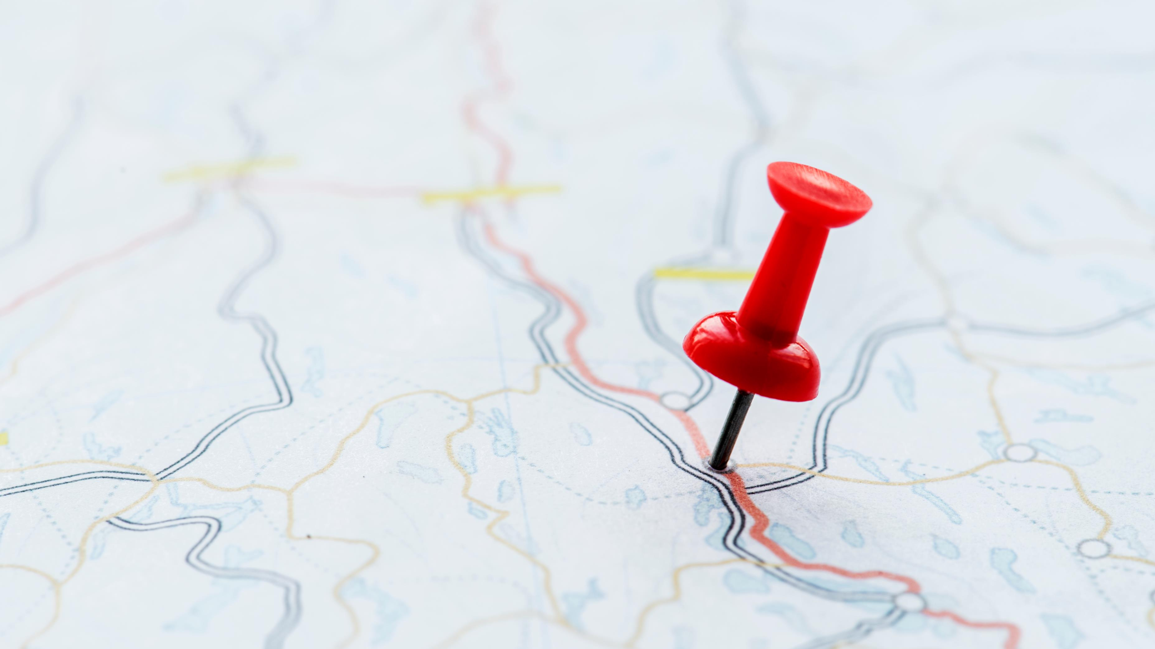
Welcome

Slide 2
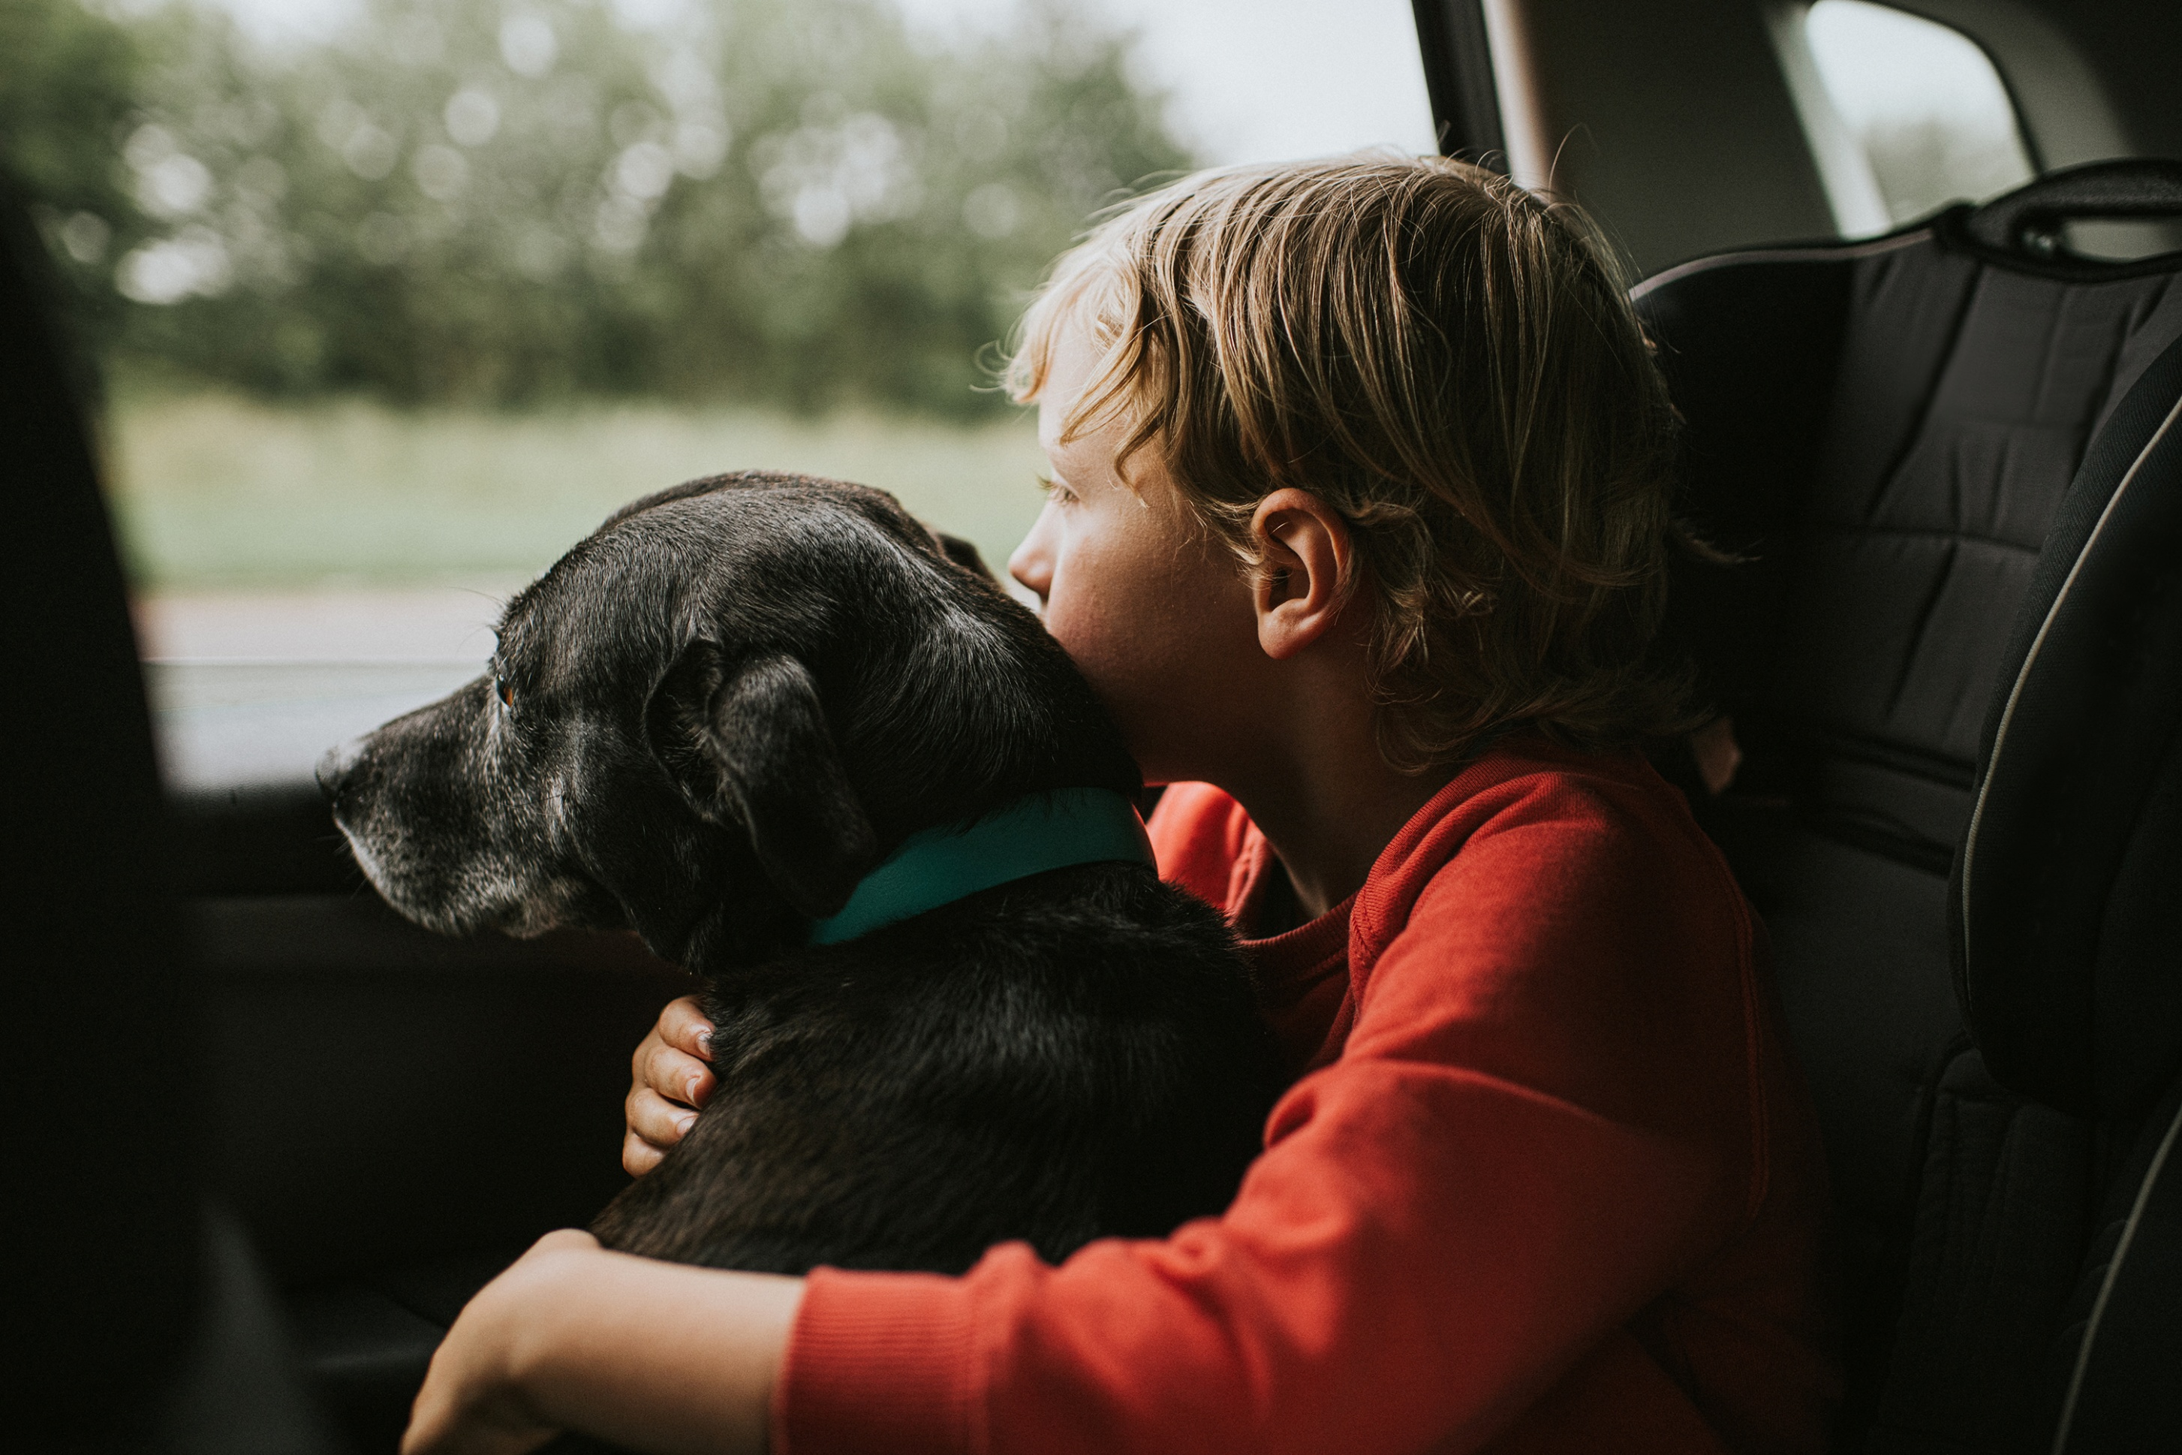

Slide 3
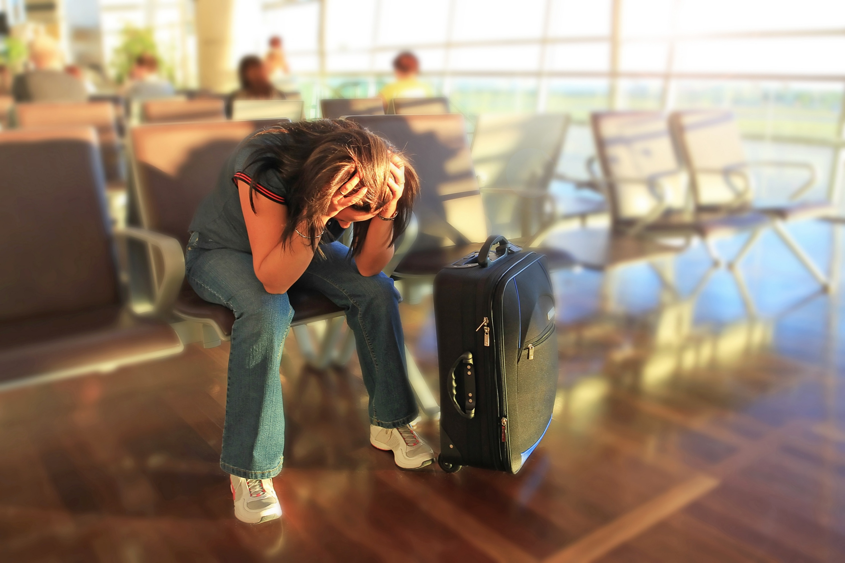

Slide 4
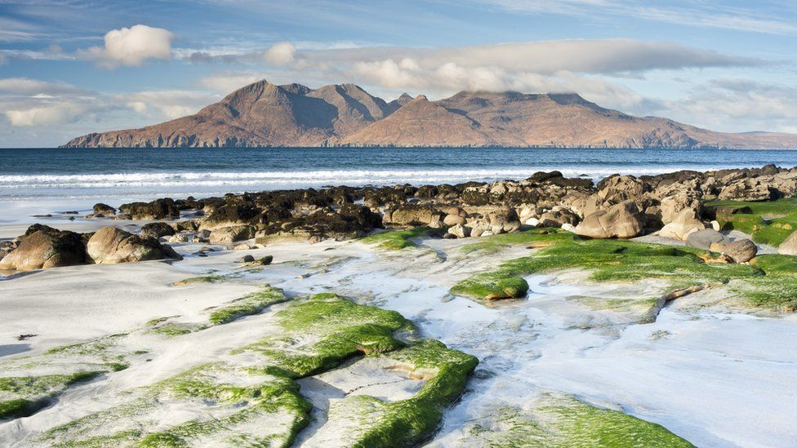

Slide 5

Life

Slide 6
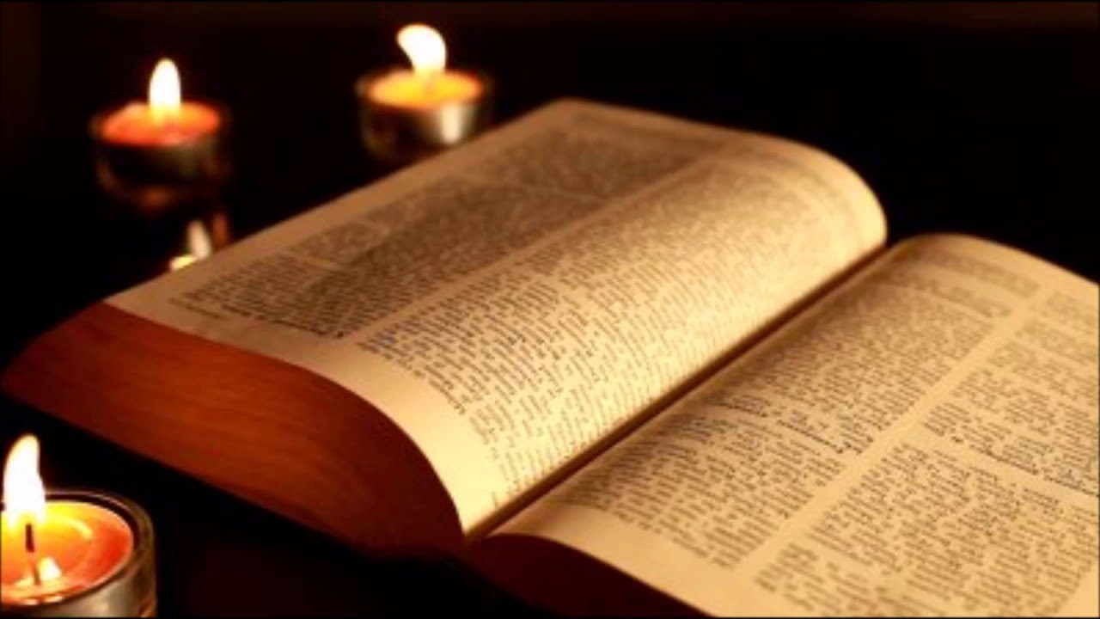
As they talked and discussed these things with each other, Jesus himself came up and walked along with them; but they were kept from recognizing him.
(Luke 24.15–16)

Slide 7
When he was at the table with them, he took bread, gave thanks, broke it and began to give it to them. Then their eyes were opened and they recognized him, and he disappeared from their sight.
(Luke 24.30–31)

Slide 8


