Slide 1
Welcome

Slide 2

Canada

Slide 3

Ghana

Slide 4

Pakistan

Slide 5

Wales

Slide 6

Sri Lanka

Slide 7


Slide 8


Slide 9


Slide 10


Slide 11
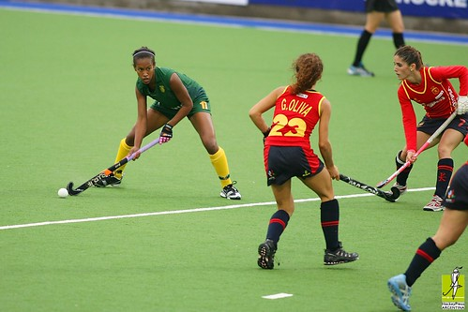

Slide 12


Slide 13


Slide 14


Slide 15


Slide 16


Slide 17


Slide 18


