Slide 1
Welcome

Slide 2


Slide 3
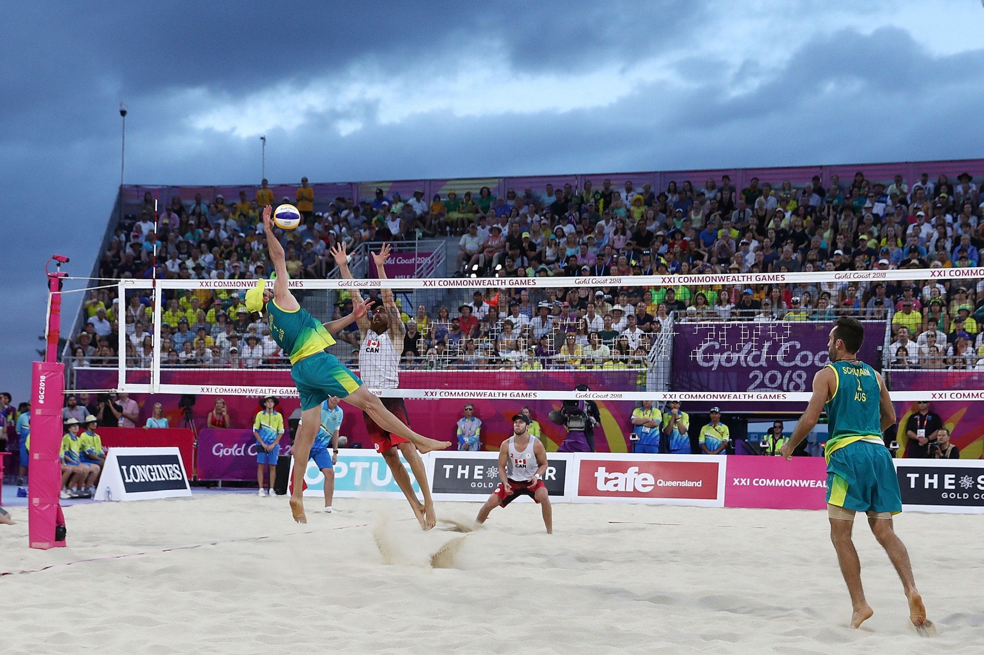

Slide 4
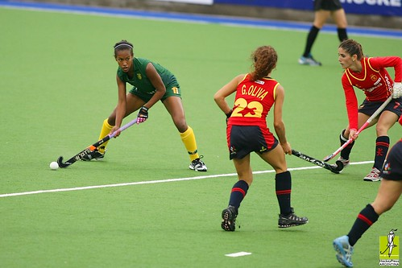

Slide 5


Slide 6


Slide 7


Slide 8


Slide 9

Canada

Slide 10

Ghana

Slide 11

Pakistan

Slide 12

Cyprus

Slide 13

Sri Lanka

