Slide 1
Who wants to volunteer to help me…..?

Slide 2


Slide 3

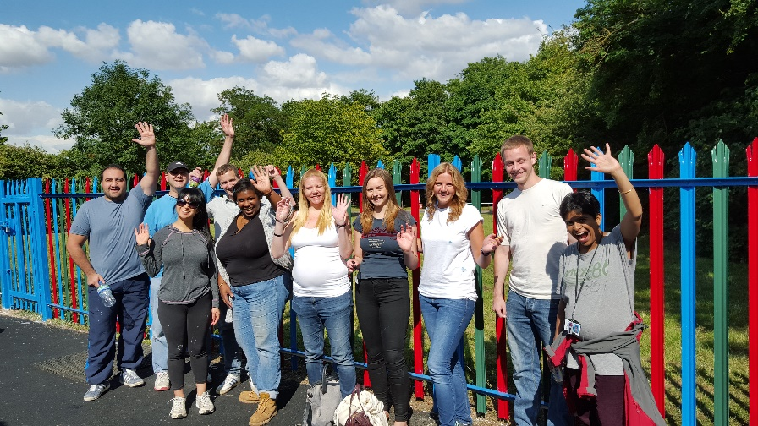
Any activity which involves spending time, unpaid, doing something which aims to benefit someone (individuals or groups) other than or in addition to close relatives, or to benefit the environment.

