Slide 1
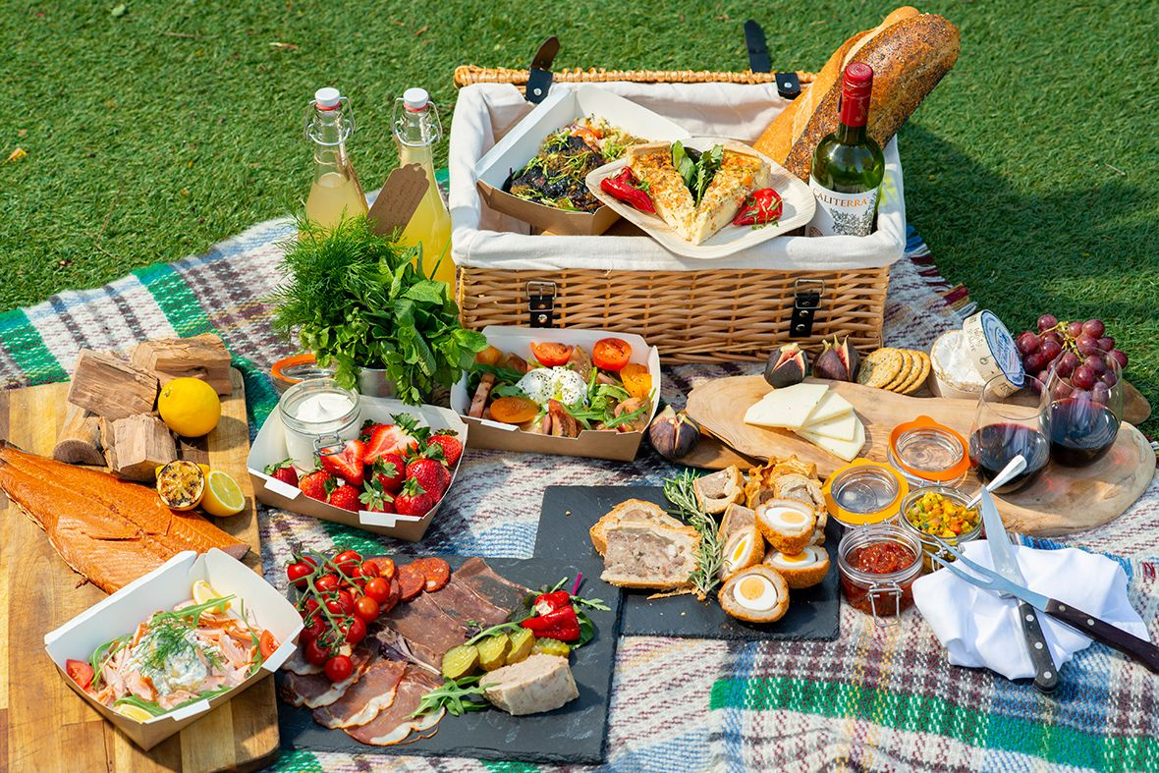

Slide 2


Slide 3
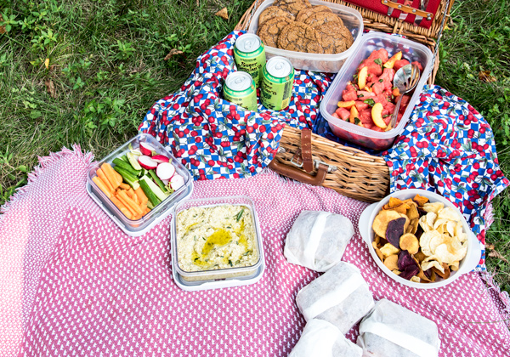

Slide 4
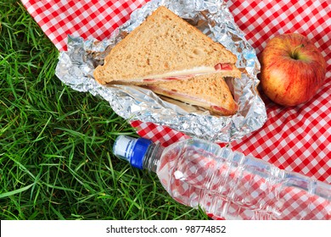

Slide 5


Slide 6


Slide 7
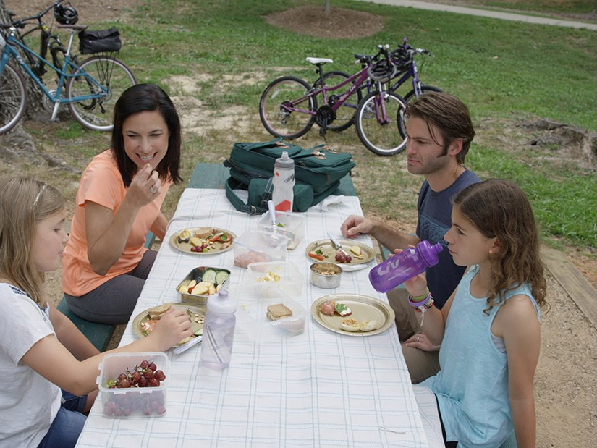

Slide 8
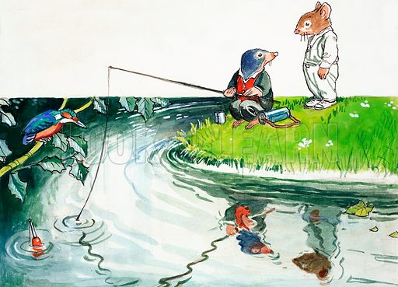



Slide 9
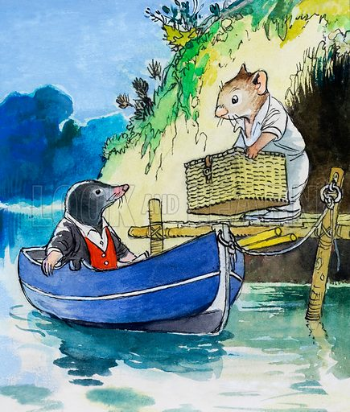
‘There’s cold chicken inside it,’ replied the Rat briefly;
‘coldtonguecoldhamcoldbeefpickledgherkinssaladfrenchrollscresssandwichespottedmeatgingerbeerlemonadesodawater—-’

Slide 10
‘There’s cold chicken inside it,’ replied the Rat briefly;
‘cold tongue, cold ham, cold beef, pickled gherkins, salad, French rolls, cress sandwiches, potted meat, ginger beer, lemonade, soda water—-’

