Slide 1

Who is by our side to help us out?

Slide 2


Who is by your side at home and
helping you?

Slide 3
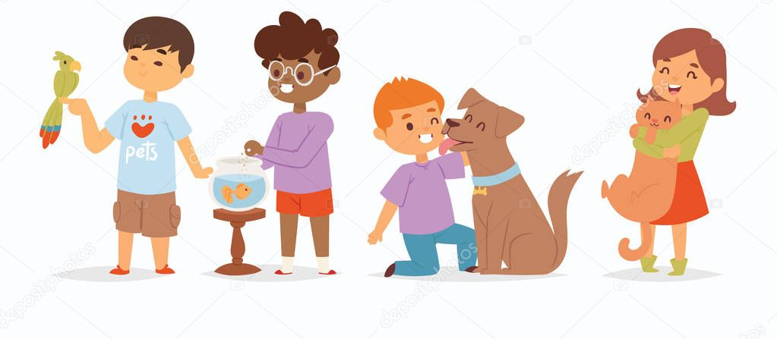
Who is helping who in this picture?

Slide 4
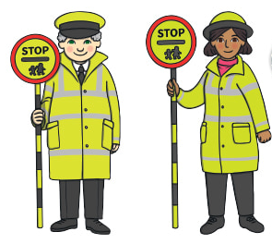
Who helps you when you cross the road?

Slide 5

Who is by your side in the classroom?

Slide 6

Who is by your side in the playground?
Can you help each other?

Slide 7

Who is by your side when you play sport?

Slide 8
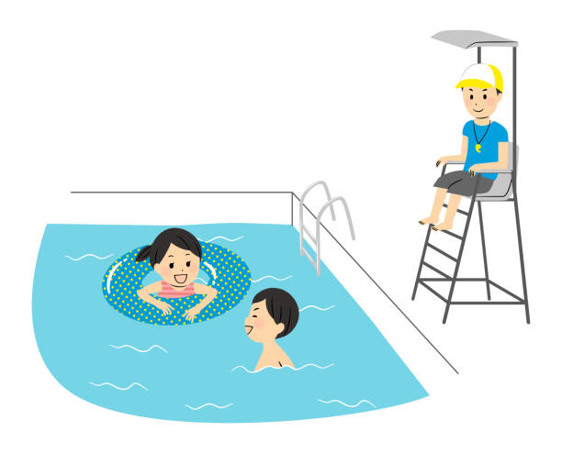
Who helps you in the swimming pool?

Slide 9

Who is by your side in an emergency?

