Slide 1
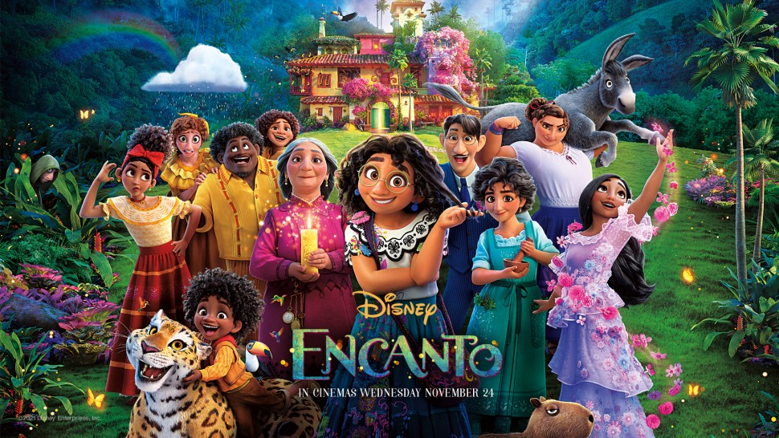
What are our gifts?

Slide 2
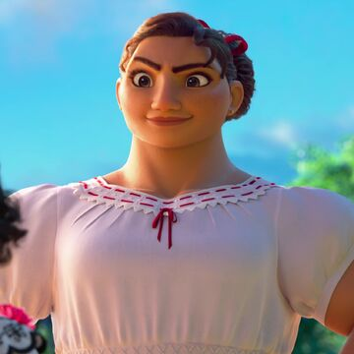
Luisa’s magical gift is . . .

Slide 3
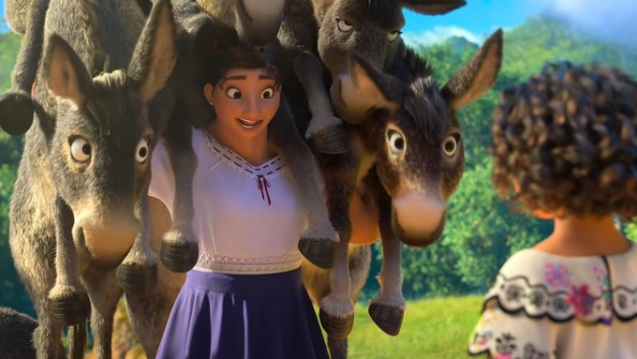
Superhuman strength

Slide 4
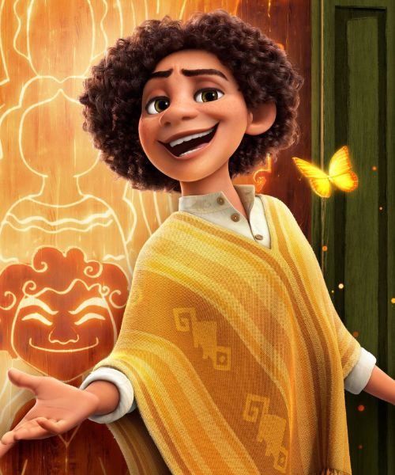
Camilo’s magical gift is . . .

Slide 5
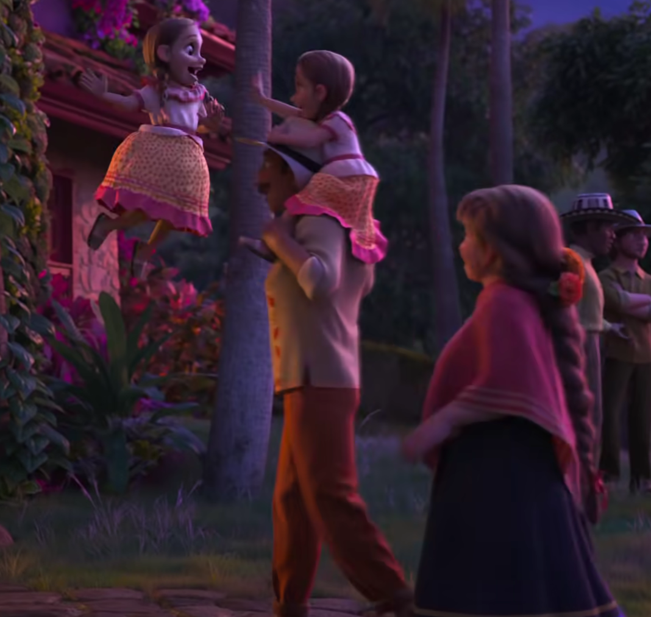
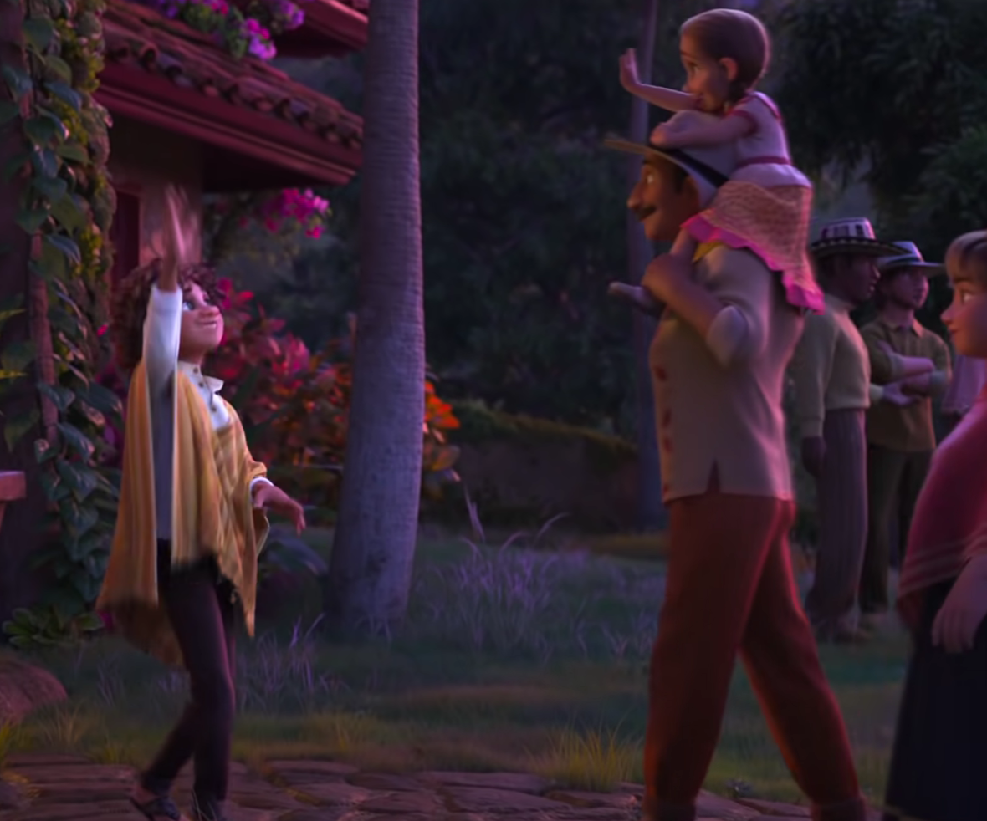
Changing his appearance

Slide 6
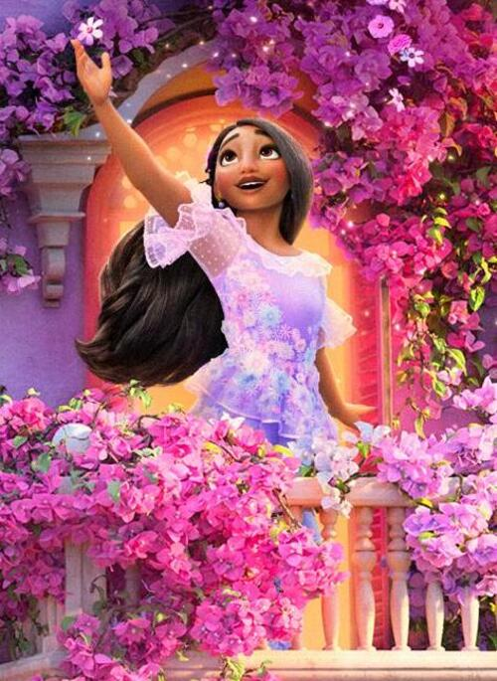
Isabela’s magical gift is . . .

Slide 7
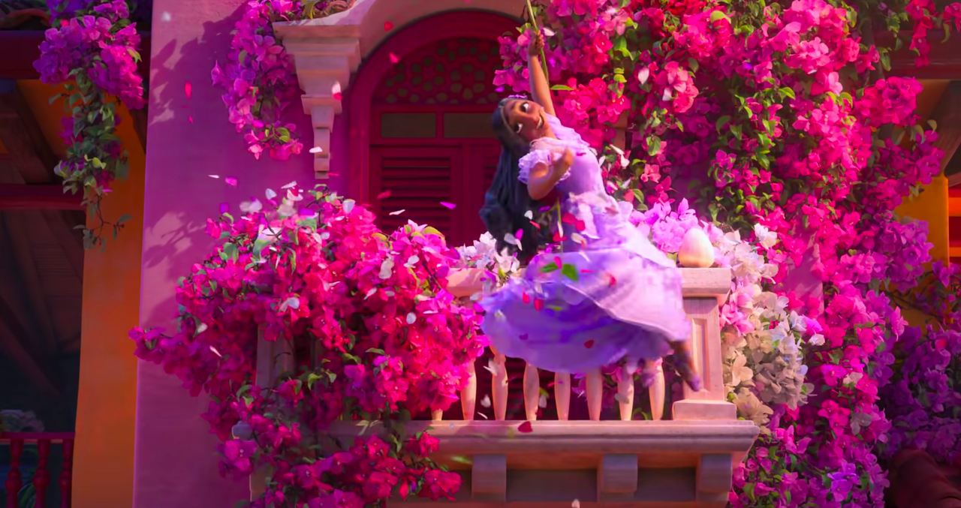
Making flowers grow
from nothing

Slide 8
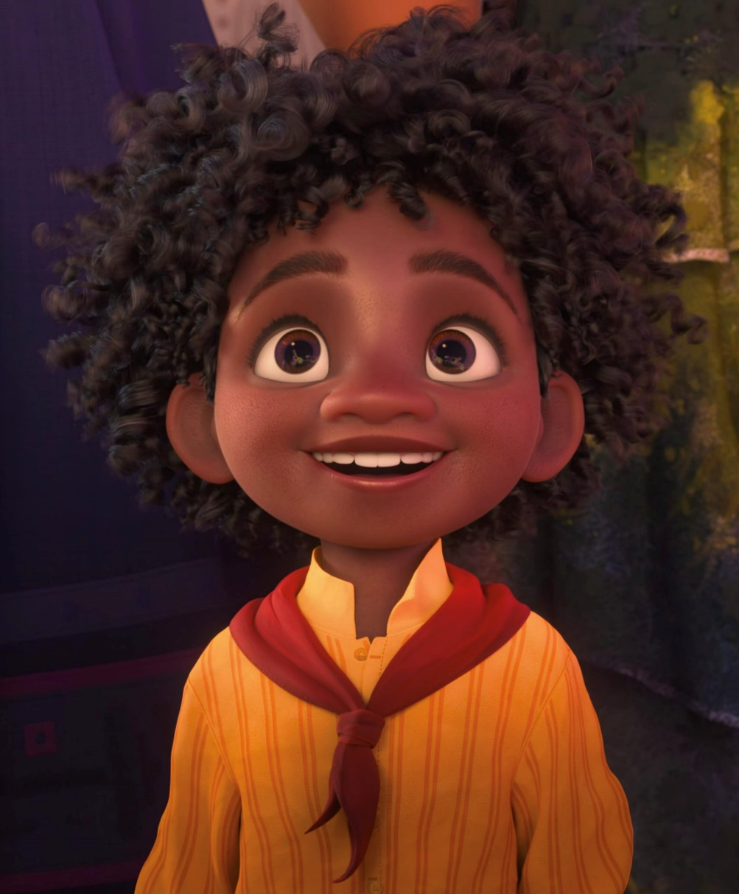
Antonio’s magical gift is . . .

Slide 9

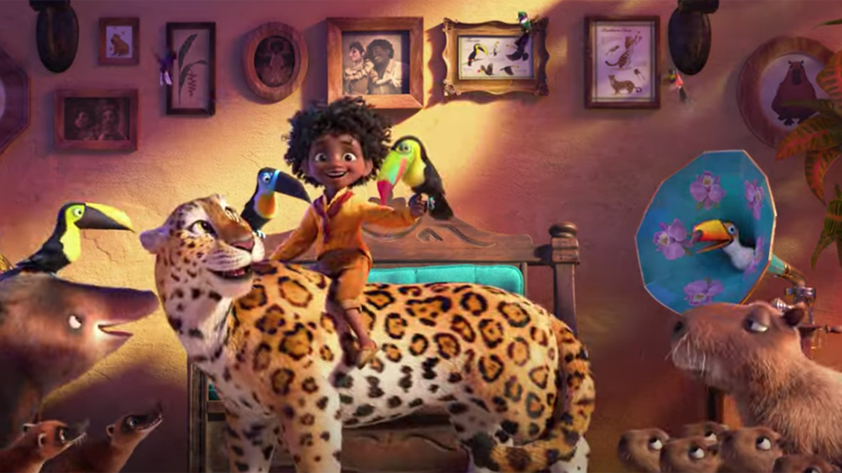
Talking to animals

Slide 10
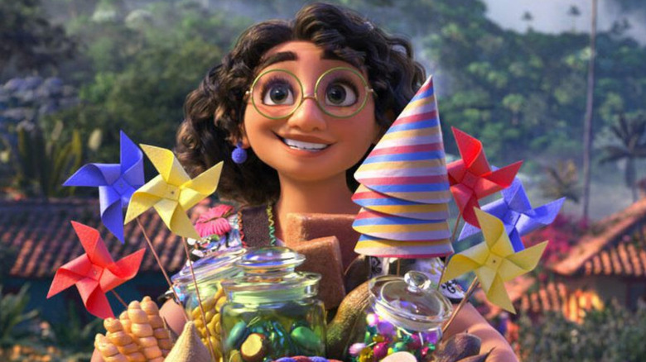

However, Mirabel has no gift . . .
Or does she?

Slide 11
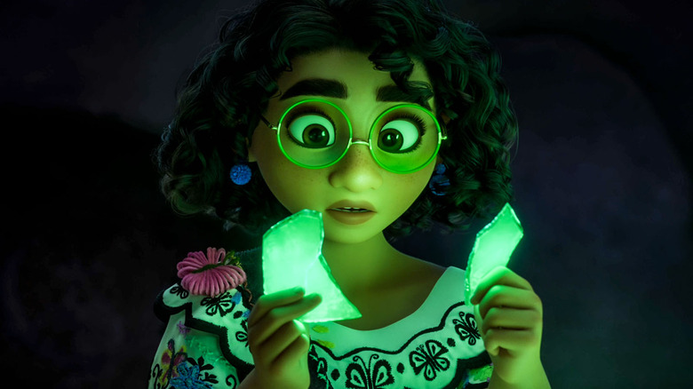
Mirabel doesn’t have a magical gift,
but she does have the gift of . . .

Slide 12
Supporting her family
Determination
Friendliness
Solving problems
Self-
confidence
An optimistic
outlook
Understanding and
having empathy
Helping
others
Saving the
day!

