Slide 1


Slide 2
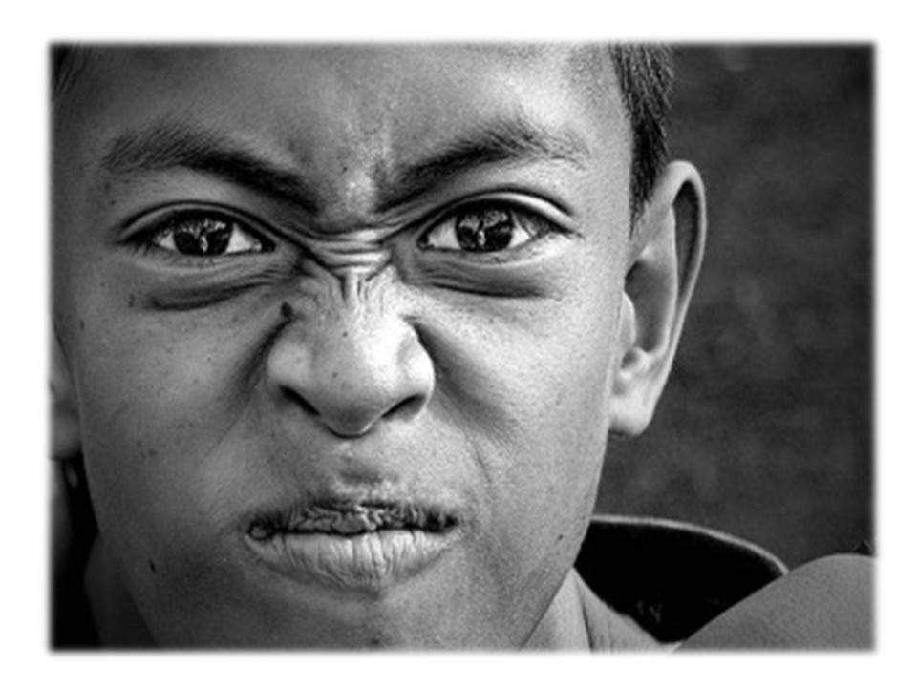

Slide 3


Slide 4


Slide 5
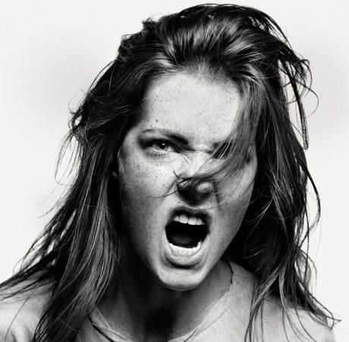

Slide 6

Anger:
a strong feeling that makes you want to hurt someone or be unpleasant because of something unfair or unkind that has happened

Slide 7
Expressions of anger - 3 choices:
Aggressive
Passive
Assertive

