Slide 1
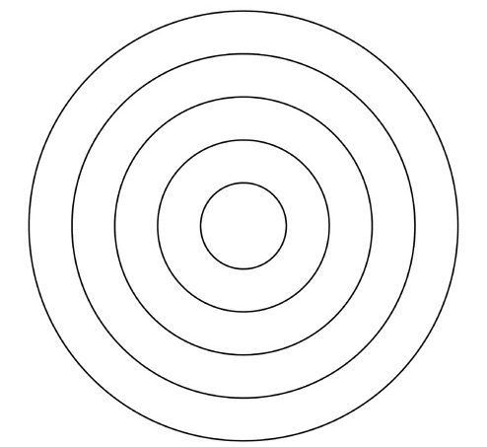
international
national
local community
family
individual

Slide 2
