Slide 1
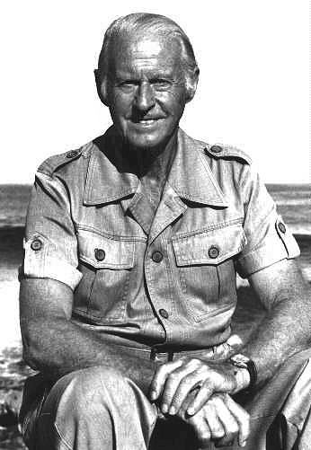
Thor Heyerdahl

Slide 2
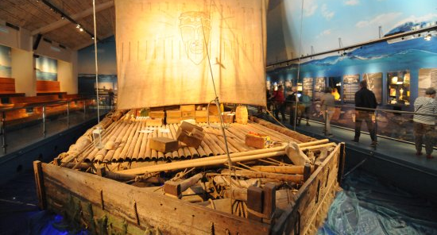
The Kon-Tiki raft

Slide 3
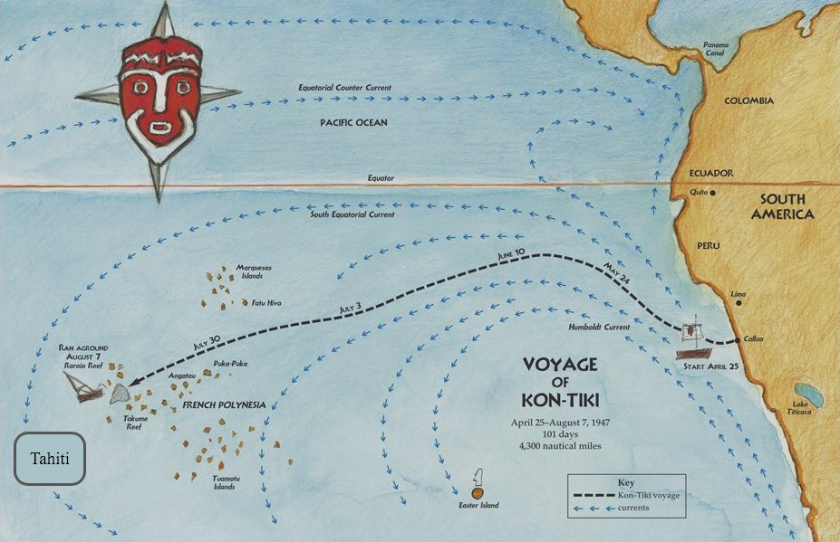

Slide 4

The Ra boat

Slide 5
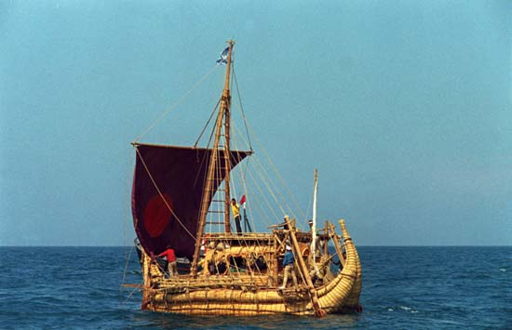
The Ra II boat

Slide 6
