Slide 1
Welcome

Slide 2


Slide 3


Slide 5
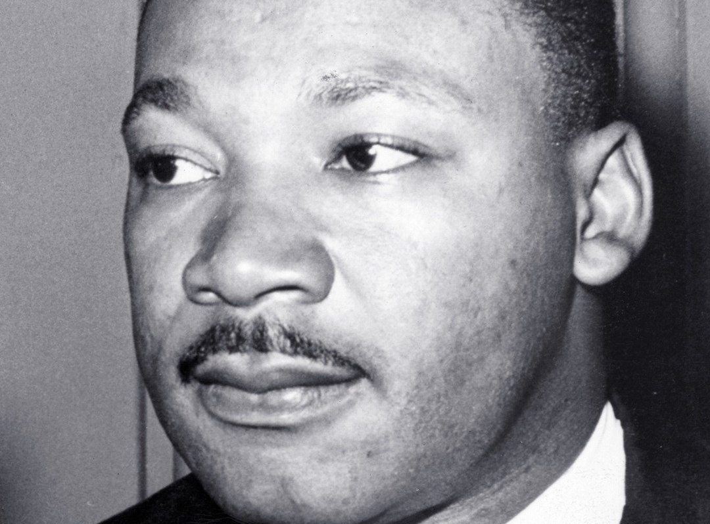

Slide 6
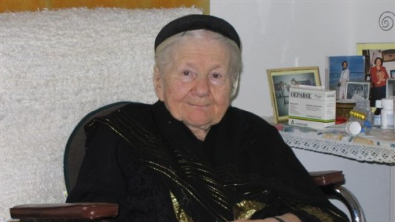

Slide 7
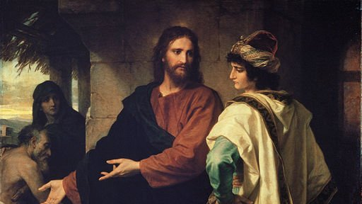
Christ and the Rich Young Ruler by Heinrich Hofmann, 1889

