Slide 1

Make a decision between . . .

Slide 2

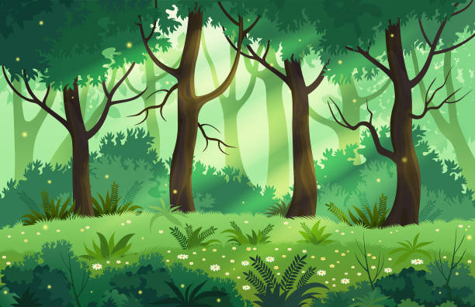
A day at the beach
Or
A day in the woods

Slide 3


Eating an apple
Or
Eating a banana

Slide 4


A pet dog
Or
A pet cat

Slide 5
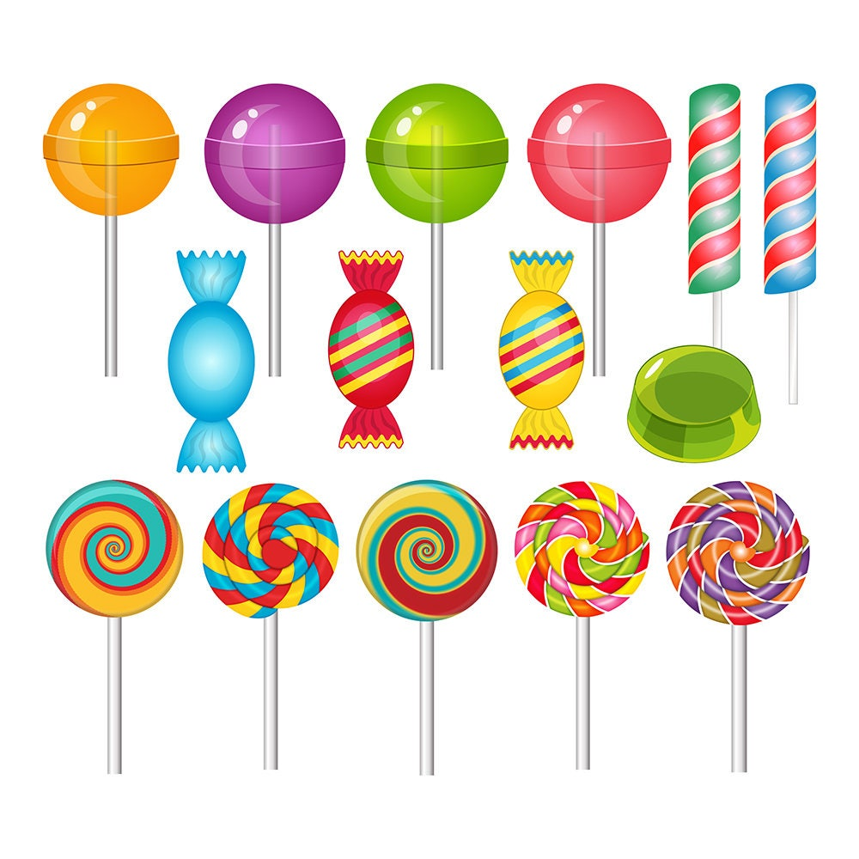
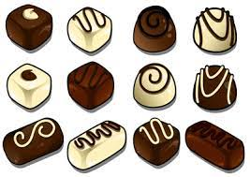
Sweets
Or
Chocolate

Slide 6
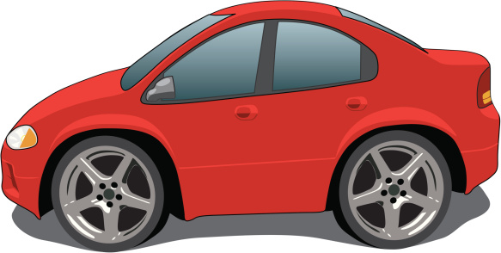

Travelling by car
Or
Travelling by train

Slide 7
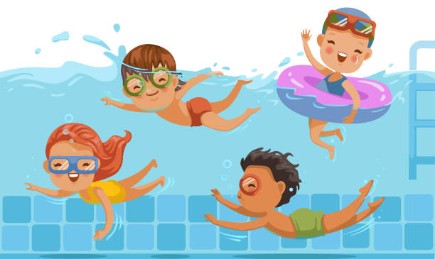
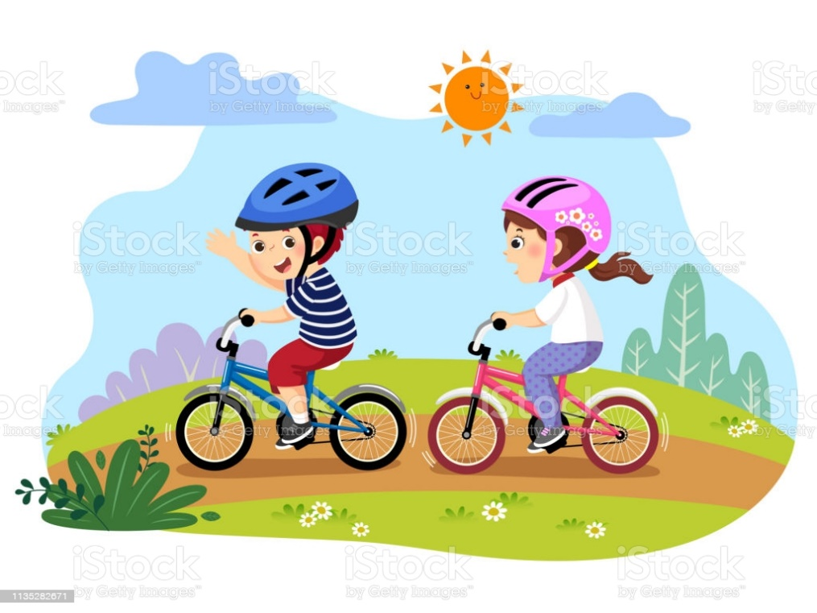
Going for a swim
Or
Riding a bike

