Slide 1

Recognizing Cyberbullying

Slide 2

Harrassment
This is the act of sending offensive, rude and insulting messages and being abusive. It includes nasty or humiliating comments on posts, photos and videos on social media sites, chat rooms and gaming sites.

Slide 3
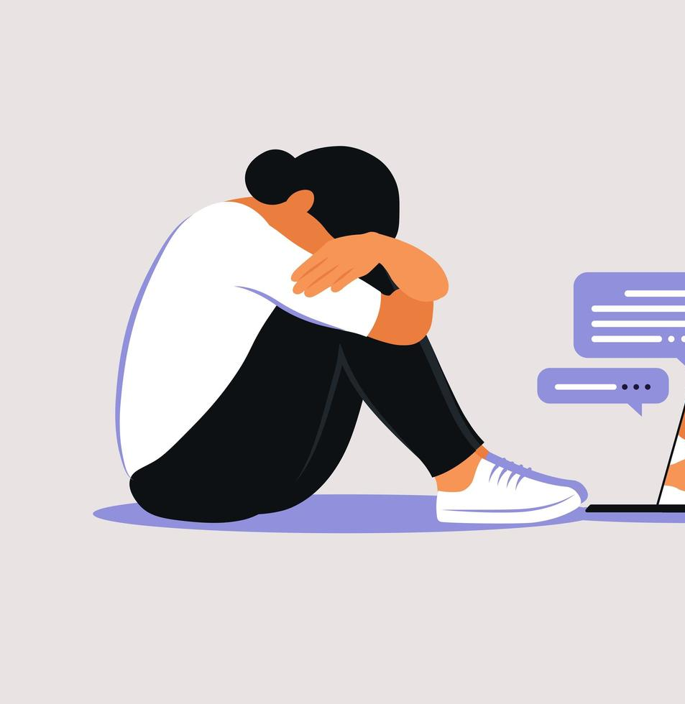
Denigration
This is when someone may send information about another person that is fake, damaging and untrue. They may share photos of someone for the purpose of ridiculing them or spreading fake rumours and gossip. The photos can also be altered for the purpose of bullying.

Slide 4

Flaming
This is when someone is purposely using extreme, offensive language and getting into online arguments. People do this to cause reactions and enjoy the fact that it causes distress to others.

Slide 5
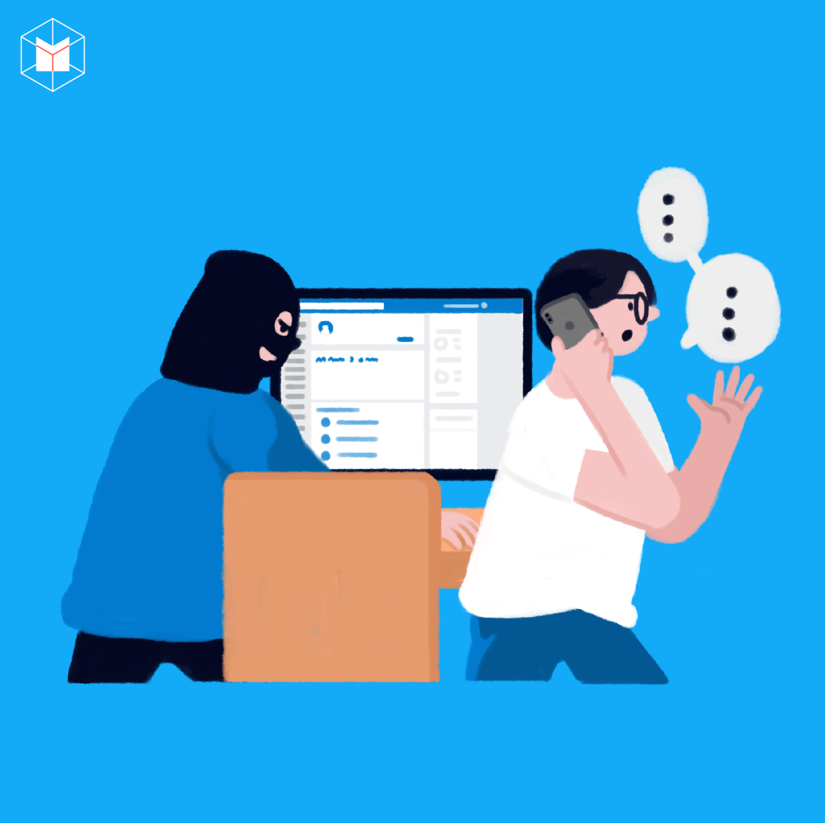
Impersonation
This is when someone hacks into someone’s email or social networking account and uses the person’s online identity to send or post vicious or embarrassing material to or about others. Perpetrators may also create fake accounts to cause hurt and humiliation.

Slide 6
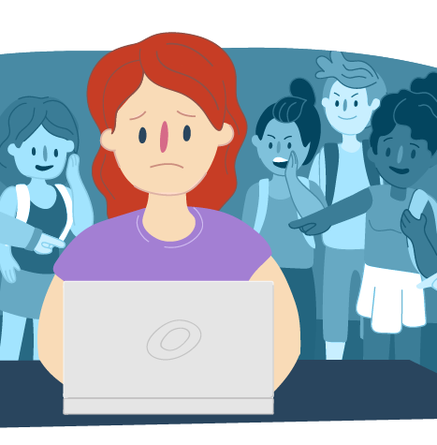
Outing and trickery
This is when someone may share personal information about another or trick someone into revealing secrets and forward them to others. They may do this with private images and videos too.

Slide 7

Cyberstalking
This is the act of repeatedly sending messages that include threats of harm or harassment, or intimidating messages. It can also involve engaging in other online activities that make a person afraid for his or her safety. The actions may be illegal, depending on what they are doing.

Slide 8

Exclusion
This is when others intentionally leave someone out of a group such as group messages, online apps, gaming sites and other online engagement.

Slide 9

Resources
Childline: Advice on bullying and cyberbullying
ThinkUKnow, a website run by the National Crime Agency’s CEOP Education team
The National Bullying Helpline: 0300 323 0169
reportharmfulcontent.com
getsafeonline.org

