Slide 1

Gangsta Granny

Slide 2

Harry Potter

Slide 3

The Christmasaurus

Slide 4
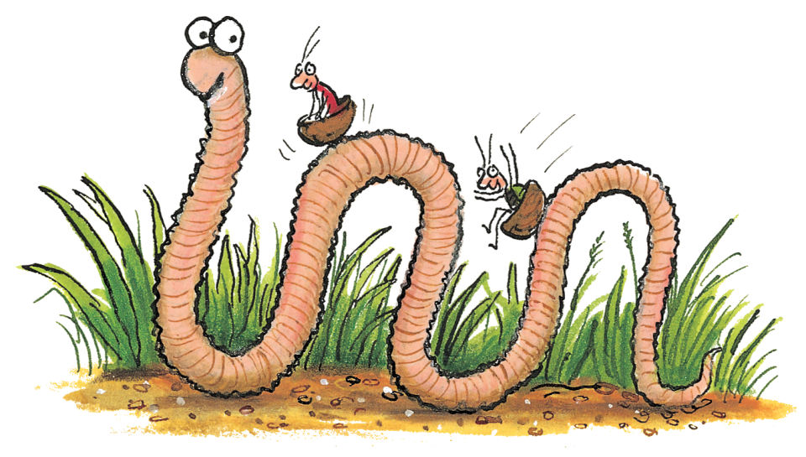
Superworm

Slide 5
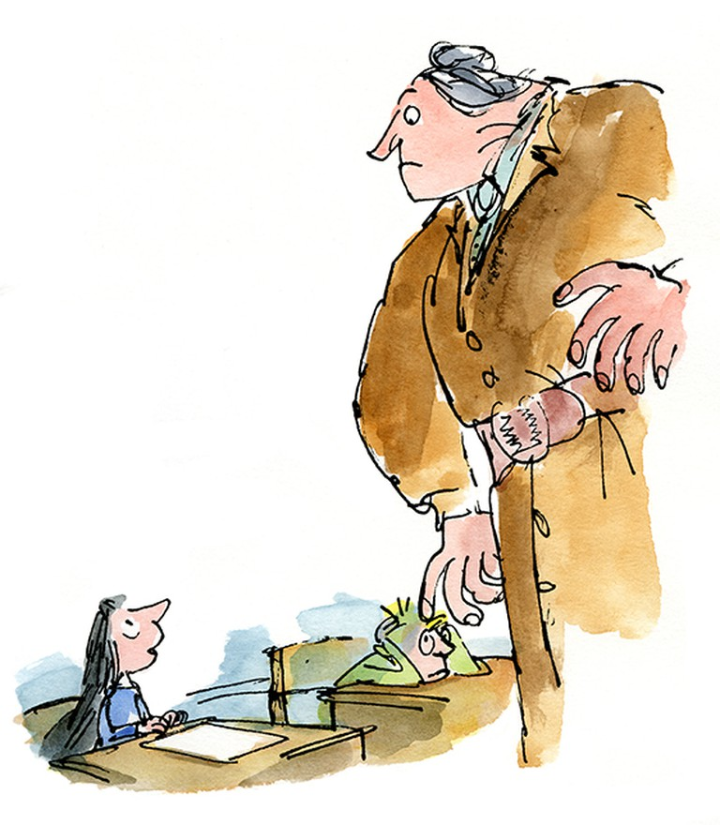
Matilda

Slide 6
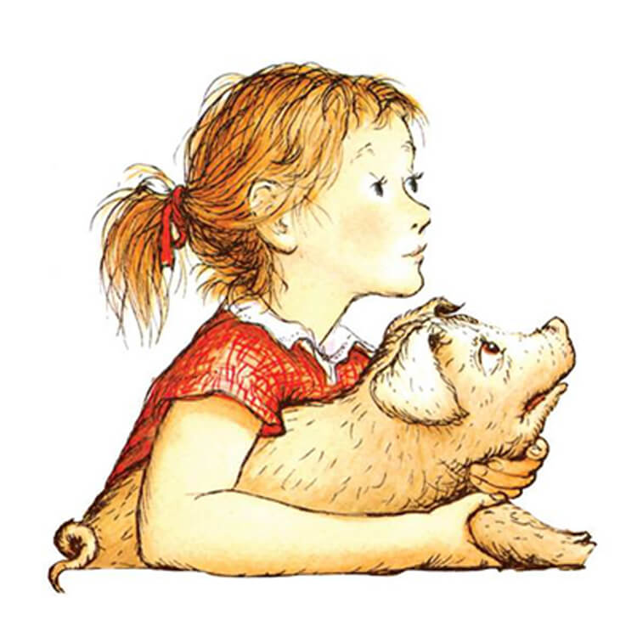
Fern and Wilbur from Charlotte’s Web

