Slide 1




Slide 2

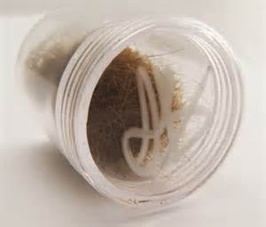
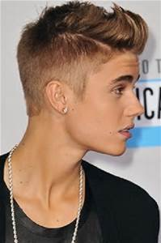
How much?
A tub of hair
Justin Bieber
£25,024

Slide 3
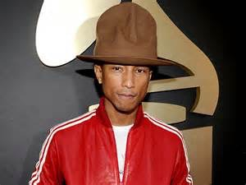
How much?
Pharrell Williams’
brown fedora hat
worn at the Grammys
£26,444

Slide 4
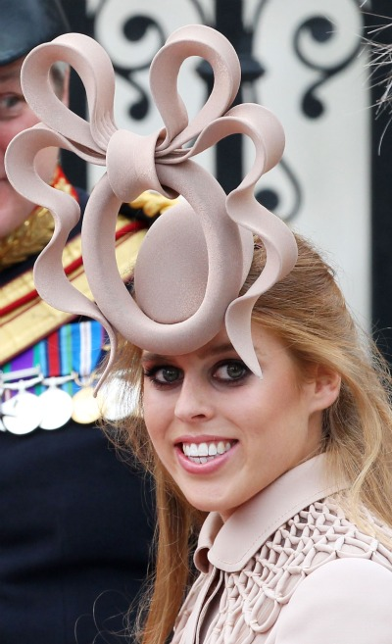
How much?
Princess Beatrice’s hat
worn at the wedding of
Prince William and Kate Middleton
£81,100

Slide 6
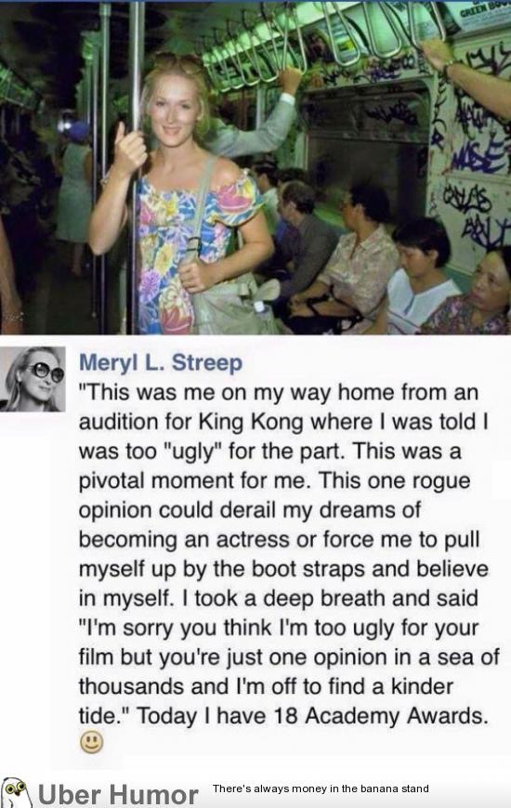

Slide 8
