Slide 1
Can you name the following objects?

Slide 2
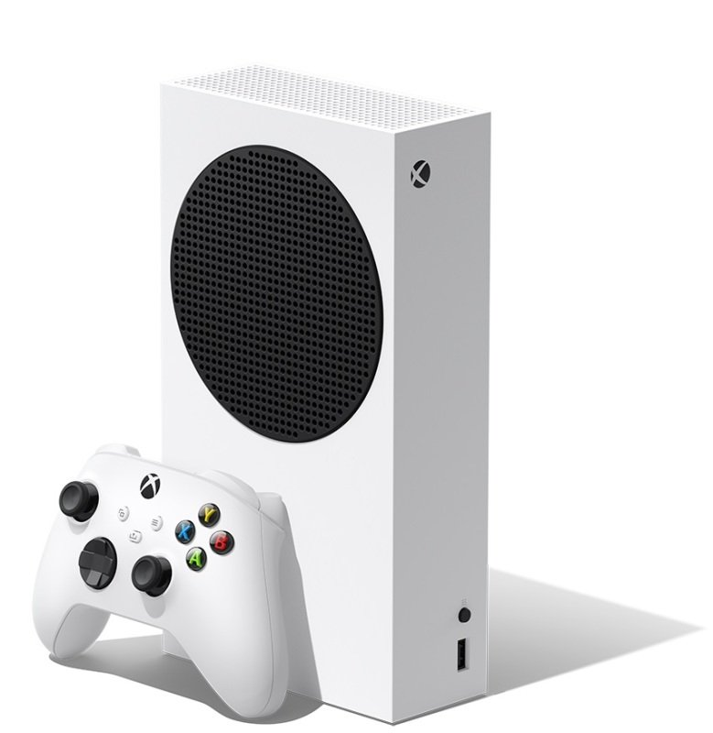

Slide 3
Xbox

Slide 4
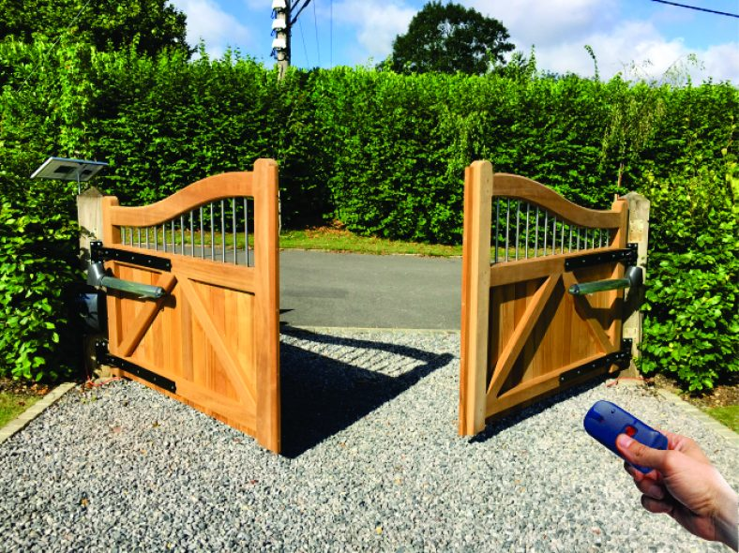

Slide 5
Gates

Slide 6
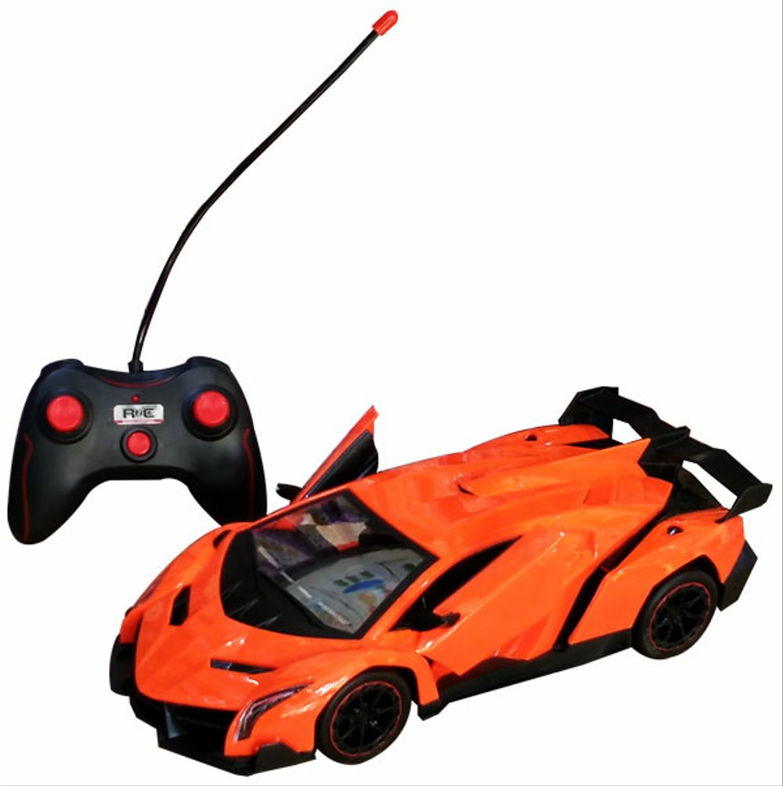

Slide 7
Remote control car

Slide 8
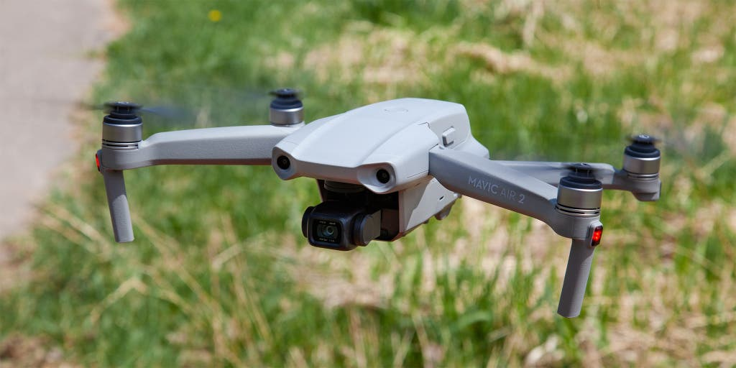

Slide 9
Drone

Slide 10
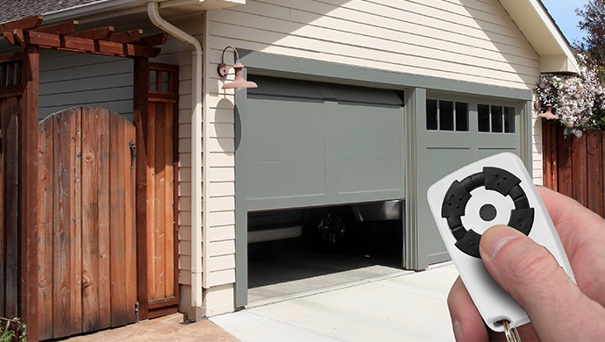

Slide 11
Garage doors

Slide 12
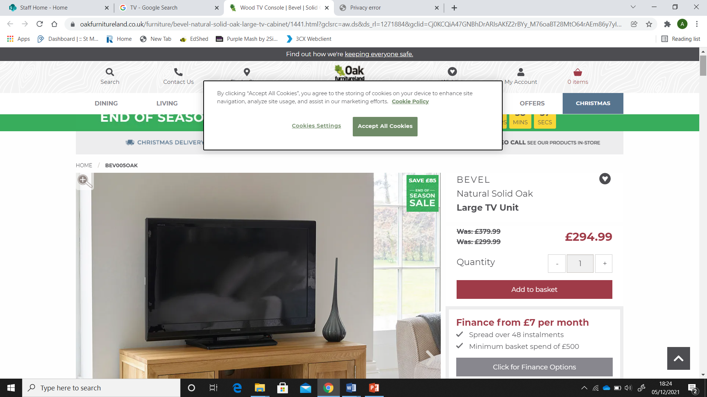

Slide 13
TV

Slide 14

What do all of these objects
have in common?

Slide 15
To use them, you need
a remote control

