Slide 1

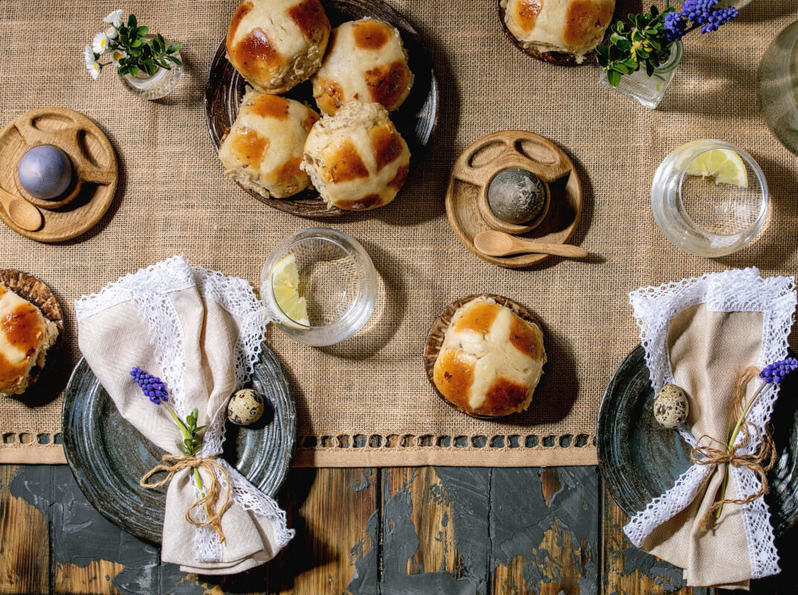
Easter traditions around the world

Slide 2
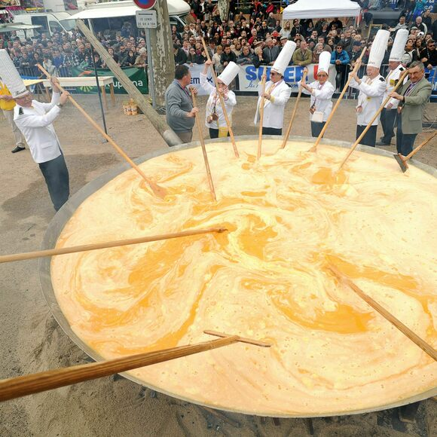
Bessières, France
Giant omelette

Slide 3
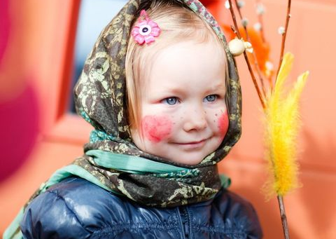
Sweden
Dressing up in old clothing

Slide 4
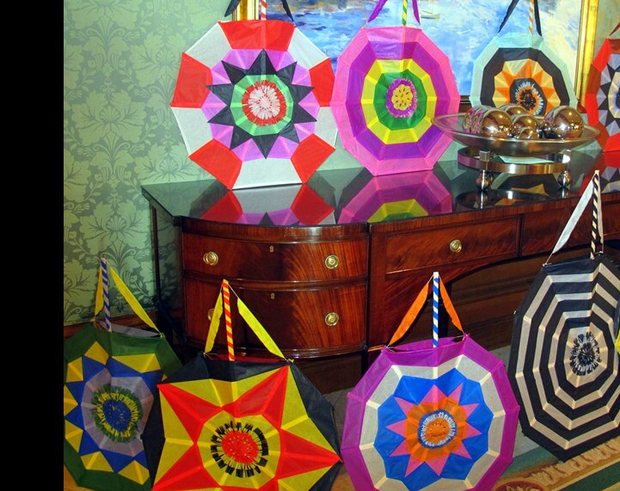
Bermuda
Flying kites

Slide 5
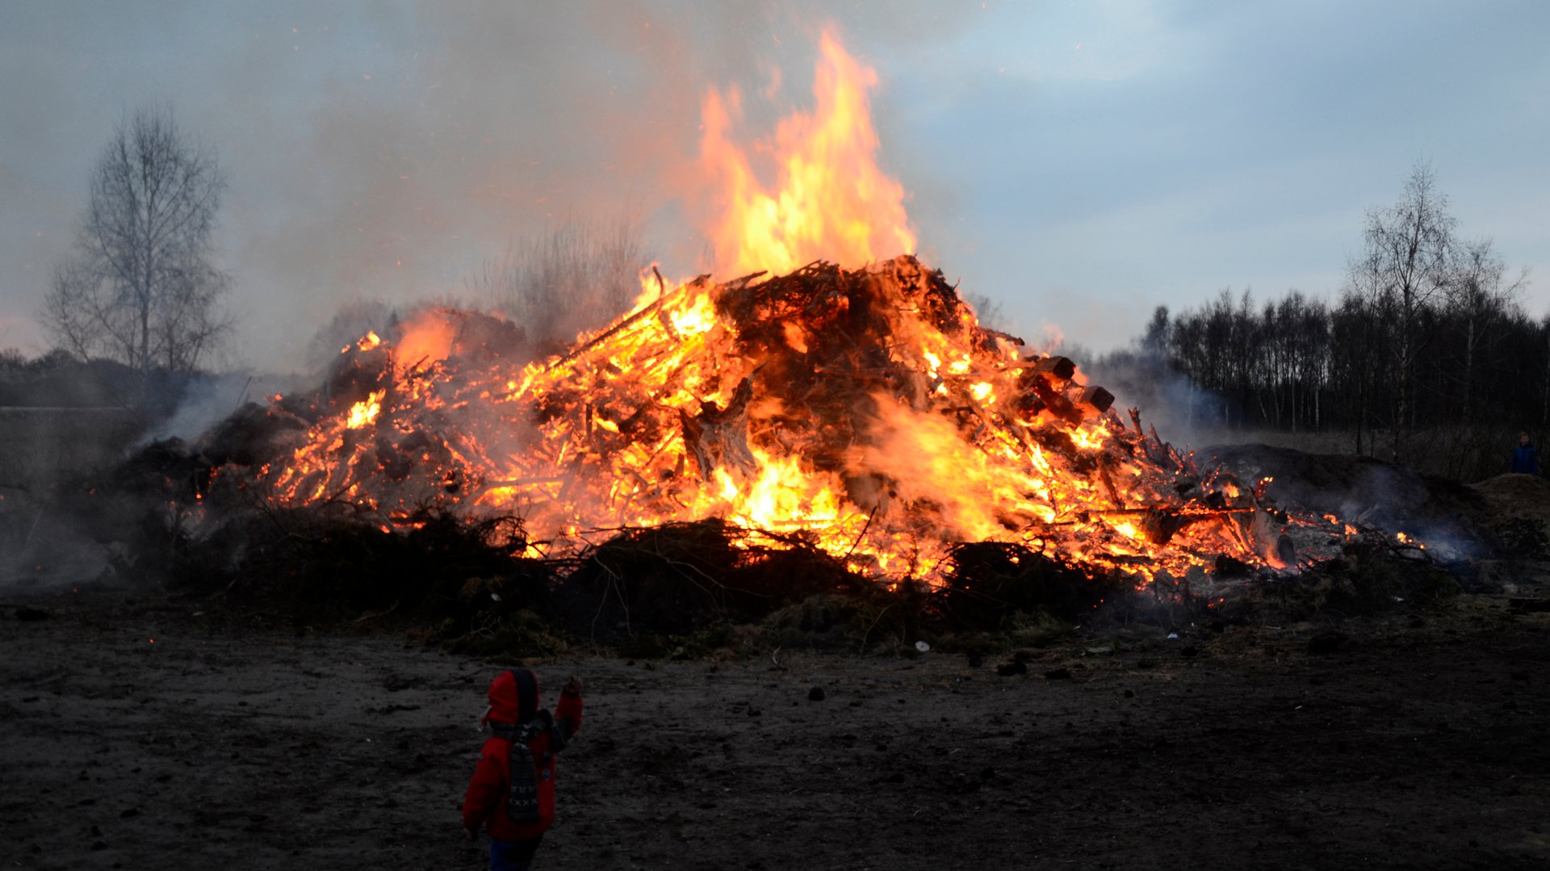
Easter fires in Denmark, Sweden and Germany

Slide 6
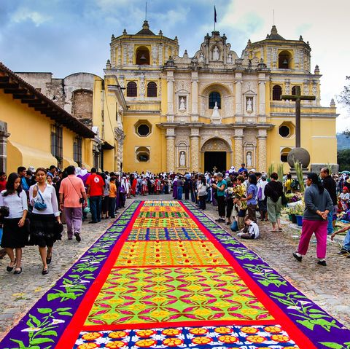
Antigua
Colourful carpets

Slide 7
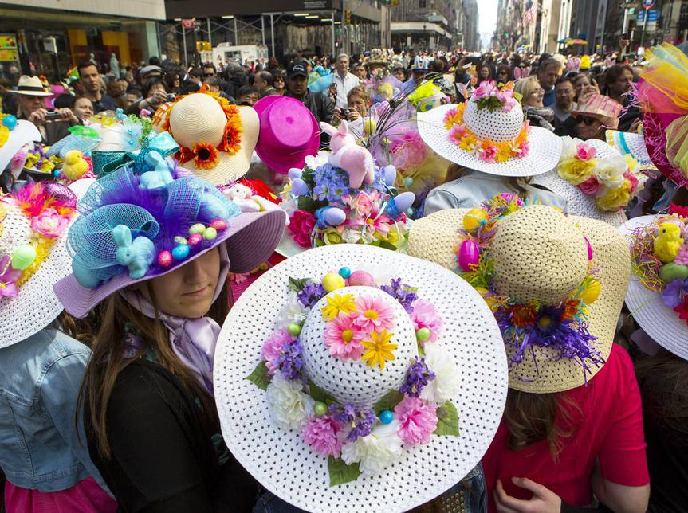
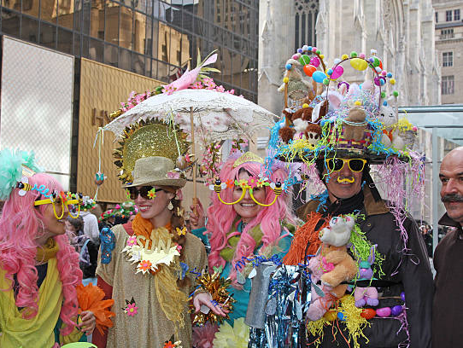
UK, Australia and USA – Easter bonnet parades

