Slide 1


The Gift of Laughter

Slide 2
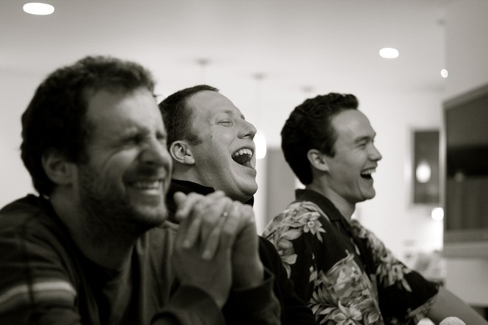
Laughter relaxes the whole body
Laughter boosts the immune system
Laughter lightens anger’s heavy load
Laughter helps us to bond with other humans and build stronger communities

Slide 3
Do not give yourself over to sorrow, and do not stress yourself deliberately. A joyful heart is life itself, and rejoicing lengthens one’s life span. Indulge yourself and take comfort, and remove sorrow far from you. Those who are cheerful and merry will benefit. Ecclesiastes 30.21-25

Slide 4
What could you do today to make
someone smile or laugh?
How can you avoid using laughter
as a form of abuse – laughing AT someone?
What is it that makes you laugh?
Seek that out today.

Slide 5
Dear God,
Let us pause and recall that you, the God of joy and laughter, are always with us, filling us with life, hope, creativity and a thirst for friendship with you.
We ask you today to enrich our lives with the gift of laughter and joy.
Amen.

