Slide 1
Managing your money

Slide 2
What is debt?
Debt is when you owe money
Notes:
Debt is when you owe money.

Slide 3
Debt is…
Easy to fall into
Hard to get out of
Spending on credit card
Borrowing money
Overspending
Falling behind on bills
Interest rates mean you have to pay back more than you borrowed
Never borrow money from a loan company like Wonga
Notes:
Explain that it can be easy to fall into debt, just spending a little on the credit card here and there, borrowing a bit of money to buy something you need or want or accidentally overspending your monthly allowance so you haven’t got enough left to pay an important bill.
However it can be difficult to get back out of debt. When people use credit cards it is easy to not think of it as real money. It is so easy to pop in your card details and forget about the money that has just been spent. However, in reality, not only is it real money, but it is money that will have interest added to it!
Explain that interest rates refer to the money a person is charged when they borrow money. Interest rates build up over time. For example, if you borrow £100 from the bank when you pay it back the next year you could have to pay them, say, £110. Some loan companies have particularly high interest rates, so you could end up paying back considerably more in interest to these companies.

Slide 4
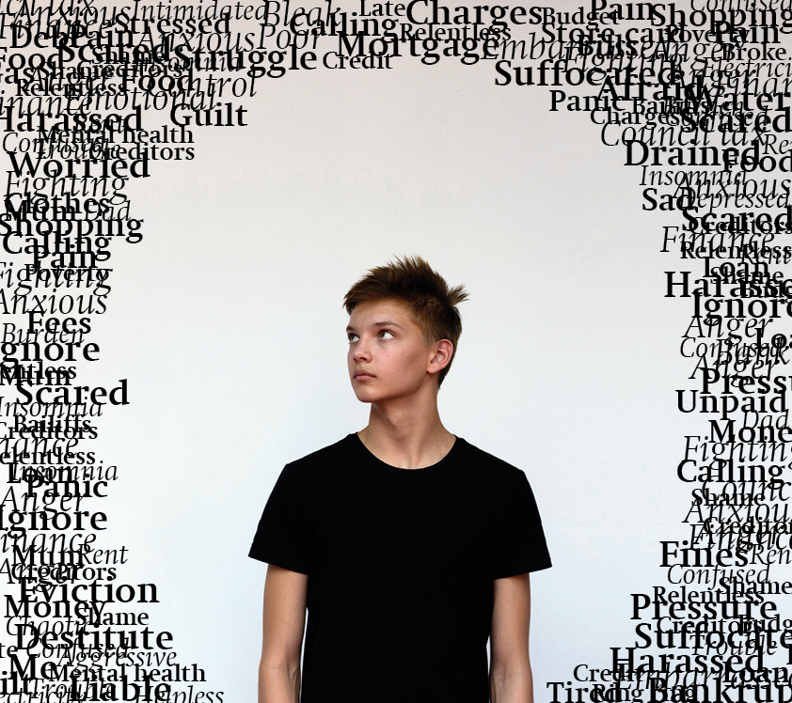
Jacob’s Journey
How Jacob’s family found themselves falling into debt
Notes:
So now let’s hear the first part of a story about a boy named Jacob.
Read or ask a student to read the first part of ‘Jacob’s Journey’.
Jacob lives with his parents and sister. Both his parents are in low paid jobs. They receive some benefits but money is still quite tight, and over time they have taken on various debts. They were making minimum payments on their debts so were managing until Jacobs mum had to go on maternity leave. Maternity pay and his dad’s income together were not enough to keep up with payments, and their debts began to spiral out of control.
Now let’s stop and reflect on what we’ve just heard. What happened to push Jacob’s family into debt? - His mum going on Maternity leave. (Maternity leave is when a pregnant woman stops work for a while to give birth and then look after her newborn baby).
Going on maternity leave is just one of many things that can happen that mean that although someone thought they would be fine to pay back the money they had borrowed, they end up struggling to keep up with the payments. Other reasons for being unable to make payments could be having an accident leading to someone being unable to work, an unexpected expenditure such as a laptop breaking or simply finding that after all essentials like food and travel have been paid for, there is not enough money left.

Slide 5
You can’t ignore debt and hope it goes away…
Because it won’t, it will pile up and get worse
Notes:
Unfortunately, debt cannot be ignored in the hope that it goes away. Once someone falls behind on repaying debt, companies often charge a fine. If the situation continues companies may even send a bailiff to the house to demand payment and take away someone’s possessions if they can’t pay. If a bailiff goes to a house, the person in debt can be charged £300 or more for the visit, which only makes things worse.

Slide 6
Jacob’s Journey
Jacob’s experience of living in problem debt
Notes:
So now let’s hear more from Jacob’s story.
Read or ask a student to read the second part of ‘Jacob’s Journey’.
Jacob’s family is left with just enough money to cover the basics each month, but even so they receive phone calls about late fees and interest charges on their debts. They have to make a lot of compromises. Jacob doesn’t get to socialise with his friends anymore as he can’t afford the bus fare to go and see them.
Jacob is very conscious of the household budget. He hates having to ask his parents for money even for his lunch, worrying that he is taking too much. His parents are always stressed nowadays, and this makes Jacob feel anxious about what is going to happen to them, as well as causing arguments in the family.
Jacob feels like his friends get to do whatever they want, whilst his family’s choices are significantly restricted. He’s sad that he’s stuck at home with nothing to do and feels like he’s losing his connection with his friendship group.
This doesn’t sound like fun does it? Have a think about how you would feel if you were living in this situation.
Pause to allow time for thought.

Slide 7
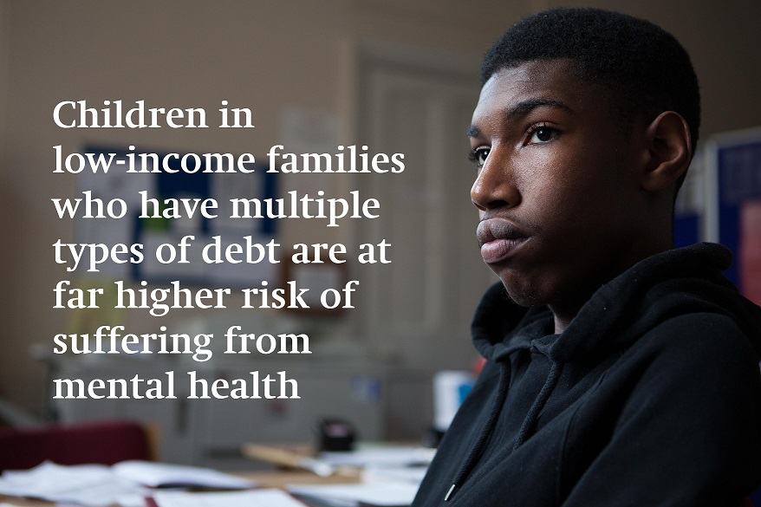
Notes:
Struggling with debt makes people feel depressed, anxious and stressed. Young people growing up in families who struggle with debt are five times more likely to suffer from low well-being than those in households not in debt, putting them at risk of developing mental health problems.
Young people living on their own for the first time are particularly vulnerable to falling into debt. The Children’s Society works to try to stop this from happening to young people.
Ask the question:
What would you do in the following scenario?

Slide 8
You want to buy the new PlayStation when it comes out in 6 months time. What do you do?
A: Do nothing and then borrow money from your mum when it’s released
B: Keep spending as usual, and put any money left over each month into savings
C: Work out how much money you need to save each month to be able to afford it, and put this money aside at the beginning of every month, spending only what you have left
Notes:
Read through the question and allow time for thought. Click for the answer.
Saving is a really good habit to get into, not just when we are saving to buy something particular, but in general for ‘a rainy day’. Unexpected expenditures or job losses can happen any time, and having money in savings creates a buffer, making sure you don’t fall into debt if something goes wrong. Putting aside a small amount each month will soon add up.

Slide 9
A Breathing Space means…
No more rising fees, charges and interest rates
No more visits from intimidating bailiffs
Notes:
Keeping track of our spending and understanding how much money we can spend each day or week is very important. However for some people, especially families, certain situations can mean that they can’t help falling into debt. The Children’s Society is a children’s charity currently working to increase awareness about the debt trap and its effects on the mental health of children and young people. The Children’s Society are asking the government to create a ‘Breathing Space’ scheme that will give parents and young people time and space to repay their debts with no rising fees or visits from bailiffs. They hope that there will be a change in the law so that families and young people in debt are given time and space to get their finances back on track.

Slide 10
Jacob’s Journey
What happens if there’s a breathing space scheme
Notes:
Let’s hear the last part of Jacob’s story.
Read or ask a student to read the third part of ‘Jacob’s Journey’.
Jacob’s family have been put on the Breathing Space scheme. Extra fees and charges have stopped piling up, and his parents have been put on a debt repayment plan. Now they just make one affordable payment each month and aren’t hassled by creditors all the time.
Jacob’s parents are a lot more relaxed now, and this makes him feel much less anxious. The family’s finances are well on their way to being back on track, and Jacob gets to see his friends again.

Slide 11
Stepchange.org
Childline: 0800 1111
Sign our petition to help make a breathing space become a reality and save children like Jacob from the damage of debt
childrenssociety.org.uk
Notes:
Explain to the students that if they or anyone they know is going through anything that sounds at all similar to Jacob’s story, there is free help available. They can talk to a teacher or phone Childline but there is also a charity called StepChange. Stepchange is a free debt advice charity that will help family’s to get their finances back in order. The website is www.stepchange.org.
Optional: You may wish to draw attention to the ‘Breathing Space’ petition by the Children’s Society. This can be found at: http://www.childrenssociety.org.uk/what-you-can-do/campaign-for-change/breathing-space

