Slide 1
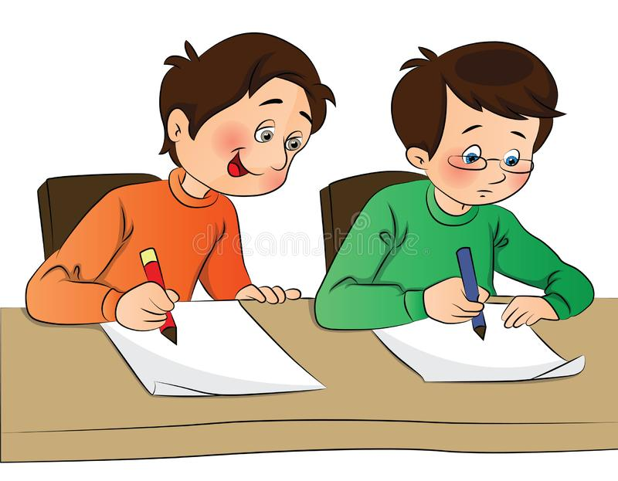

Should we copy?

Slide 2
It depends on what we’re doing!
Look at the following slides and decide which ones show good copying and which ones show bad copying.

Slide 3
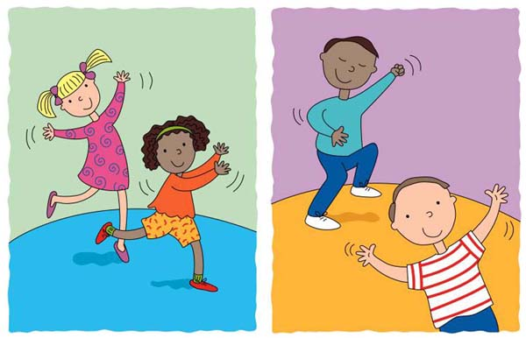
Should you copy . . . a dance teacher?

Slide 4
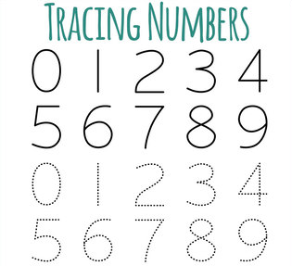
Should you copy . . . how to write numbers?

Slide 5
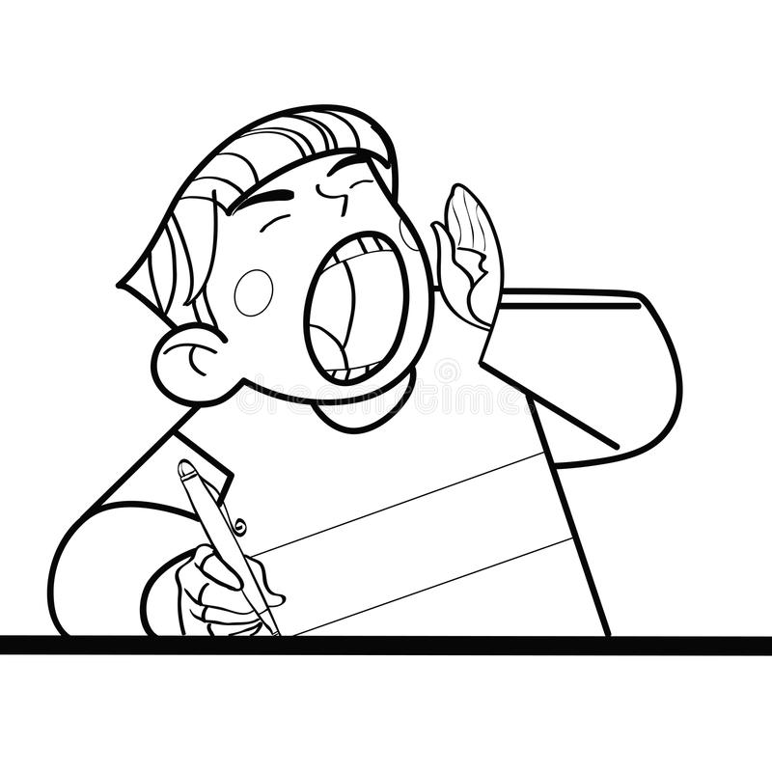
Should you copy . . . shouting out in class?

Slide 6

Should you copy . . . how to use your manners?

Slide 7
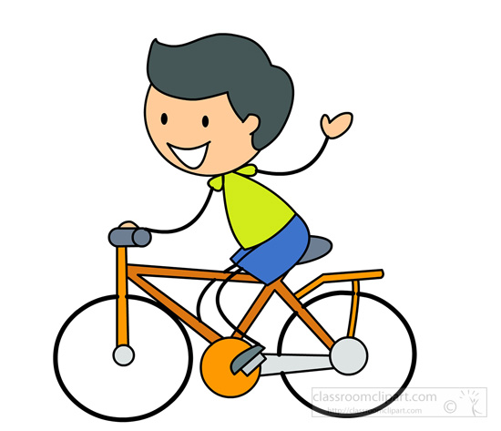
Should you copy . . . not wearing a bicycle helmet?

Slide 8
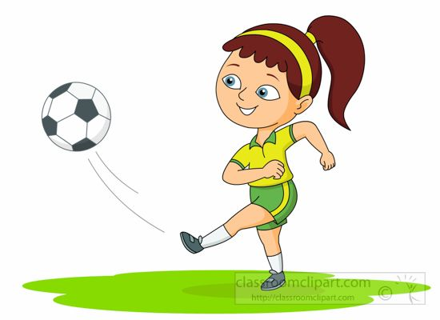
Should you copy . . . how to kick a ball?

Slide 9
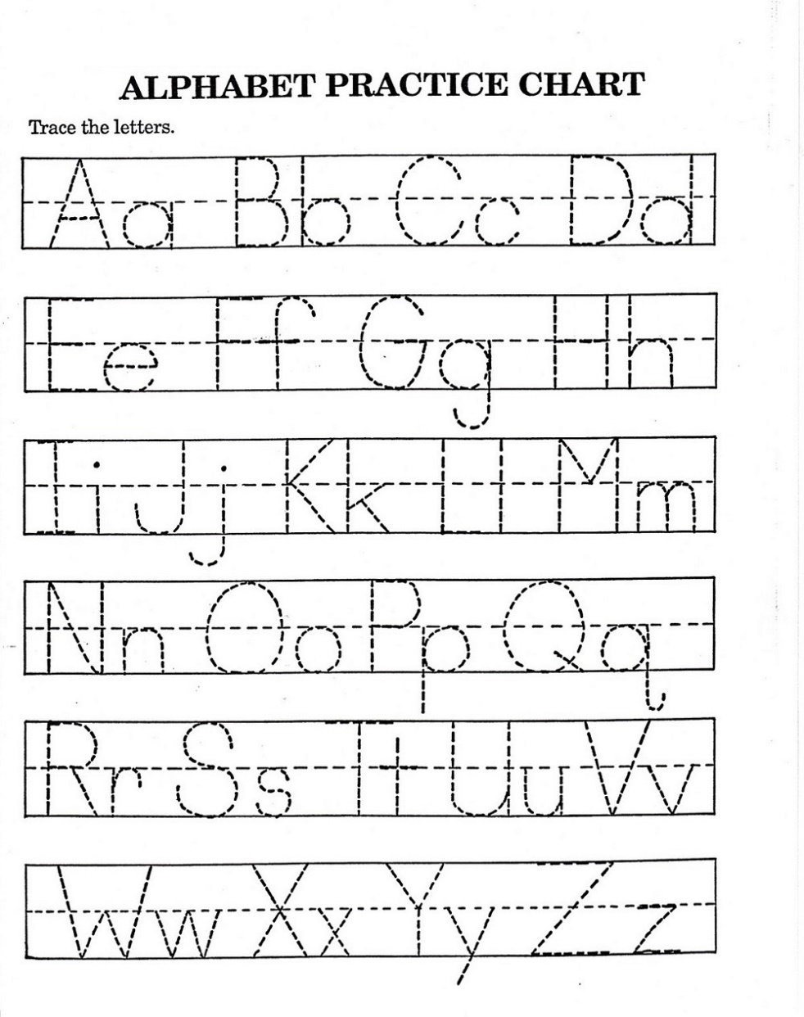
Should you copy . . . how to form letters?

Slide 10
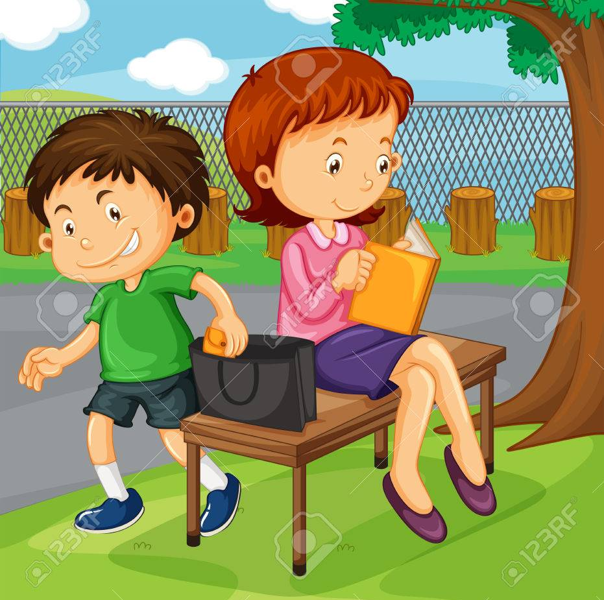
Should you copy . . . somebody stealing?

Slide 11

Should you copy . . . bullying behaviour?

Slide 12
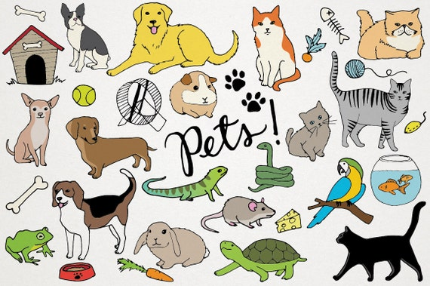
Should you copy . . . how to look after a pet?

Slide 13
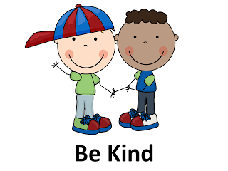
Should you copy . . . how to be kind?

Slide 14
