Slide 1
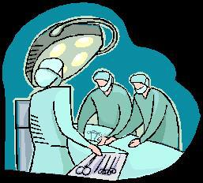
A man and his son were in an car accident. The man died on the way to the hospital, but the boy was rushed into the operating theatre. The surgeon said "I can't operate, that's my son!"

Slide 2


Slide 3
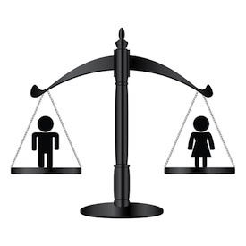
Parity
Parity - the state or condition of being equal, especially as regards status or pay.

Slide 4

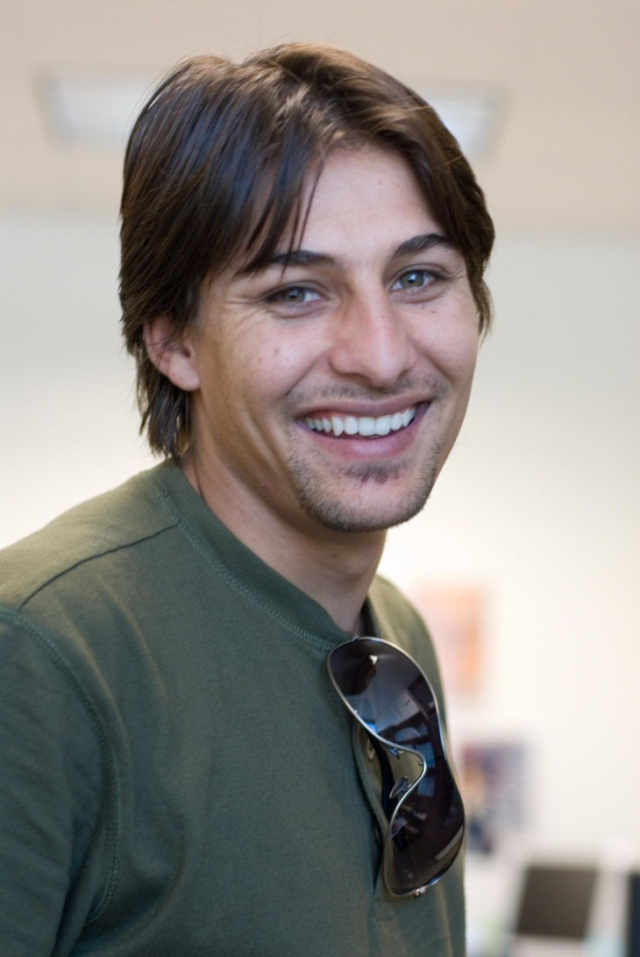
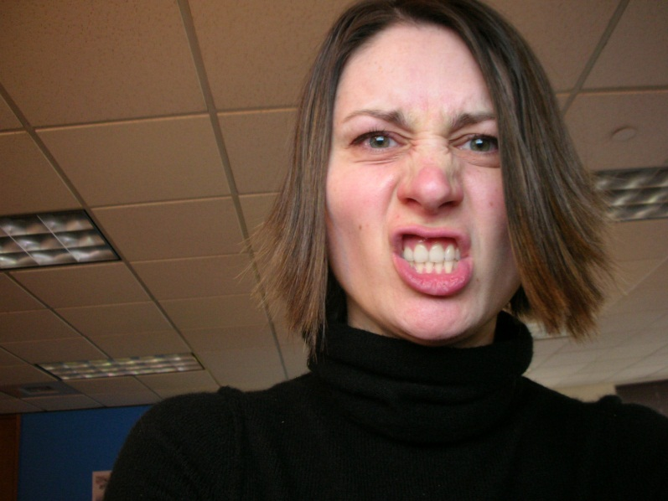
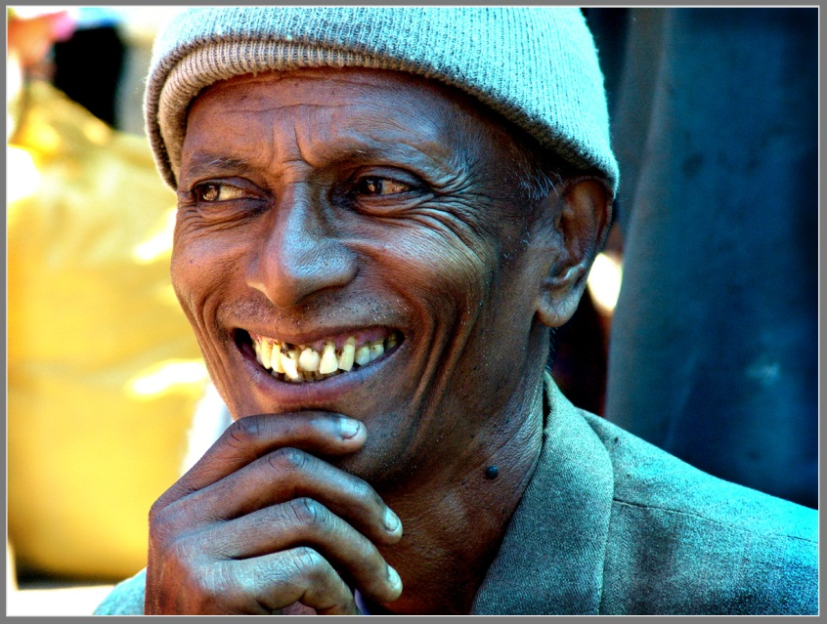
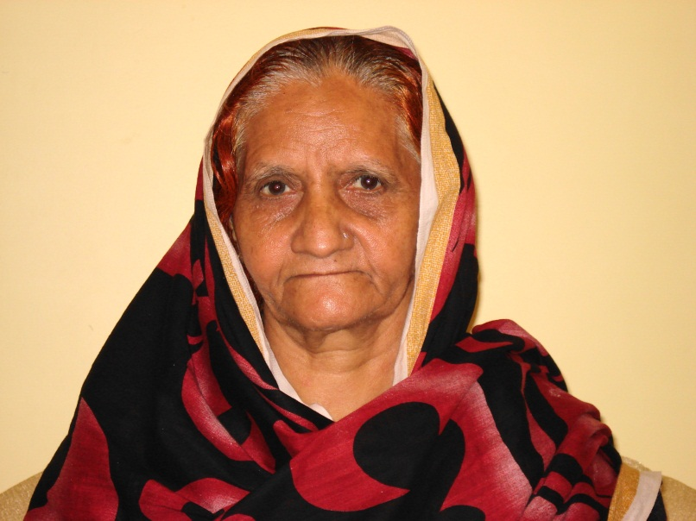
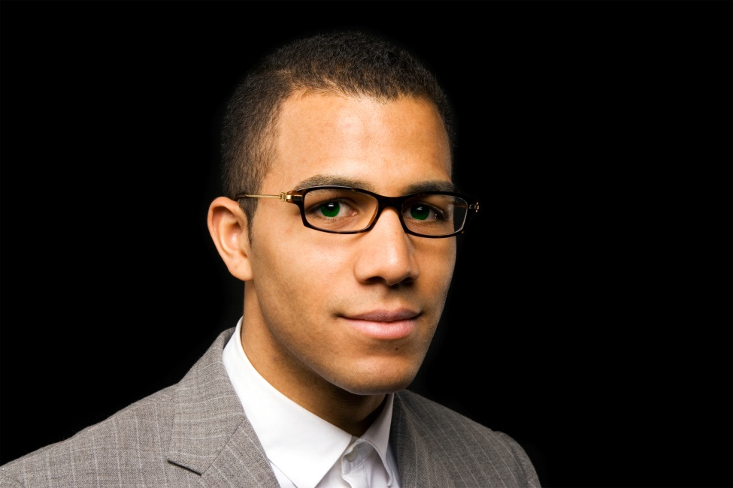
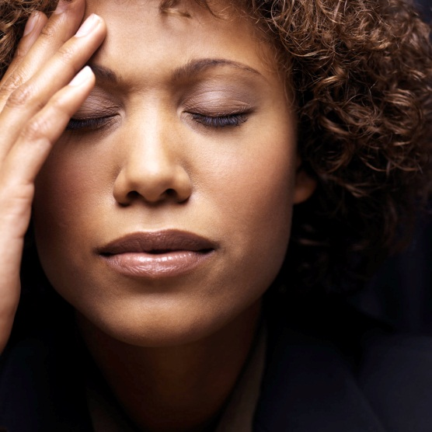

Slide 5

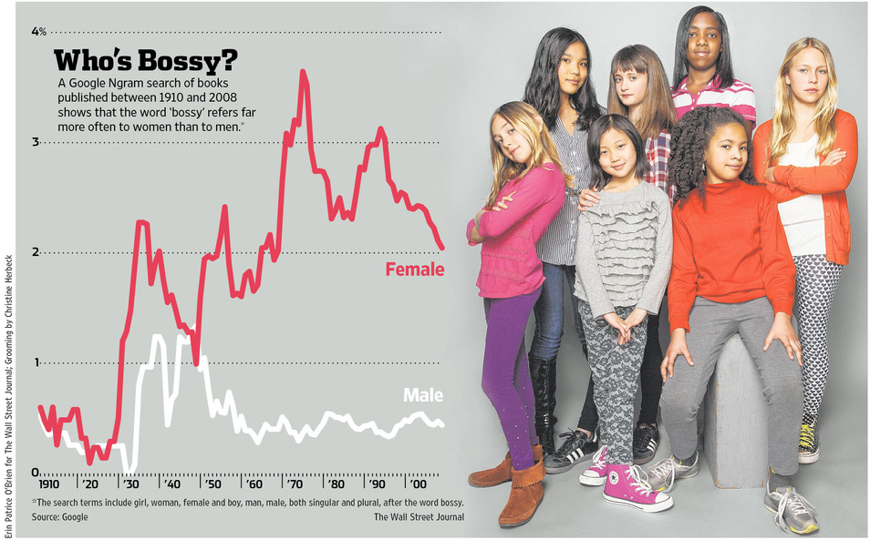
Bossy?

Slide 6
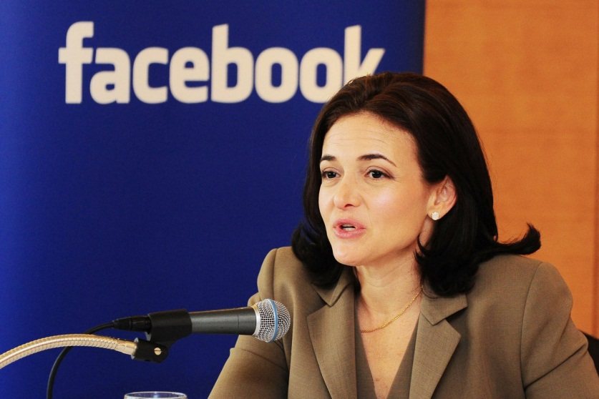
‘When a boy asserts himself, society calls him a leader. When a girl does it, she is called bossy’.
Cheryl Sandberg

Slide 7
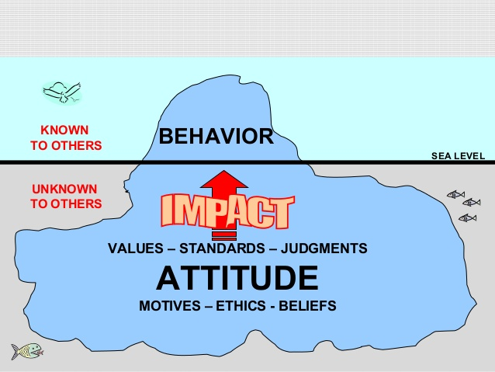

Slide 8

‘God shows no favourites.’ (The Bible, Romans 2:11).
‘In the image of God he created them;
male and female he created them.’ (The Bible, Genesis 1:27).

Slide 9
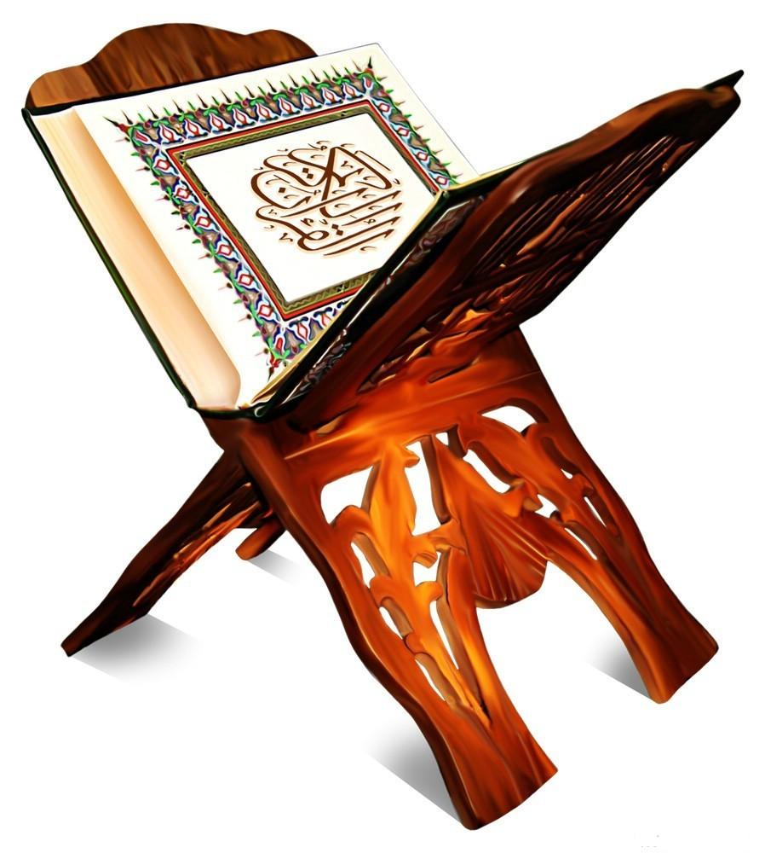
‘Be it man or woman; each of you is equal to the other.’ (The Qur’an 3:195)

