Slide 1
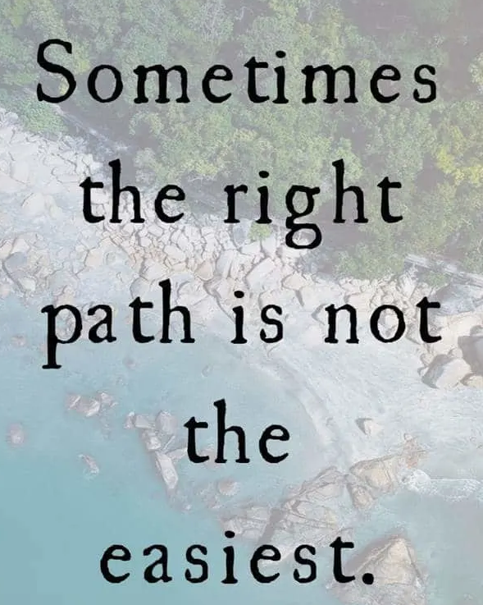
Should I just follow what everyone else is doing?
Am I good enough?
Do I feel confident enough to take this step?
Could I feel judged for choosing a different path?

Slide 2
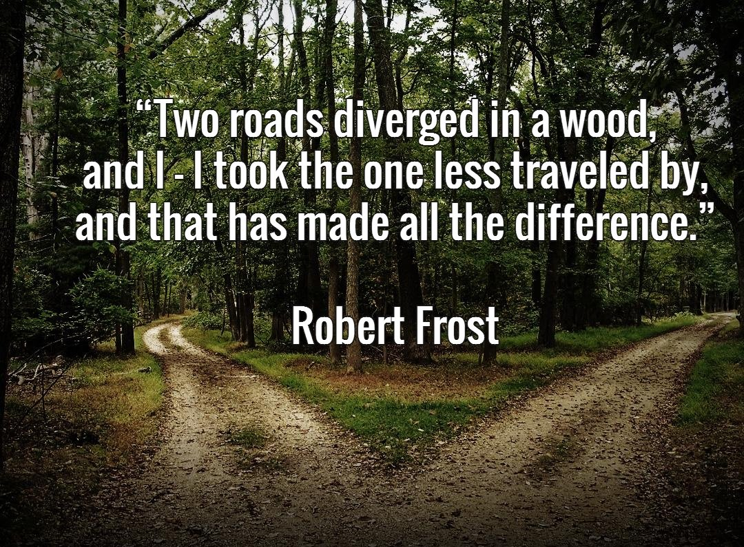

Slide 3


